Slide 1
Virtual Learning Professional Learning Series
VL Webinar 3: Virtual Learning in VA
Tuesday, March 15, 2022
3:00-4:00 p.m.

Slide 2
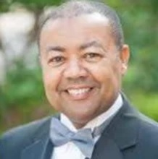



Presenters
Dr. Meg Foley
meg.foley@doe.virginia.gov
(804) 786-0877
Coordinator of Virtual Learning
Reginald Fox
reginald.fox@doe.virginia.gov
(804) 371-5663
Virtual Learning Specialist
Twitter: @VDOE_News
Facebook: @VDOENews
#VAis4Learners #EdEquityVA

Slide 3
Virtual Learning in Virginia
To provide school divisions, schools, staff, and stakeholders with information related to virtual learning in Virginia with emphasis on policies, procedures, professional development, and implementation of virtual programs.
  Follow-up from February 2nd Webinar
  Guest Presenter: Maggie Clemmons, Director of Licensure and School Leadership in the
  Department of Teacher Education & Licensure, VDOE
  What it means for School Divisions (IPAL)
  Accreditation – Teacher Licensure

Slide 4
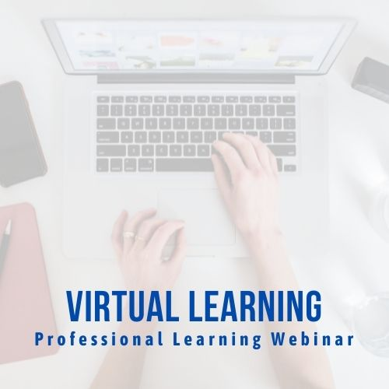
Topics from February 2nd
  Enrollment in virtual courses
  Communication and support for virtual students
  Monitoring progress and reporting
  Teacher Licensure and staff roles

Slide 5

Guest Presenter: Maggie Clemmons
Director of Licensure and School Leadership
Department of Teacher Education & Licensure, VDOE
  What it means for School Divisions (IPAL)
  Accreditation – Teacher Licensure

Slide 6

MOPs Licensure Training
Spring 2022
Office of Licensure and School Leadership
March 15, 2022

Slide 7


Resources
All Licensure Resources
Licensure Webpage
Regulation Information
Licensure Regulations for School Personnel
Assessment Information
Professional Teacher’s Assessments
Search School Quality Profiles
School Quality Profiles

Slide 8
Types of Licenses
Non-Renewable Licenses
Provisional (PROV)
Provisional Special Education (PRSE)
Provisional Career Switcher (PRCS)
Online Provisional OLT(PROV)
One Year License (OYL)
International Educator License (IE)
Renewable Licenses
Postgraduate Professional (PGP)
Collegiate Professional (CP)
Technical Professional (TP)
Online Teacher License (OLT)
Pupil Personnel Services (PPS)
School Manager (SM)
Division Superintendent (DS)

Slide 9

Routes to Licensure

Slide 10
Components of Licensure to Prepare Teachers
Bachelor’s Degree (except for the Technical Professional License) from a nationally recognized college or university
Content
Professional Studies, including clinical experiences (student teaching or successful classroom teaching)
Assessments
Statutory Requirements

Slide 11
Routes to Licensure: Overview
Approved Programs
Reciprocity
Alternate Routes:
Provisional License
Provisional (Special Education) License
Provisional (Career Switcher) License
Provisional (Online) License
Provisional License/Technical Professional License
Experiential Learning

Slide 12

Virginia Approved Programs
Components of Approved Programs
Content Coursework
Professional Studies Courses
Student Teaching
Assessments
Statutory Requirements
List of Programs and Contacts
List of Approved Programs in Virginia

Slide 13
Reciprocity
An applicant coming to Virginia from any state may qualify for a Virginia teaching license if they have:
Completed a state-approved educator preparation program through a nationally recognized four-year college or university,
or
Holds a valid out-of-state teaching license (full credentials without deficiencies) with a comparable endorsement in force at the time the application for Virginia is made
Note: all conditions for licensure must be met

Slide 14
Alternate Route to Provisional
May be issued to an individual who:
Is employed by a Virginia Educational Agency or accredited nonpublic school;
Earned a bachelor’s degree from a nationally recognized college or university (except for the Technical Professional License); and
Met requirements for the endorsement area and conditions for licensure (including statutory requirements)

Slide 15
Notes on Provisional Licenses
Only the Virginia school division may request a provisional license based on the teaching assignment;
If experience is cited, the experience must be in a contracted position in a brick and mortar classroom for a CP or PGP;
If experience is cited and the applicant is only teaching online, they can only qualify for a provisional Online Teacher License

Slide 16
Online Teacher Licenses
10-year renewable license, valid for teaching online courses only
Applicants must satisfy content endorsement requirements, professional studies requirements, pass assessments, and complete an online instructional procedures course (3 semester hours)
A provisional license in special education is not applicable to individuals seeking the Online Teacher License

Slide 17
School Quality Profiles

Slide 18
Overview
School Quality Profiles are a way to look at the performance of Virginia’s public schools and factors that can impact student learning and achievement. Developed in response to the 2015 Virginia General Assembly, the Board of Education redesigned online reports for schools and school divisions to more effectively communicate to parents and the public about the status and achievements of Virginia’s public schools. School Quality Profiles are available for all schools, school divisions, and for the state.

Slide 19
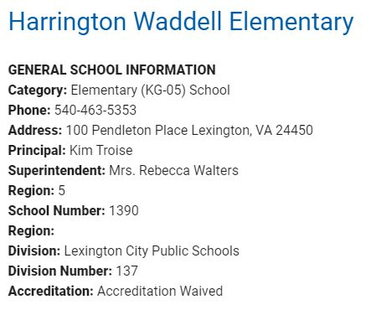
School Quality Factors
Accreditation
Assessments
Enrollment
College & Career Readiness
Finance
Learning Climate
Teacher Quality
ESSA
School Readiness

Slide 20
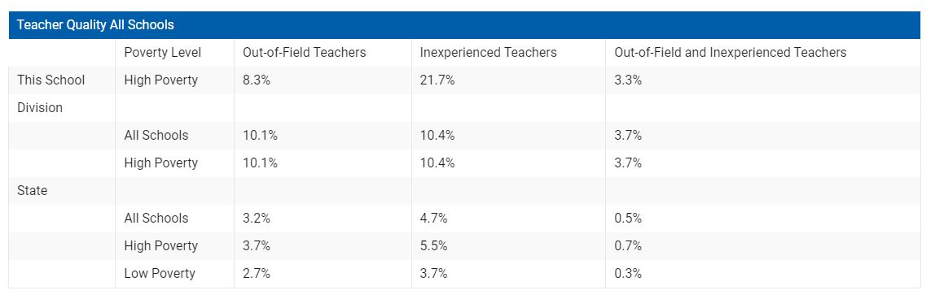
Teacher Quality
The Teacher Quality tab includes reports on student-teacher ratios, teacher educational attainment, provisionally licensed teachers, and the percentage of classes in schools, school divisions and the state taught by teachers who may be considered inexperienced or out-of-field or both.

Slide 21
Role of Divisions
§ 22.1-299. License required of teachers; provisional licenses; exceptions.
A. No teacher shall be regularly employed by a school board or paid from public funds unless such teacher holds a license or provisional license issued by the Board.
In addition, under Every Student Succeeds Act of 2015 (ESSA), teachers must be properly licensed and endorsed for the classes they are assigned to teach.
Human resources and licensure staff work in coordination to ensure the teachers being hired will qualify for a license. The division also determines the teachers’ course assignments and link them to SCED codes.

Slide 22
Role of MOPs
MOPs supply virtual teachers coupled with online content to K-12 students. A school division may contract with a MOP to provide approved online courses.
Questions to ask division personnel:
Who is the main division contact person - HR or licensure?
To what course (SCED code) will the teacher be assigned?
What endorsement must a teacher have when they are assigned to a particular course (SCED code)?

Slide 23

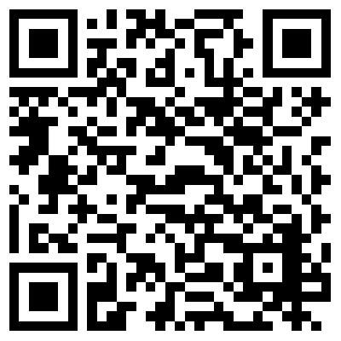
Contact Us
Office of Licensure and School Leadership
Maggie M. Clemmons, Director
Maggie.Clemmons@doe.Virginia.gov
804-371-2471
Main Phone Line: 804-225-2022
General Inquiries: Licensure@doe.Virginia.gov
Scan the QR Code to go straight to the Teacher Education and Licensure webpage.
Notes:
If you had specific questions that were not answered, a specialist will reach out to assist. Y’all, we have incredibly talented team of specialists! In the few short months I have been here, they have shown patience and grace, and their willingness to help exceeds anything I have ever experienced on the job. Their ability to explain these regulations so that even a layman can understand always stuns me. Never feel like your questions are stupid, or that you should know something. What we do is extremely technical in nature and we are here to help. If you need assistance on a particularly tough application, please do not hesitate to reach out.
Thank you for joining us today. If you feel like a colleague would benefit from this training, please encourage them to sign up for our presentation on Friday. Being a licensure specialist in a division or here at the department is not something you can go to school for. It is definitely a career path that takes training and experience, even when there’s not a pandemic. We hope you always find us to be partners on that path.
Have a wonderful afternoon and we’ll see you next time. Stay well.

Slide 24
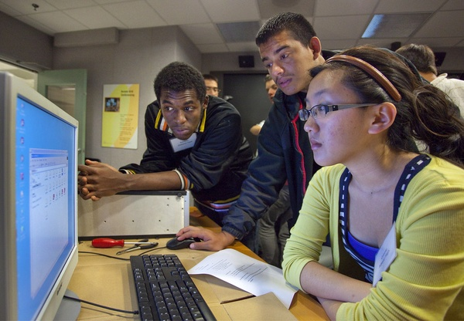
What questions do you have about teacher licensure?
Dr. Meg Foley
meg.foley@doe.virginia.gov
(804) 786-0877
Coordinator of Virtual Learning
Reginald Fox
reginald.fox@doe.virginia.gov
(804) 371-5663
Virtual Learning Specialist
Twitter: @VDOE_News
Facebook: @VDOENews
#VAis4Learners #EdEquityVA

Slide 25
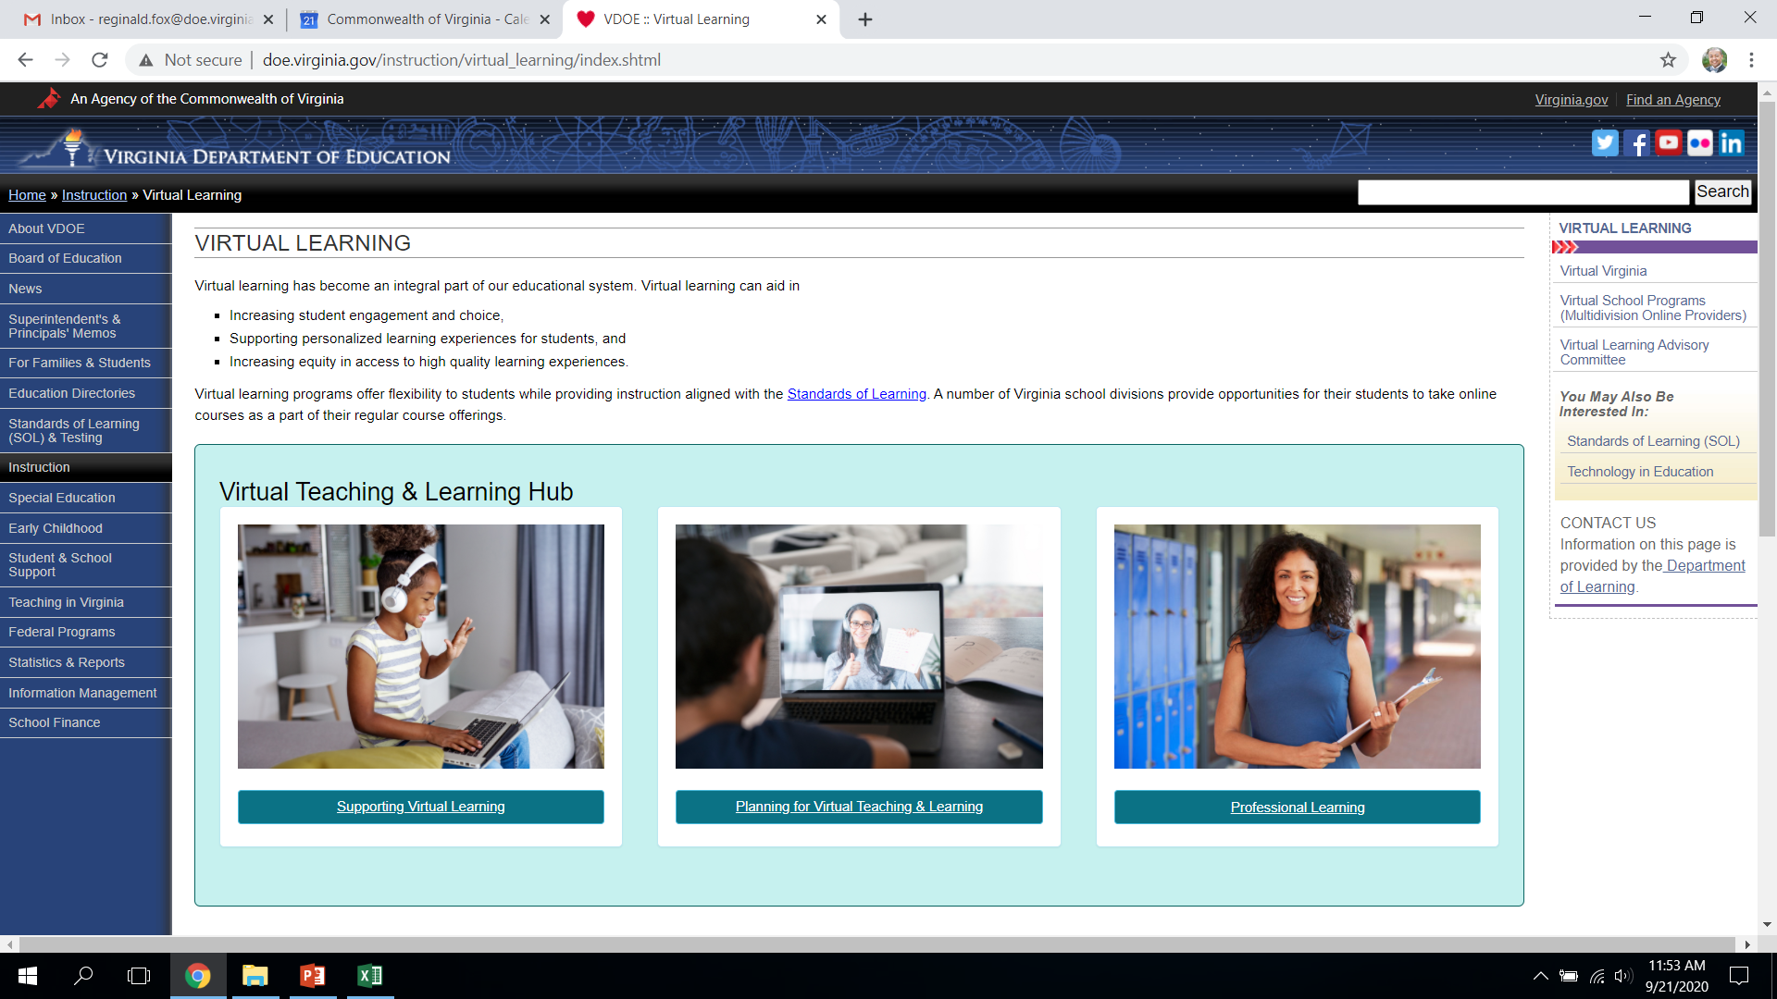
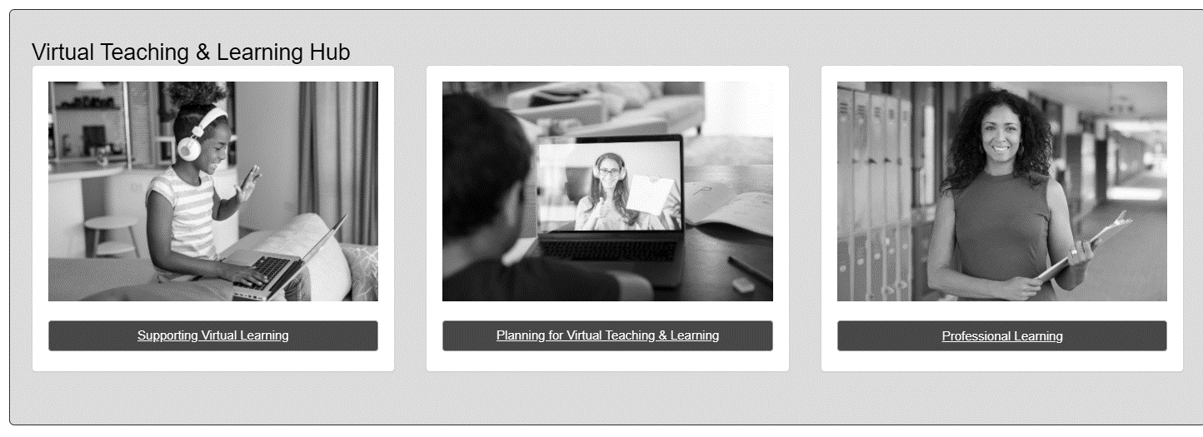
Professional Learning Community
Continue to expand our professional learning community in collaborating with school division staff and all of our virtual programs.

Slide 26
Thank you for participating!
Additional information may be found at Virtual Learning Professional Learning website.
https://www.doe.virginia.gov/instruction/virtual_learning/professional-learning/index.shtml
Dr. Meg Foley
meg.foley@doe.virginia.gov
(804) 786-0877
Coordinator of Virtual Learning
Reginald Fox
reginald.fox@doe.virginia.gov
(804) 371-5663
Virtual Learning Specialist

