Slide 1
Student Record Collection Introduction
Virginia Department of Education
Office of Data Services

Slide 2



WEBINAR PARTICIPATION
This presentation will be available to participants once this webinar has been completed

Slide 3
Agenda
Introduction and Background
File Submission Types
SRC and Cohort
Approval and Verification Process
Resources
Questions

Slide 4
Introduction and Background
What is the SRC?
Reporting Rules

Slide 5
What is the Student Record Collection (SRC)?
The Student Record Collection (SRC) was implemented to consolidate and promote efficiency in processing multiple data collections.
It includes program participation, demographic, and attendance data for publicly served and funded students.
Comprised of 107 active data elements
Some elements have been retired
Not all are required on each submission
If retired or not required a tab character must be included
Notes:
Not all elements are required on each collection. We will review how to tell which elements are required by submission type later in the presentation. We use everything. Nothing is extraneous or just ‘nice to know’.

Slide 6
Why is this collected?
Every Student Succeeds Act (ESSA)
State Mandates
Public Reporting
VDOE started collecting SRC in 2003 to comply with the information and reporting requirements
Notes:
To comply with the information and reporting requirements for adequate yearly progress, report cards, and other federal reporting requirements, the Student Record Collection System was implemented to consolidate and promote efficiency in processing multiple data collections. Open the data elements to view the scope of SRC and the file submission types

Slide 7
Who is included?
Who?
Full-Time students
Part-Time students
Students placed in other public and private centers
Students in local or regional jails
Every student who depends on a public school division in Virginia for a free appropriate public education must be included in each student record collection.
Notes:
Every student who depends on a public school division in Virginia for a free appropriate public education must be included in each student record collection. This includes all full-time and part-time students served in the division's schools as well as those the division has helped place in other public and private schools/centers regardless of how the placements are funded. Students in local or regional jails are reported by the division that serves the jail.

Slide 8
Reporting Rules
One record per student per school EXCEPT when
Grade Level Code,
GED Program Code,
Tuition Paid Code,
Non-public student FTE,
Intensive Support Services Code,
Primary Disability Code, or
Full Time Virtual Program Code
changes while still attending the same school.
In these cases, a student MAY have more than one record per school per record collection.
Notes:
Moved to previous slide: Every student who depends on a public school division in Virginia for a free appropriate public education must be included in each student record collection. This includes all full-time and part-time students served in the division's schools as well as those the division has helped place in other public and private schools/centers regardless of how the placements are funded. Students in local or regional jails are reported by the division that serves the jail. Tie it all back to funding. Does not include students who are just served in public schools and not publicly funded.

Slide 9
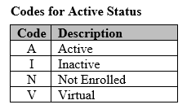
Reporting Rules
If a student has more than on record, only one record can be active on a collection (‘A’ or ‘V’)
All others must be ‘I’ or ‘N’

Slide 10
Multiple Records Scenario
Joseph starts the school year on the first day as a second grader in Petsworth Primary in Lehigh County (36/099). For personal reasons, his mother decides to homeschool Joseph but he needs some extra support with reading. He goes into the same school for Language Arts instruction as a part time student.
Fall (record 1)
Responsible Div. = 36, Responsible School = 099
Serving Div. = 36, Serving School = 099
Active Status Code = I
Aggregate Days Present/Absent = 15/2
Non-Public FTE is blank
Fall (record 2)
Responsible Div. = 36, Responsible School = 099
Serving Div. = 36, Serving School = 099
Active Status Code = A
Aggregate Days Present/Absent = 12/0
Non-Public FTE = 25

Slide 11
Reporting Rules
The Reporting Division
Reporting Division is typically the Serving Division
Only the LEAs, the School for the Deaf and Blind, and the Department of Juvenile Justice report data to the Virginia Department of Education.
If a student receives educational services from another source, then the division that is fiscally responsible for that student will report a record(s) for the student. (responsible division = reporting division)
Notes:
In general, the school division (Serving Division) that provides the educational services to the student will submit a record(s) for the student. An exception to this rule is when Tuition Code 19 is used to report a student served in a non-membership school in another LEA. Note: The LEAs’ division numbers are all less than or equal to 218, the Department Juvenile Justice’s division number is 917. Therefore, if the Serving Division number is greater than 218 OR not equal to 917, the Responsible Division will report the record(s). If a student is receiving services from a State Operated Program (SOP), then the LEA is still responsible for reporting that student because SOPs do not report data to the Virginia Department of Education. The record(s) of a student who is enrolled in a half-day program at a Governor’s School, local Alternative Ed centers, regional Special Ed center, regional CTE centers, STEM Academies, Virtual Virginia or any other type of regional center or school should have the Governor’s School or other type of regional center or school listed as the Serving Division and Serving School/Center.
When a non-resident student from a state outside of Virginia is served in Virginia, the Responsible Division is 888 and the Responsible School is the corresponding state code. The LEA in Virginia is the Serving Division.

Slide 12
File Submission Types
Fall
Spring
End of Year (EOY)
Summer
Presubmission

Slide 13
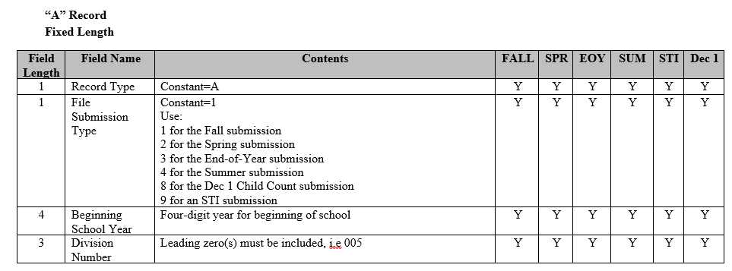
SRC File Submission Types
A?2022099

Slide 14
Fall SRC
Who is included?
Students with at least one day of membership as of 10/1
Students who were active on the previous EOY and did not return
Reporting Timeline
Opens 10/1 (unless it falls on a weekend)
Successful file submission due two weeks later
Closes the last Friday in October (includes verification)
Miscellaneous Collection
Number of Children Receiving Home Instruction
Number of Religious Exemptions
Days in Session
Notes:
K-3 Class Size Reduction goes hand in hand with a successful file submission. Public reports for number of students receiving This division/school level data that we can’t tell from the student level data.

Slide 15
Primary Products from Fall
Fall Membership Build-a-Table Tool
K-3 Class Size Reduction Program
Annual Dropouts
PreSchool Program Data
Retentions
Title III, Part A (EL and Immigrant Students)
Internet and Device Access for Remote Instruction
Other Program Office Reports
These reports and datasets come the data submitted on the Fall SRC.
Notes:
It is very important to verify the data in the reports. It is widely used for research (internal and external) publicly published tools, and program office reports to support decision making. (VPI Reports depend on a locked Fall SRC.

Slide 16
Fall – Private Placement Scenario
Kylie started the year at Green Middle in Lehigh County (52/099) after transferring from out of state. On September 28th, she started receiving services from a private residential facility called New Beginnings (475/600). Luckily, CSA is funding the placement.
Fall (record 1)
Responsible Div. = 36
Responsible School = 099
Serving Div. = 52
Serving School = 099
Active Status Code = I
Exit Code = W304
Exit Date = 9/27/2022
Aggregate Days Present/Absent = 15/2
Fall (record 2)
Responsible Div. = 36
Responsible School = 099
Serving Div. = 475
Serving School = 600
Active Status Code = A
Entry Code = R201
Entry Date = 9/28/2022
Aggregate Days Present/Absent = 3/0
Tuition Paid Code = 7

Slide 17
Spring SRC
Who is included?
Students with at least one day in membership as of March 31
Reporting Timeline
Opens 4/1 (unless it falls on a weekend)
Successful file submission due two weeks later
Closes the last Friday in April (includes verification)
Miscellaneous Collection
Days in Session (used in ADM calculation)
Number of KG FTE
Notes:
Jail records (N) refer back to introduction information. How ADM relates to the days reported present and absent. Number of KG FTE used for purposes of calculating Adjusted ADM. For more information, see the page itself.

Slide 18
Products from Spring
March 31 ADM
Special Education Regional Tuition Reimbursement Claims (First Semester)
Early College Scholars
Virginia High School League (membership)
Comprehensive Services Act (CSA)
Other Program Office Reports
These reports and datasets come the data submitted on the Spring SRC.
Notes:
Mention Certificate Generator for number 3

Slide 19
Spring – Private Placement Scenario
Kylie’s services are changing so she needs a new placement. She is transferred from New Beginnings and enrolled at Bright Side (265/600) in February of 2023.
Spring (record 1)
Responsible Div. = 36
Responsible School = 099
Serving Div. = 52
Serving School = 099
Active Status Code = I
Exit Code = W304
Exit Date = 9/27/2022
Aggregate Days Present/Absent = 15/2)
Spring (record 2)
Responsible Div. = 36
Responsible School = 099
Serving Div. = 475
Serving School = 600
Active Status Code = I
Exit Code = W304
Exit Date = 2/15/2023
Aggregate Days Present/Absent = 85/5
Tuition Paid Code = 7
Spring (record 3)
Responsible Div. = 36
Responsible School = 099
Serving Div. = 265
Serving School = 600
Active Status Code = A
Entry Code = R201
Entry Date = 9/28/2022
Aggregate Days Present/Absent = 26/0
Tuition Paid Code = 7

Slide 20
End of Year (EOY)
Who is included?
Students with at least one day in membership as of the last day of school
Reporting Timeline
Opens Mid-May
Successful file submission due a few weeks before it closes
Closes Mid-July (includes verification)
Miscellaneous Collection
Days in Session (EOY ADM)
Number of Instructional Hours
Notes:
This collection contains data elements for Accreditation and On Time Graduation and are locked down for public reporting in early/mid September. However, divisions can resubmit these collections through the fall if needed (to update AP data, dropouts, graduates, etc.) We expect it to be successful by then because preliminary Accred reports become available to LEA’s

Slide 21
Products from EOY
School Quality Profiles
Advanced Placement
EOY ADM/ADA
Accountability Calculations
Chronic Absenteeism
Cohort Graduates and Dropouts
CTE Finishers
Annual Graduates and Completion
CTE Completer Demographics Report
Special Education Regional Tuition Reimbursement Claims (Second Semester)
Superintendent's Annual Reports (SAR)
Gifted Program
Seclusion and Restraint
Remote Instruction Percent of Time
These reports and datasets come the data submitted on the EOY SRC.
Notes:
Discuss that advanced placement data is only on the SQP’s. All other SQP data is published in at least one other location. CTE data on MSC doesn’t have demographics so it all come together

Slide 22
EOY – Returning to School Scenario
Malachi started the year in Green Middle (52/099). In November, their dad decided to enroll Malachi in the division’s virtual program which has a school number of 110/099. By Spring, Malachi was missing his friends and sports were starting up so he wanted to go back to Green Middle full time.
EOY (record 1)
Responsible Div. = 52
Responsible School = 099
Serving Div. = 52
Serving School = 099
Active Status Code = A
Entry Code = R201
Entry Date = 4/15/2023
Aggregate Days Present/Absent = 104/2
EOY (record 2)
Responsible Div. = 52
Responsible School = 099
Serving Div. = 110
Serving School = 099
Active Status Code = I
Exit Code = W201
Exit Date = 4/14/2023
Aggregate Days Present/Absent = 80/2
Tuition Paid Code = 18
Notes:
R201/W201
Transfer from a public school in the same local education agency

Slide 23
EOY – Returning to School Scenario
Malachi started the year in Green Middle (52/099). In November, their dad decided to enroll Malachi in the division’s virtual program which has a school number of 110/099. By Spring, Malachi was missing his friends and sports were starting up so he wanted to go back to Green Middle full time.
EOY (record 1)
Responsible Div. = 52
Responsible School = 099
Serving Div. = 52
Serving School = 099
Active Status Code = I
Exit Code = W201
Exit Date = 11/15/2022
Aggregate Days Present/Absent = 35/2
EOY (record 2)
Responsible Div. = 52
Responsible School = 099
Serving Div. = 110
Serving School = 099
Active Status Code = I
Exit Code = W201
Exit Date = 4/14/2023
Aggregate Days Present/Absent = 80/2
EOY (record 3)
Responsible Div. = 52
Responsible School = 099
Serving Div. = 52
Serving School = 099
Active Status Code = A
Entry Code = R201
Entry Date = 4/15/2023
Aggregate Days Present/Absent = 67/2
Notes:
R201/W201
Transfer from a public school in the same local education agency
If you’re wondering why we don’t add a third record, like we did for Kylie, we have to remember the reporting rule about one record per student per school. There is no difference in record 1 and record 3 so they must be combined.

Slide 24
Summer SRC
Who is included?
ONLY Summer Graduates are reported on the Summer SRC but EVERY LEA must submit a file and verify the reports.
Reporting Timeline
Opens the first week of August
Successful file submission due two weeks later
Closes about three weeks after it opens (includes verification)
Miscellaneous Collection
Summer ADA/ADM
Remedial Summer School
Notes:
Note to pay attention to beg school year

Slide 25
Products from Summer
Final Graduates and Completers
Final CTE Completers
Triggers sliders in the Cohort
These reports and datasets come the data submitted on the Summer SRC.
Notes:
As soon as any LEA submits a summer file, sliders slide.

Slide 26
Summer – Graduate Scenario
Derek was one class away from graduating in May with his classmates. He finished the requirements over the summer and was awarded a Standard Diploma in July.
Summer
Active Status Code = N
Exit Code = W730
Exit Date = 7/27/2023
Graduate/Other Completer Code = 1
Aggregate Days Present/Absent = 0/0
Notes:
This is the only student reported on Summer. Only for graduates. This is why everyone must submit a file and verify – leads to the final grads

Slide 27
Presubmission (presub)
The SRC Presubmission application is open a few weeks before each file submission type.
This is a tool to be used for error resolution.
No data is stored from Presub.
No reports are created from Presub.
No verification required.
It is highly encouraged that all divisions take advantage of this useful reporting tool.

Slide 28
SRC and Cohort
How are they related?

Slide 29
SRC and Cohort
Collected 4 times a year
Fall → Data as of Oct 1st
Student first reported in 9th grade
Spring → Data as of March 31st
Updates to enrollment status or demographics
End of Year → Data as of the last day of school
Graduation/Completer and dropout status
Summer → Only includes summer graduates

Slide 30
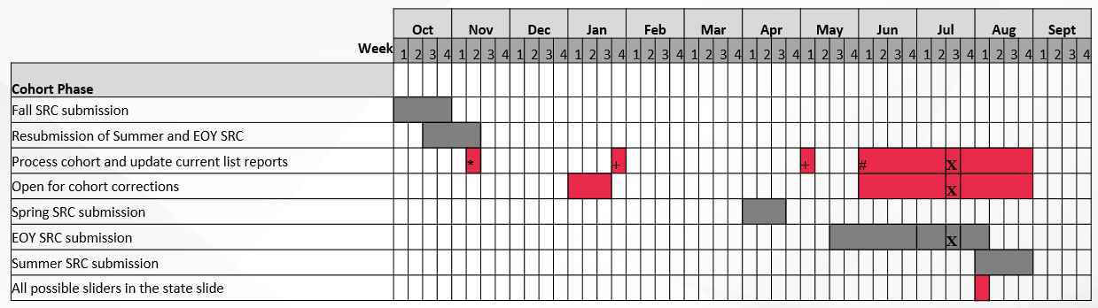
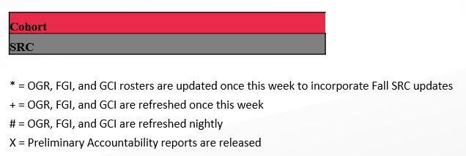
How does the SRC Timeline Effect Cohort?

Slide 31
Approval and Verification Process
SSWS Roles
Data Verification Process
Resubmission Steps

Slide 32
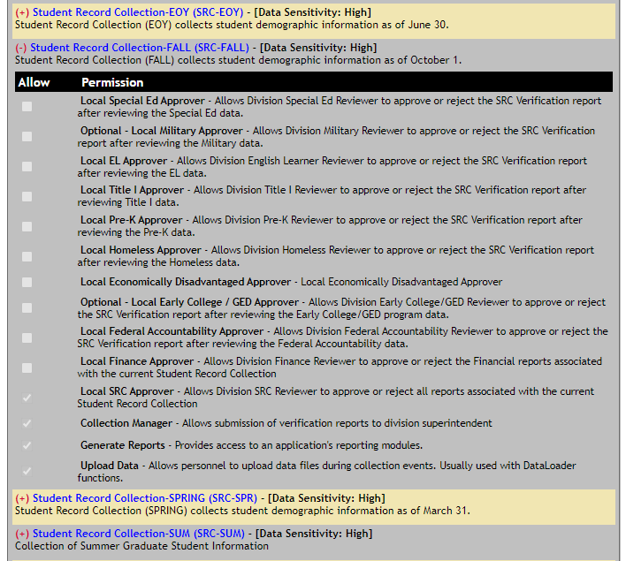
SSWS Roles
The division SSWS Account Manager can assign permissions for each collection.
Each SRC file submission type contains local approvers.
Not all approvers are required for each submission type.

Slide 33
SSWS Roles
Collection Manager
Submit for Local Approvals
Monitor Local Approvals
Submit for Verification
Return for Resubmit
Data Uploader
Submit the data file
Error resolution
Generate Reports
Generate reports after a successful data submission

Slide 34
Upload Data
Resolve all errors
Submit For Local Approval
All Local Approvers review appropriate reports
Submit For Verification
Select Submit for Verification
Review Verification Report
Not all Approvers see all reports
Must have access to SRC Application
Collection Manager monitor the process until all approvals are complete
Sends the reports to SDCA
Superintendent or designee needs SDCA permissions, not SRC.
Notes:
Each file submission type follows the same process.
A collection is and is not considered complete on time until all steps have been completed.

Slide 35
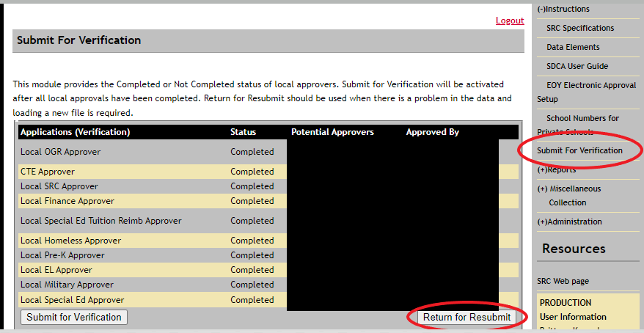
Data Resubmission Steps
Contact the Office of Data Services
Collection Manager returns the data
File Uploader can submit a new file
Collection Manager must submit for Local Approvals again
Collection Manager must submit for verification
Throughout the year, Data Services allows resubmissions to correct verified data.
Note: If you do not see the File Upload button, step 2 has not been completed.

Slide 36
Resources
Support Documents
SSWS
Tuesday Telegram

Slide 37
Support Documents
The SRC web page contains all current documentation.
Specifications for Completing the Student Record Collection
Details every data element, contains data edits, and reporting rules.
Data Elements
Excel and PDF table containing the data elements, similar to the Specifications Document.
Use for quick reference and for file submission type information
Data File Template
Follows the layout of the text file submitted.
Used to find students and resolve errors.
Specifications for Completing the Miscellaneous Collection
Layout for Tab Delimited File
SDCA User Guide

Slide 38
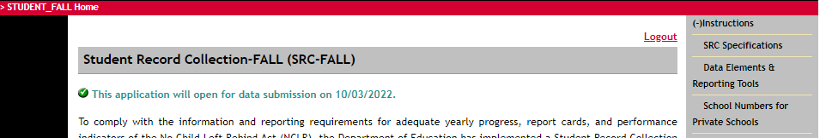
SSWS Resources
SRC Application
Support Documents
Private School Listing

Slide 39
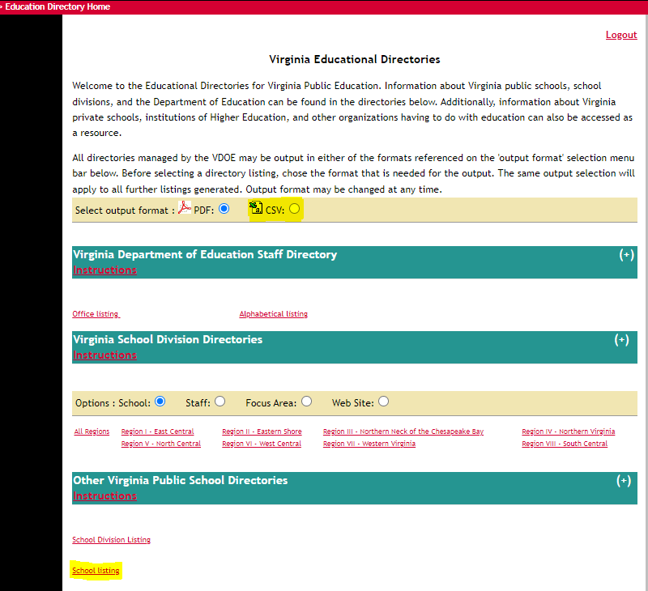
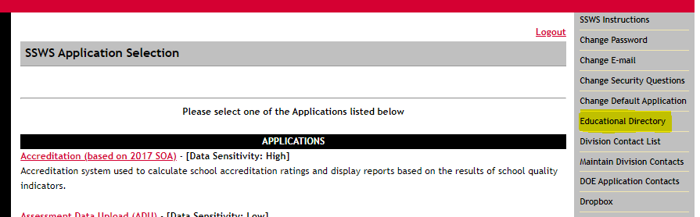
SSWS Resources
School Listing Report
includes all school numbers needed for VDOE reporting that are not provided in the public listing on the VDOE website.

Slide 40
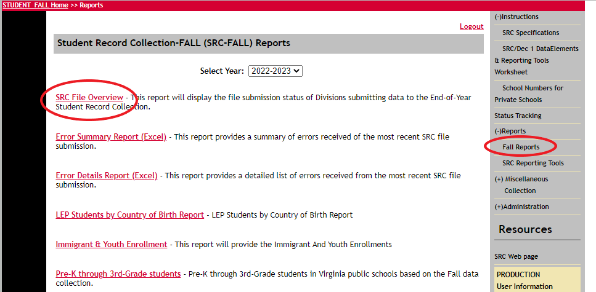
SSWS Resources
File Overview Report
Displays LEA file submission status (successful, failed, not submitted)
Helpful when looking for cohort corrections, duplicate reports of students, ect.

Slide 41
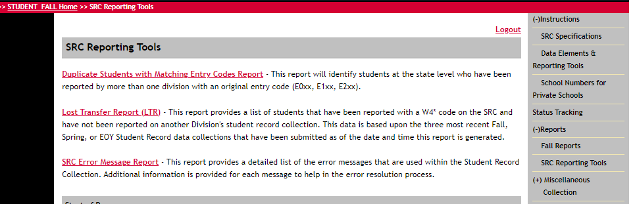
SSWS Resources
Reporting Tools
Each collection has different tools
Listed under ‘Reports’
Description is provided

Slide 42
Tuesday Telegram
We announce all news related to the data collections in the Office of Data Services
Reporting Timeline
Superintendent’s Memos
Tips of the week
New Documentation
General Reporting Guidelines
SIS Vendors receive this as well.
Notes:
Tuesday Telegram – vendors get this too! Divisions should communicate them directly.

Slide 43
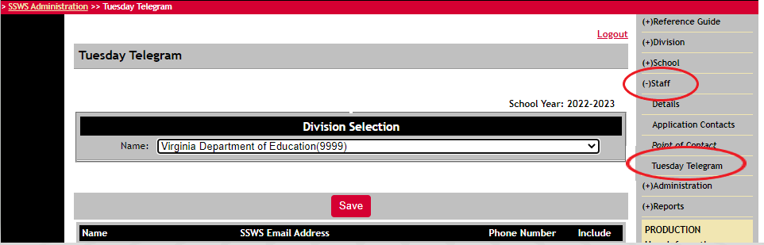
Tuesday Telegram – How to sign up
SSWS Admin staff have access to sign staff members up for the Tuesday Telegram.
Notes:
Tuesday Telegram – vendors get this too! Divisions should communicate

Slide 44
Questions
This presentation will be available to participants on the SRC website.

Slide 45
Contact Information
Student Record Collection web site
http://www.doe.virginia.gov/info_management/data_collection/student_record_collection/index.shtml
Brittney Kanard, Education Data Specialist
Phone: 804-225-3909
Email: Brittney.Kanard@doe.virginia.gov or
resultshelp@doe.virginia.gov Monitored: 7:30 am to 4:00 pm, Monday through Friday except for state holidays
Carol Wells Bazzichi, Data Collection Manager
Email: Carol.WellsBazzichi@doe.virginia.gov
Susan Williams, Director of Data Services
Email: Susan.M.Williams@doe.virginia.gov

