Slide 1

VDOE-SNP Technical Assistance Webinar: Regulations Governing Nutritional Standards for Competitive Foods Available for Sale in the Public Schools (8VAC20-740)
Virginia Department of Education
Office of School Nutrition Programs
November 2, 2017
www.doe.virginia.gov/support/nutrition
804-225-2082
Notes:
The Virginia General Assembly initiated legislation in 2010 to establish state regulations for competitive food sales in Virginia schools. It has been a long road, with revisions, amendments and updates at both the federal and state level.
But, today, we are conducting this webinar to provide information on the Virginia Regulations Governing Nutritional Standards for Competitive Foods Available for Sale in the Public Schools that became effective on October 18, 2017.

Slide 2
Webinar Outline
What are the new state regulations?
Definitions
Applicability
Nutrition Standards
Local Wellness Policy Requirements
LEA vs. SFA Responsibilities
Determining if foods meet the nutrition standards
Alternate non-food fundraisers
Monitoring compliance
Exempt Fundraisers
Online Toolkit
Notes:
2
Here is a brief outline of today’s webinar. We will begin by discussing what the new state regulations are and all of the information that we are going to address today is taken directly from the state regulations. The state regulations are in order of the way we are going to cover the information on today’s slides. If you downloaded the Superintendent’s Memo, 291-17 and Attachment A, then you will have this outline. In addition to the specifics of the regulations which would include the local wellness policy, the LEA and SFA responsibilities, and everyone’s most burning topic, exempt fundraisers, we also talk about an online toolkit DOE is developing to provide resources and help you implement these new regulations.

Slide 3
STUDENTS
Notes:
Why new regulations? It’s all about the students and making sure they have access to good, healthy food at school.

Slide 4
The School Nutrition Environment
Improving the nutritional profile of all foods sold in school is critical to:
improving the diet and overall health of students;
ensuring students from all income levels adopt healthful eating habits that will enable them to live productive lives; and,
helping students make healthier choices and reducing their risk of obesity.
Notes:
Since a significant portion of calories are consumed by students at school, improving the nutritional profile of all foods sold in school, beyond Federally-reimbursable meals, is critical to improve the diets and overall health of American children, and to ensure that students from all income levels adopt the kind of healthful eating habits and lifestyles that will enable them to live healthier, more productive lives.
Through strong competitive food standards, we will also help students make healthier choices during the school day that can help to reduce their risk for obesity.

Slide 5
What are the new state regulations?
8VAC20-740
Superintendent’s Memorandum 291-17
Definitions
Applicability
Nutrition Standards
Local Wellness Policy Requirements
LEA vs. SFA Responsibilities
Exempt Fundraisers
Notes:
As I mentioned before, the regulations are outlined in Supt. Memo 291-17 which was published on Friday, October 6.
The new state regulations (1) establish nutritional standards for competitive foods available for sale to students on the school campus of any public school, or public residential child care institution, during the school day (2) require all local school boards to adopt the nutritional standards as part of the existing local wellness policy (3) establish recordkeeping requirements and (4) require the Department of Education to ensure compliance with the standards.
The regulations are based on the Institute of Medicine’s recommended standards for competitive foods in schools, align with the USDA final rule governing competitive foods in school, which was effective July 1, 2014 and known as Smart Snacks in School, and incorporate the fundraiser exemptions required by the 2015 session of the General Assembly.

Slide 6
Definitions (8VAC20-740-10)
“Competitive Food”
“School Campus”
“School Day”
Notes:
There are many definitions detailed in section 10 of these regulations. Please refer to that section for complete information. Today we will focus on these three:
“Competitive food” means all food available for sale to students on the school campus during the school day other than meals reimbursed under the NSLP, SBP, and ASP.
“School campus” means, for the purpose of these regulations, all areas of the property under the jurisdiction of the school that are accessible to students during the school day.
“School day” means, for the purpose of these regulations, the period from midnight the night before to 30 minutes after the end of the official school day.

Slide 7
Applicability (8VAC20-740-20)
All public schools and public RCCIs in Virginia
Foods available for sale to students on the school campus during the school day include:
A la carte in the school cafeteria
Vending machines
Snack bars and school stores
Student activities, such as fundraisers
Culinary education programs
Notes:
These regulations apply to all public schools and public RCCIS in Virginia. The regulations and nutrition standards apply to foods available for sale to students ala carte in the cafeteria, in vending machines anywhere on the campus, in snack bars, school stores, student activities, such as fundraisers, and in culinary education programs. This applicability is consistent with the federal regulations.

Slide 8
Applicability (8VAC20-740-20)
These regulations do not apply to foods:
Provided as meals in the NSLP, SBP, or ASP
Available after the school day
At snack bars, concession stands, or athletic events
As school fundraisers
At any school-sponsored activity that takes place off campus
Available to adults only in areas not accessible to students
Notes:
These regulations do not apply to reimbursable meals in the lunch, breakfast, or afterschool snack programs or to foods available for sale after the school day or off the school campus. They also do not apply to foods sold to adults in areas that students do not have access to during the school day.

Slide 9
Nutrition Standards (8VAC20-740-30)
Calories
Fat
Sugar
Sodium
Etc…
Notes:
The nutrition standards apply to all foods available for sale to students as described in the previous slides. Since these state regulations were first required in 2010, they have been updated to align with the federal Smart Snacks in School regulations to create a unified set of nutrition standards to be applied to competitive foods in Virginia schools. This simplifies the process of determining which foods and beverages meet the standards since they are not unique to Virginia and are consistent with products manufactured and sold throughout the country.

Slide 10
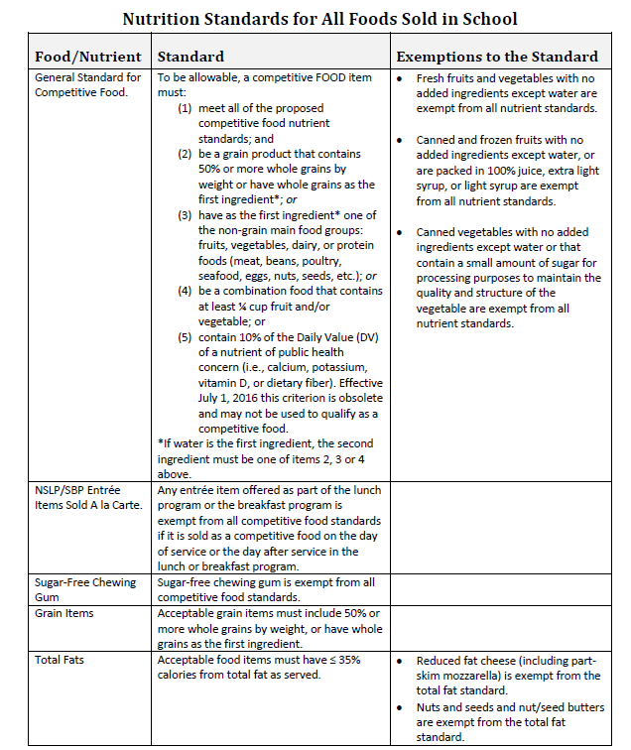
Federal Smart Snacks in School
(SSiS) Nutrition Standards
SSiS Effective July 1, 2014
VA Standards Effective October 18, 2017
Notes:
This handout may be familiar to some of you. We have been using it to describe the detailed information in the federal Smart Snacks in School standards.
These federal regulations, which are known as Smart Snacks in School, became effective in July 2014. You may be familiar with this chart that details the specifics of the nutrition standards for competitive foods from the Smart Snacks in School regulations. Schools across the country, including Virginia, have been implementing these standards for more than three years. The regulations are consistent with the Dietary Guidelines for Americans, incorporate science based recommendations, and specify general standards that require a competitive food to meet all of the nutrient standards and either:
Be a grain product with 50% or more whole grain,
Have as the first ingredient one of the other major food groups: fruits, vegetables, dairy, or protein, or
Be a combination food that contains ¼ cup of fruit or vegetables.
The food must first meet one of these general standards and then it must meet all of the nutrition standards.
The Department of Education, working with stakeholder groups, revised the proposed state regulations to align with these federal regulations with one exception, the state regulations do not address beverages. Because of this regulatory silence on beverages in the state regulations, the federal regulations apply for all beverages.
Let’s look at a brief, simplified summary of the state nutrient standards and then follow that with a comparison of the federal and state standards.

Slide 11
State Nutrition Standards Summary
Calories
Snacks & side dishes ≤200 calories
Fat
Total fat: ≤35% of total calories
Trans Fat: Zero (0) grams
Sugar
≤ 35% of weight from total sugars per item
Sodium
Saturated Fat: <10% of total calorie
Entrée items that do not meet NSLP/SBP exemptions: ≤480 mg sodium per item
Snack and side items: ≤200 mg
Entrée items ≤350 calories
Notes:
The summary of the state nutrition standards address four major nutrients, calories, fat, sugar, and sodium. With regard to calories, snacks and side dishes must contain no more than 200 calories per serving and entrée items, which would be a cheeseburger or a slice of pizza, must contain no more than 350 calories. With regard to fat, the item must contain less than or equal to 35% of the total calories from total fat. Saturated fat must be less than 10% of total calories and trans fat must be zero grams in the serving of the product. For sugar, the determination is made by weight. 35% or less of the weight of the product must be from total sugar. And then finally, sodium. An entrée that does not meet the NSLP or SBP exemption must be equal to or less than 480 mg. per item. And snack and side items must be equal to or less than 200 mg. of sodium per serving. So, let’s see how these nutrition standards compare to the federal.

Slide 12
Comparison of Nutrition Standards
Federal SSiS Standard
Virginia Standard
General standards
Calories
Total fat
Saturated fat
Trans fat
Sugar
Sodium
Same
Same
Same
Same
Same
Same
Notes:
As you can see from this chart, the state and federal nutrition standards are consistent and aligned. There are no nutrition standards in these state regulations that differ from the federal nutrition standards for foods available for sale to students at school during the school day. The general standards for calories, fat, sugar, and sodium are all the same.

Slide 13






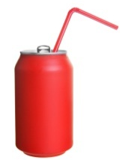




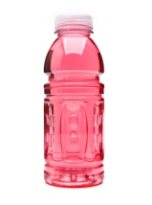
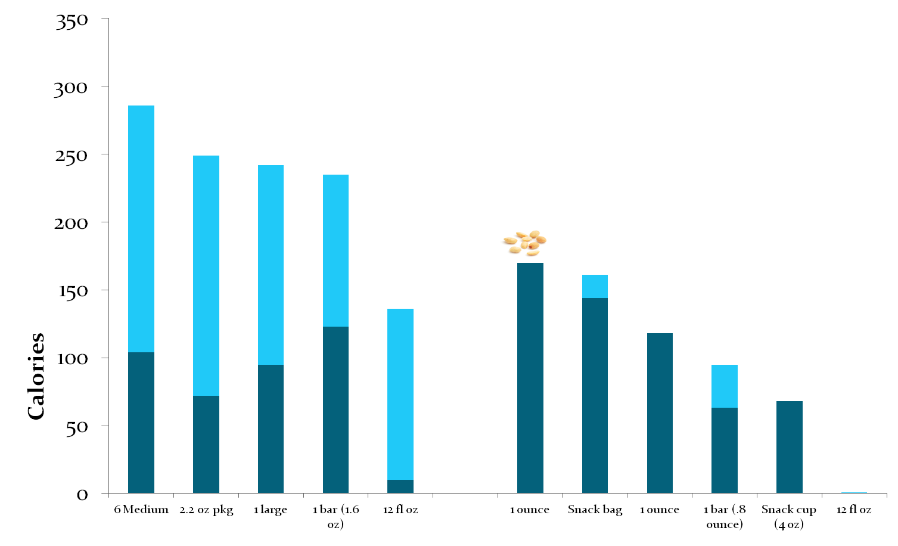
Snacks Not Meeting Standards
Snacks Meeting Standards
Chocolate sandwich
cookies
Fruit Flavored Candies
Fewer empty calories from fats and added sugars
Chocolate
bar
Donut
Empty Calories from Fats and Added Sugars
Light Popcorn
Regular Cola
Peanuts
Low-fat Tortilla Chips
Granola Bar (oats, fruit, nuts)
Fruit Cp (w/ 100% juice) u
No-calorie Flavored Water
Notes:
What does that look like?
This slide provides some examples of food and beverages that may or may not meet the standards. It is important to note that each product must be evaluated individually as specific nutrition profiles of foods vary greatly.
Foods such as vegetables, fruits, granola bars, low-fat tortilla chips, peanuts, and light popcorn will likely meet the nutrition standards.
Typically, foods that are not likely to meet the standards include most fried foods such as donuts, and most desserts high in fat, calories, and sugar such as cakes, pastries, cookies, candy, and energy bars.
However, as we said, each food is formulated differently; it is critical to evaluate each food item on an individual basis to determine compliance.
You can see in the chart that the snacks that are not likely to meet the standards have many more, in that light blue bar, what we would call empty calories, primarily from added fats and sugars. And, snacks that would meet the standards have fewer empty calories from added fats and sugars.

Slide 14
Exemption to the Nutrition Standards for School-sponsored Fundraisers
A limited number of exemptions to these nutrition standards may be permitted, but are not required. The LEA may set more restrictive guidelines in their local wellness policy.
Notes:
The federal regulations permit states to allow a limited number of exemptions to these nutrition standards, but exemptions are not required. In 2015, the Virginia General Assembly passed legislation that required DOE to incorporate standards for limited number of exempt fundraisers into these state regulations on competitive foods.
The fundraiser exemption was first implemented in Virginia by a state Board of Education resolution in November 2015. However, there were no regulations to provide specific guidelines for these exemptions. These new regulations provide the guidelines that must be followed if exempt fundraisers are permitted.

Slide 15
Exempt Fundraisers (8VAC20-740-35)
LEA Responsibility (SFA may not be exempt from the federal or state guidelines)
Each school
No more than 30 per school
Foods or beverages that do not meet the nutrition standards
Not required to allow exempt fundraisers and may establish more restrictive standards (none, 5 per year, etc.) as part of the local wellness policy outlined in 8VAC20-740-40
Notes:
Exempt fundraisers, if permitted in the local school division’s wellness policy, are the responsibility of the LEA (local educational agency) – the school nutrition program may not be exempt from the state or federal regulations. Let me say that again, these exemptions would apply to foods that are not sold by the SNP, because the SNP may not be exempt from state or federal regulations. Each school may conduct a maximum of 30 school-sponsored fundraisers per year that sell foods or beverages which are exempt from the state and federal nutrition standards. The LEA is not required to permit exempt fundraisers and instead could require all fundraisers that sell foods or beverages to meet the nutrition standards.
The LEA could also limit the number of exempt fundraisers to fewer than 30, or could create a limit for each grade level school, for example 5 exempt fundraisers in elementary schools and 10 exempt fundraisers in secondary schools. The LEA may always set a standard that is more restrictive than the state or federal regulations, but may not set a standard that is less restrictive.

Slide 16
Exempt Fundraisers (8VAC20-740-35)
One fundraiser is defined as one or more fundraising activities that last one school day
If multiple school-sponsored organizations conduct a fundraiser on the same day, the combined activities count as one fundraiser
If one fundraiser activity lasts for more than one day, each subsequent day is considered one fundraiser counting toward the limit of 30 per year
Notes:
What is the definition of a fundraiser? For the purpose of these regulations, a fundraiser is defined as one or more fundraising activities that last one school day.
One day, one fundraiser – if multiple groups sponsor a fundraiser on the same day, it’s still one fundraiser. If one group sponsors a fundraiser for 5 days during the week, that would be counted as 5 fundraisers toward the maximum of 30.
This regulation for exempt fundraisers has a limit of 30 total school days when foods or beverages that do not meet the nutrition standards may be sold to students. One or more organizations may sponsor a fundraiser on one school day and the total number of days when that may be approved by the LEA is 30. The LEA must track the number of exempt fundraisers, if they are permitted, along with other information, such as the name of the organization and the item(s) sold. More information on those requirements follows in the LEA responsibility section of this webinar.

Slide 17
Nonfood Fundraisers (8VAC20-740-35)
An exemption is not required for nonfood fundraisers
Schools are encouraged to consider options for items and activities other than foods or beverages as fundraising activities
Notes:
Fundraisers that sell foods and beverages that meet the nutrition standards, or fundraisers that do not sell foods or beverages do not require an exemption. But they are restricted by other state regulations.

Slide 18
Fundraiser Limitations (8VAC20-290 and 8VAC20-580)
Any fundraiser that sells foods or beverages, whether meeting the nutrition standards or exempt, may not be conducted anywhere on the school campus during school meal service times.
From 6 a.m. through the end of the breakfast period
From the beginning of the first scheduled lunch period through the end of the last
Income from the sale of any foods or beverages sold during these times shall accrue to the school nutrition account
Notes:
Previous state regulations restrict the sale of foods or beverages (compliant with the nutrition standards or exempt from the nutrition standards) anywhere on the campus during the school meal times as defined on this slide. The school nutrition program may sell foods and beverages a la carte during these times and the revenue from those sales must be deposited to the school nutrition account. But, other entities are restricted from selling any products from 6 in the morning through the end of the breakfast period and from the beginning of the first scheduled lunch period through the end of the last.

Slide 19
Fundraiser Resources
The School Nutrition Director in your LEA
Potential partner for purchasing compliant snacks
Expert in implementing these nutrition standards
Tools for evaluating products for compliance
Local Wellness Policy Committee and Stakeholders
Notes:
The LEA should consult with the SNP director in the division as a resource for meeting these regulations. The school nutrition program may partner with school-sponsored organizations to provide information on products. Some school divisions’ SNP allow school-sponsored organizations to purchase products that meet the nutrition standards from their SNP for their fundraiser. And, some SNP also help these school-sponsored organizations by working with them to use the available tools to evaluate different products to determine if they comply with these nutrition standards.

Slide 20
Fundraiser Resources
Nonfood Fundraiser Ideas:
https://healthymeals.fns.usda.gov/sites/default/files/uploads/Healthy_Fundraising_Handout_Nov_2015.pdf
Healthy Food and Beverage Items:
https://healthymeals.fns.usda.gov/sites/default/files/uploads/Healthy_Fundraising_Handout_Nov_2015.pdf
Smart Snacks Compliance Calculator
https://foodplanner.healthiergeneration.org/calculator/
Smart Food Planner: List of Foods That Are Compliant with the Nutrition Standards
https://foodplanner.healthiergeneration.org/products/1-55-oz-1-55-oz-welchs-fruit-snacks-bnc-144ct-sc-case/
The Healthier Generation Store - Online
https://www.amazon.com/healthiergeneration
Notes:
On this slide you see some resources that can potentially be used by either the LEA or the SFA to determine if products and items meet these nutrition standards and meet the regulations for fundraisers in these state requirements.
A number of these resources are perhaps familiar to you: the USDA resource on nonfood fundraisers; another USDA resource that outlines healthy food and beverage items; the Alliance for a Healthier Generation Smart Snacks Compliance calculator; and the Alliance’s list of foods that have already been put through the calculator and are compliant with the nutrition standards. And, finally, one that was new to me but may be familiar to you. Amazon has an online store called the Healthier Generation store. They have partnered with the Alliance for a Healthier Generation to provide easy online ordering for foods that meet the new standards and that be of help to school-sponsored fundraising organizations.

Slide 21
Implementation and Compliance (8VAC20-740-40)
Local Wellness Policy
LEA and SFA Responsibilities
Recordkeeping
DOE Responsibilities
Notes:
The final section of these regulations is 8VAC20-740, detailed information on implementation of the requirements and compliance with these regulations in the following areas:
State regulations for the federally required Local Wellness Policy
LEA and SFA responsibilities for compliance with the regulations
Recordkeeping and documentation requirements
And, DOE responsibilities to provide guidance to LEAs and SFAs and to monitor compliance

Slide 22
Federal Requirements of the Local Wellness Policy
Effective July 1, 2017, revise and update the Local Wellness Policy
Strengthen the policy to promote student wellness
Requires an LEA official with authority to monitor and enforce the policy
Notes:
Many of you are very familiar with the federal requirements of the local wellness policy. These state regulations supplement those requirements. They do not take the place of the federal requirements for the local wellness policy. As of July 1, of this year, school divisions were required to update their federally required local wellness policies and to include certain standards that would strengthen the policy and further promote student wellness. These state regulations reinforce those requirements and provide Virginia guidelines for the LWP for the purposes of these regulations. One of the things in both the federal and state requirements is an LEA official with authority to monitor and enforce the policy must be identified.

Slide 23
Local Wellness Policy Requirements (8VAC20-740-40)
Local school board shall:
Incorporate and adopt state nutrition standards into LWP
Local Wellness Policy shall:
Identify LEA leadership to enforce LWP
Establish goals for nutrition promotion, nutrition education, physical activities and other school-based activities to promote student wellness
Establish policies that address marketing and advertising of only foods that meet the nutrition standards
Notes:
For these state regulations, local wellness policy requirements mandate that the local school board incorporate and adopt the state nutrition standards in these regulations into their local wellness policy. Since we’ve already talked about these regulations being consistent with the federal standards, if your local wellness policy is up to date and has incorporated the SSiS standards into the policy, then you can review the standards in the state regulations and they should already be present in your LWP. So you can say check it off the list, that one we have accomplished.
The state regulations go further and say that in the local wellness policy (LWP), the LEA shall define the leadership who will enforce the LWP. The LEA shall also establish goals for nutrition promotion, nutrition education, physical activities, and other school-based activities to promote student wellness. And, in the local wellness policy, the LEA should establish policies that address marketing and advertising of only foods that meet the nutrition standards. Again, very consistent with the federal requirements. These state regulations are expressing support for and reinforcement of the best practices that should already be incorporated into the federal LWP.

Slide 24
In the interest of children…
The best possible option for consistent nutrition messaging throughout the school environment is to follow the state and federal standards for all foods and beverages available for sale to students during the school day.
Notes:
The best possible option for consistent nutrition messaging throughout the school environment is to follow the state and federal standards for all foods and beverages available for sale to students during the school day.
That is our best practice. That is what we would all strive to do on behalf of the students in our school divisions.

Slide 25
LEA and SFA Responsibilities (8VAC20-740-40)
Local Educational Agency (LEA)
School Board, Superintendent, Principals
School Food Authority (SFA)
School Nutrition Program and SNP Staff
Notes:
The implementation of these regulations, the Local Wellness Policy and Exempt Fundraisers are a shared duty with specific responsibilities assigned in these regulations to both the Local Education Agency and the School Food Authority.
The LEA represents the school board, the superintendent, and the principals and the school food authority is also known as the school nutrition program, the school nutrition director and the staff.

Slide 26
LEA Responsibilities
Identify and establish LEA staff with authority to monitor and enforce compliance with these regulations:
Designate an individual at the division or school level to monitor and ensure compliance with these regulations in all areas that are outside the control of the school nutrition program operation
This individual shall not be school nutrition personnel
Maintain records to document compliance with the nutrition standards for food available for sale in areas that are outside the control of the school nutrition program
Ensure any organization or school activity responsible for the sale of food in venues other than the school nutrition program maintains records documenting compliance with the nutrition standards
Maintain records each school year documenting the number of exempt fundraisers, if any, conducted at each school within the LEA
Notes:
Let’s take a look at the specific responsibilities of the LEA.
First, to identify and establish which LEA staff at the division level will monitor and enforce compliance with these regulations. That is a general requirement for all parts of these regulations.
Second, designate specific individuals at the division and school levels that will monitor compliance in all areas outside the control of the school nutrition program. And these individuals cannot be employed by the SNP.
Monitoring compliance for non-SNP areas includes maintaining records of compliance with the nutrition standards for any foods sold on the school campus during the school day outside of the SNP as detailed in earlier slides.
It also requires the individual to work with any organizations or school activities that sell compliant foods or beverages to maintain appropriate records documenting compliance with the nutrition standards, the requirements not to sell any foods or beverages during the school meal service times, and the types of items sold, frequency, time and location of these sales.
Finally, it is the responsibility of the LEA designated division and school level staff to comply with the fundraiser requirements detailed in the division’s LWP. And, if permitted, to maintain documentation of the number of exempt fundraisers, if any, conducted at each school.

Slide 27
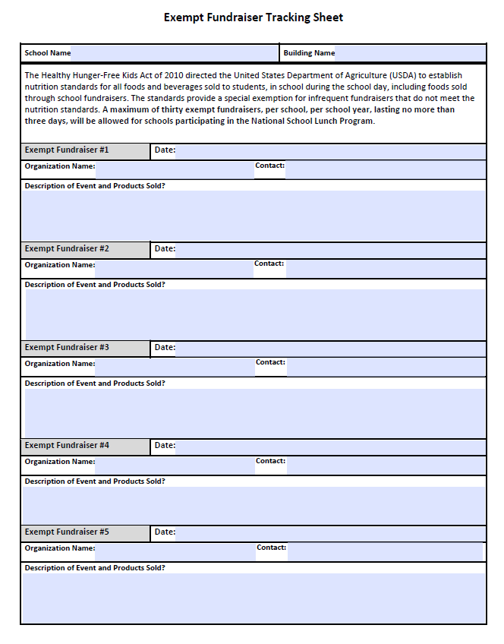
Sample Exempt Fundraiser Tracker
Notes:
The approval of an exempt fundraiser should take place in sufficient time before the day of the activity to determine if it is allowable, to determine how many fundraisers have been conducted during the school year, and to determine if the organization or activity meets the standards set forth in the LWP.
To accomplish this task, LEA officials might consider using a “permit” or official signage that would provide documentation of this approval of the fundraiser. And, the signage or permit could be posted by the organization at the time the exempt fundraiser is conducted. A process to ensure only approved fundraisers, whether they sell products that meet the nutrition standards or they are exempt from the nutrition standards, is important to be sure that any fundraisers held on school grounds during the school day would promote consistent implementation of the regulations and prevent non-compliance by any individuals or organizations.
Documentation of exempt fundraisers must be maintained on file by the LEA official for a period of three years beyond the school year in which the exempt fundraiser was conducted.
On the screen is an example of a tool LEA officials might use for tracking purposes. It will be posted to the DOE website as part of the resources provided after this webinar. It is just one way to track the 30 or fewer, whatever the standards are in your school division. Those are the LEA responsibilities.

Slide 28
SFA Responsibilities
Monitor compliance with state and federal regulations for all competitive foods sold as part of the School Nutrition Programs
Document compliance with nutrition standards
Notes:
Now let’s look at the responsibilities of the school food authority (SFA). These responsibilities include compliance with all aspects of the state and federal regulations governing the sale of competitive foods as part of the school nutrition programs. Documentation of compliance with the nutrition standards for all food and beverages sold to students as part of the program must be maintained. All products sold by the SNP must meet the nutrition standards outlined in the Smart Snacks in School regulations and these state regulations.

Slide 29
Recordkeeping and Documentation
LEA and SFA must:
Retain records to document compliance with these regulations
Maintain documentation used to assess the nutritional profile of all competitive foods available for sale to students
Nutrition Facts Labels
Recipes
Product Specifications
Notes:
Both the LEA and SFA are required to maintain records and documentation of compliance. This slide restates these recordkeeping and documentation responsibilities. It is important to note that whether a food is compliant with these nutrition standards or exempt from these nutrition standards, documentation must be maintained at both the LEA and SFA level, depending on who is selling the item. And that kind of documentation to show compliance with the nutrition standards or exemption from the nutrition standards could include things like the Nutrition Facts label, recipes, and product specifications.

Slide 30
DOE Responsibilities
Ensure LEAs and SFAs comply with these nutrition standards and regulations
Provide guidance on:
Alternative school fundraisers that do not involve the sale of foods or beverages
How to determine if foods and beverages available for sale meet these standards
Non-compliance determined by DOE, the LEA or SFA shall require corrective action
Notes:
And finally, what are the department of Education’s responsibilities with regard to these new regulations? It is the responsibility of the Department of Education to ensure compliance with these state regulations and to provide guidance to LEAs and SFAs.
If non-compliance is determined by DOE, or if non-compliance is determined by the LEA or SFA staff responsible for monitoring compliance with these regulations, corrective action shall be required. Documentation of the implementation of this corrective action must also be maintained.

Slide 31
Resources – DOE Online Toolkit
Webinar Recording and Handouts
DOE tools
Fundraiser 101 Fact Sheet
Exempt Fundraiser Tracking Tool
Local Wellness Policy Resources
Alliance for a Healthier Generation Resources
Product Calculator
Compliant Products Listing
Nonfood Fundraiser Ideas
USDA Smart Snacks in School Resources
Notes:
31
The DOE SNP staff is developing an online tool kit to provide resources to assist LEAs and SFAs in implementing these regulations. This online toolkit, including a recording of today’s webinar and a copy of today’s Power Point slides, will be coming in the next few weeks. Some of the items we plan to include in that online resource are provided on this slide.

Slide 32
Action Plan for 2017-2018
Implement state regulations and nutrition standards
Review Local Wellness Policy and adopt these nutrition standards, if not already included
Determine LEA policy on fundraisers and incorporate into LWP
Identify LEA leadership to monitor and enforce LWP
Designate division level and school level LEA staff to monitor and ensure compliance with these regulations at each school in the LEA
Maintain documentation of compliance with nutrition standards, fundraiser exemptions, and these regulations
Notes:
32
What is your action plan for the 2017-2018 school year to implement these state regulations?
One of the first things to do would be to:
Conduct a review of the current LWP to determine if updates are needed to incorporate and adopt these nutrition standards as part of the policy.
Another would be for:
The superintendent and school board, along with LEA and SFA officials, should determine the LEA policy on fundraisers and incorporate specific LEA regulations into the LWP. One of the first things to determine will be, will exempt fundraisers be allowed?
If allowed, procedures for evaluating and approving exempt fundraisers must be developed.
Tracking tools to document the number of exempt fundraisers approved and implemented at each school during the school year must be included in these procedures.
Additionally, your action plan should:
Identify the LEA leadership to monitor and enforce the LWP for the entire division.
And also, the method to:
Designate division and school level staff, not SNP personnel, to monitor and ensure compliance with these regulations at each school for any foods and beverages sold outside the area of responsibility of the school nutrition program.
And finally, your action plan should:
Develop a system of required documentation to provide evidence of compliance with the nutrition standards, fundraiser exemptions, and all aspects of these state regulations.

Slide 33
Implementation Success
Students FIRST
Notes:
When we think about successful implementation, it starts with students. To be successful in your implementation of these state regulations, when you are developing your local polciies and determining your procedures for your schools, think Students First.

Slide 34
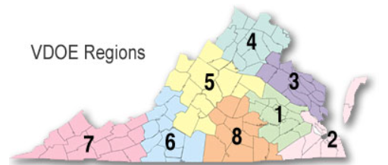
VDOE-SNP Regional Specialist Contact Information
http://www.doe.virginia.gov/support/nutrition/resources/region_specialists.shtml
or
(804) 225-2082
Notes:
If you have questions or need assistance with the implementation of these new state regulations, please contact the regional specialist assigned to your school division or RCCI. This is the map and that is the link where you can find those people or you can call our main phone number, 804-225-2082, to be connected with the person who is assigned to work with your school division or RCCI.

Slide 35
State and Federal Nutrition Standards and Regulations Information and Tool Kit
http://www.doe.virginia.gov/support/nutrition/index.shtml
Notes:
The plan is to post the online tool kit to the DOE-SNP web page when it is ready. And this is the url where we post all of the SNP information and we will lead you to the tool kit for these regulations when you get to this page.

Slide 36
QUESTIONS?
Please type your question in the chat box.
Notes:
Are there any questions? Please type your question into the chat box, if possible, so I can read it for everyone. If you would like to ask your question on the phone, I will unmute the phone line in a second so you can ask your question. I will repeat the question for everyone before answering.
Question 1: Is there a copy of this Power Point presentation available?
Answer 1: Yes, we will provide the Power Point slides to you as part of the online tool kit. And, we may provide you a pdf handout of the slides via email like we did the memo about this webinar so you can have that information in your hand before the online tool kit is ready.
Question 2: You mentioned that these regulations apply to Culinary Arts, does that include the food produced or only the food sold?
Answer 2: That would apply only to Culinary Arts education programs that want to sell the food to students on the school campus during the school day. If your culinary arts education program wants to be able to sell the food to students on the school campus during the school day, they must comply with these nutrient standards. If the culinary arts education program only sells their food to adults and students may not access that, then they do not have to comply with these nutrition standards.
Question 3: Can culinary arts sell during lunch time?
Answer 3: Culinary arts may not sell during lunch time to students. But, the regulations do not apply to sales to adults. So, if they operate their program for adults during the lunch period, that would be permissible, but not ideal. But, it is not prohibited by these regulations.
Now I am going to unmute the line so anyone who wants to ask their question on the phone can do that. Just one second. (microphones have been turned on.) Does anybody else who hasn’t put their question in the chat box have a question that they would like to ask? (Silence.) I think that we have predominantly school nutrition professionals on the phone and all of you are very familiar with these nutrition standards and have been implementing them for several years. So, that should not be new information to you. So, hopefully, that is why there are not a lot of questions particularly about that piece. If there are any LEA representatives on the phone who do have questions about that, your first resource is your school nutrition program director in the division and second would be the Superintendent’s Memo, 291-17 from October 6. Any questions about fundraisers, fundraiser exemptions, or anything else in these regulations? (END)

