Slide 1
Standards-Based Individualized Education Program
Module Six: Determining the Most Appropriate
Assessment Option
Notes:
SBIEP Module Six: Determining the Most Appropriate Assessment Option - According to federal regulations, students with disabilities are expected and required to participate in the statewide accountability assessment program. The IEP team determines how a student will participate in the state’s accountability system. The decisions are made on a student-by-student, assessment-by-assessment, subject-by-subject, and year-by-year basis.

Slide 2
A. Selecting the Most Appropriate Assessment Option
(1 of 2)
Ask:
What types of assessments are offered in the state?
What types of responses do different state assessments require?
Has the student received standards-based, grade-level instruction?
Notes:
When determining the most appropriate assessment option, ask yourself what types of assessments are offered in the state; what types of responses do different state assessments require; and has the student received standards-based, grade-level instruction?

Slide 3
A. Selecting the Most Appropriate Assessment Option
(2 of 2)
Ask:
What is the student’s instructional level?
Can the student make progress toward grade-level standards in the same timeframe?
Can the student demonstrate what he/she knows on the assessment option under consideration?
Notes:
In addition, ask yourself, what is the student’s instructional level; can the student make progress toward grade-level standards in same timeframe; and finally, can the student demonstrate what he/she knows on the assessment options under consideration?

Slide 4
Virginia SOL Assessment Options Include Participation in:
The Standards of Learning test with no accommodations
The Standards of Learning test with accommodations
The Virginia Alternate Assessment Program (VAAP)
The Substitute Tests for Verified Credit (i.e., WorkKeys)
Notes:
Federal Regulations further require that all students have access to and instruction in enrolled grade-level content. These laws make allowances for appropriate accommodations and alternate assessments, as mandated by a student’s IEP. However, even alternate assessments are aligned to the same general education curriculum standards.
When determining participation in Virginia's Accountability System, all students with disabilities first must be considered for participation in the SOL assessments. A student's IEP or 504 Plan must specify the student's participation in the state accountability system as follows:
Standards of Learning (SOL) test with no accommodations;
Standards of Learning (SOL) test with accommodations;
Virginia Alternate Assessment Program (VAAP); or
the state board of education’ substitute tests for verified credit such as WorkKeys
For information about the Virginia Standards of Learning Assessments, explore the VDOE Website at the addresses on the screen.

Slide 5
B. Adding the Appropriate Assessment Accommodation
Ask:
What accommodations are allowed on the assessment(s)?
Are the accommodations approved for the assessment also used in the classroom?
Notes:
When adding the appropriate assessment accommodations, ask yourself, what accommodations are allowed on the assessment(s), and are the accommodations approved for the assessment also used in the classroom?
Accommodations considered for testing should be those that the student uses during classroom instruction and assessments as identified in the student's IEP. Accommodations should not be used only for participating in a state assessment. The use of an unfamiliar accommodation during testing may have a negative impact on the student's performance. It is important to note that certain accommodations used for instruction or classroom assessment may not be allowable on the statewide assessment. An accommodation based solely on its potential to enhance performance beyond providing equal access is inappropriate.

Slide 6
Typical Categories of Testing Accommodations
Timing/Scheduling time of day breaks during test multiple test session* | Setting small group testing individual testing special lighting
Presentation read directions to student audio version of test items* large print | Response enlarged copy of the answer document* student marks test booklet and examiner/proctor transfers responses to answer document* word processor or augmentative communication device*
Notes:
Typically, testing accommodations can be classified in the following categories: Timing/Scheduling, Setting, Presentation, Response. Please note these categories differ slightly from the classroom accommodations discussed in Module five: Identifying Special Education and Related Services. Also, be aware that Special procedures must be followed for some testing accommodations.
Once again, the student should be familiar with accommodations selected and their use should not be limited to state assessments only. An accommodation should provide equal access and should not be selected solely to enhance performance. Some accommodations used during instruction or classroom assessment may not be allowable on statewide assessments. Questions about the appropriateness of a specific accommodation should be directed to the division Director of Testing.

Slide 7
Quick Check: Adding Assessment Accommodations
(1 of 2)
An appropriate state assessment or assessments has been selected for each tested subject area.
If not participating in the regular SOL assessment, a justification for participation in an alternate assessment is documented.
Notes:
When adding assessment accommodations, ensure that an appropriate state assessment has been selected for each tested subject area. If the student is not participating in the regular SOL assessment, document a justification for participation in an alternate assessment.

Slide 8
Quick Check: Adding Assessment Accommodations
(2 of 2)
A need for and selection of accommodations has been determined.
If a specific accommodation has eligibility criteria, the student has met the eligibility requirements.
The selected accommodation is allowable on the state assessment.
Notes:
Determine whether a need for and selection of accommodations has been determined, and that the student has met any eligibility criteria, and if the selected accommodation is allowable on the state assessment.

Slide 9
Educator and Parent Resources
Procedures for Participation Document:
  Students with Disabilities: Guidelines for Assessment Participation
  A Guide for Educators and Parents
Notes:
Students with Disabilities: Guidelines for Assessment Participation is available for download at the web address linked on the screen.
Students with Disabilities: Guidelines for Assessment Participation

Slide 10
C. Explanation for Non-Participation in
Regular State Assessments (1 of 2)
  Explanation includes:
  Why the student cannot participate in the regular assessment;
  Why the particular assessment selected is appropriate for the student, including the criteria for the alternate assessment; and
  How the student’s nonparticipation in the regular assessment will impact the student's promotion, graduation, or other matters.
Notes:
If an IEP team determines that a student must take an alternate assessment instead of a regular state assessment, the IEP team must explain why the student cannot participate in the regular assessment; why the particular assessment selected is appropriate for the student, including that the student meets the criteria for the alternate assessments; and how the student’s nonparticipation in the regular assessment will impact the child’s promotion, graduation, or other matters.
Refer to the VDOE’s Students with Disabilities: Guidelines for Assessment Participation A Guide for Educators and Parents for guidance.

Slide 11
C. Explanation for Non-Participation in
Regular State Assessments (2 of 2)
Alternate/Alternative Participation Criteria must be attached or maintained in the student’s educational record. Refer to the VDOE’s Students with Disabilities: Guidelines for Assessment Participation, A Guide for Educators and Parents for guidance.
Notes:
Alternate/Alternative Participation Criteria must be attached or maintained in the student’s educational record. Refer to the VDOE’s Students with Disabilities: Guidelines for Assessment Participation A Guide for Educators and Parents for guidance.

Slide 12
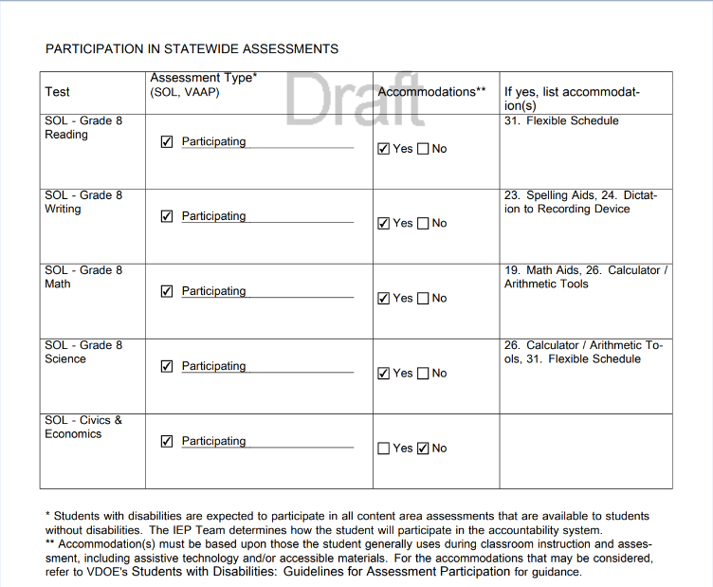
Sample Documentation of Participation In Statement Assessments
Notes:
An IEP team may not exempt a student from participation in a content area assessment, only determine how the student will be assessed.
Accommodation(s) must be based upon those the student generally uses during classroom instruction and assessment. For the accommodations that may be considered, refer to “Accommodations/Modifications” page of the IEP.
In this particular example, this grade 8 student is participating in the Standards of Learning Assessments for Reading, Writing, Math, and Science with accommodations. This student is participating in the Civics and Economics Standard of Learning Assessment without accommodations.

Slide 13
Standards-Based Individualized Education Program
Module Six: Determining the Most Appropriate Assessment Option
The resources used during the development of this training module are in the guidance document found on the VDOE Standards-Based IEP webpage.
Notes:
This concludes the sixth of nine training modules on developing Standards-based IEPs. Additional information can be found on the Virginia Department of Education’s website by accessing the link on the screen.

