Slide 1
Accidents and Emergencies
UNIT F

Slide 2
Accidents and Emergencies
Student inattention during the loading or unloading process
Driver inattention – due to students, vehicle or their environment
Improperly adjusted mirrors
Driver misjudgment while backing, turning or stopping
Faulty components on vehicle

Slide 3
Accidents and Emergencies
Emphasize all safety precautions
Pay close attention to the driving task
Gain the proper skills necessary to maneuver the bus
Use good professional judgment
Keep all mirrors in proper adjustment
Conduct a thorough pre-trip and post-trip inspection
Back only when necessary and if safe to do so
Notify officials when hazards exist

Slide 4
Accidents and Emergencies
The more we know about what causes accidents, the more likely we are to avoid them in the future.
Learning from the accident is accomplished through the accident investigation process.
Reduce or eliminate hazards: A hazard is any real or potential condition that can lead to or cause injury or death; damage to or loss of equipment or property.
Notes:
Use SSWS Crash and Incident Tracking to help with re-training in your division

Slide 5
Accidents and Emergencies
Stay calm
Secure the bus
Keep students on bus
Notify supervisor immediately
Check students for injuries and assist if necessary
Place reflective triangles according to guidelines
Do not allow students to leave the scene
Collect necessary information and follow local policy

Slide 6
Accidents and Emergencies
Negligence occurs when someone acts carelessly or fails to act at all, resulting in injury or loss to another person
Driver can be held personally responsible if a risk is taken and an accident occurs
A School Bus Drivers #1 priority is to provide SAFE transportation
Eating or drinking while driving?
Talking on a cell phone while driving?
Sending text messages while driving?
Driving under the influence of prescribed medication?

Slide 7
Accidents and Emergencies
If you have a mechanical breakdown, you should try to move the bus to a safe location, if possible, and secure the bus.
Do not unload passengers unless there is potential danger
Set reflective triangles according to guidelines
Radio or phone for assistance
Finish route when bus is repaired or a substitute bus is supplied

Slide 8
Accidents and Emergencies
8VAC20-70-230 Required materials “All vehicles used primarily to transport students to and from school or school related activities shall carry reflective triangles, first aid kit, body fluid clean up kit and fire extinguisher.”
A seat belt cutter should be on the bus in an area that can be accessed by the School Bus Driver

Slide 9
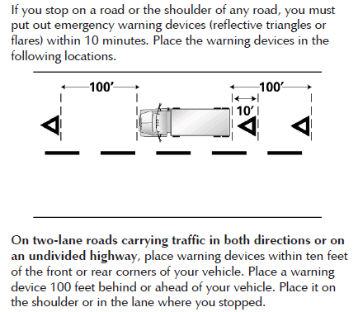
Accidents and Emergencies

Slide 10
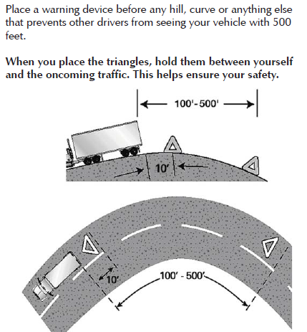
Accidents and Emergencies

Slide 11
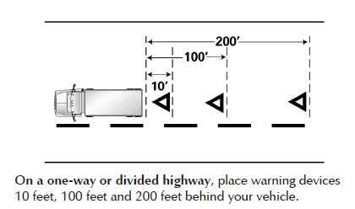
Accidents and Emergencies

Slide 12
Accidents and Emergencies
Bus shall carry a first-aid kit, unit-type, mounted in full view and in an accessible place in the front of the bus and identified as a first-aid kit
The bus should also have personal protective equipment, gloves and a facial barrier or mask
Always use caution when handling body fluids

Slide 13
Accident and Emergencies
Everyone should know how to operate a fire extinguisher
Remember the acronym PASS
Pull pin
Aim at the base of the fire
Squeeze top handle lever
Sweep from side to side
Position yourself with a means of escape before attempting to extinguish

Slide 14
Accidents and Emergencies
Emergency drills must be conducted at least twice a
  school year (8VAC20-70-110)
Evacuate through front door, rear door or split
  between the two
You may need to use the side emergency exits or
  possibly the emergency roof hatch
The drills should be timed and complete within 2 minutes

Slide 15
Accidents and Emergencies
Evacuation exits are determined by the emergency
All riders through front door
All riders through rear door
Riders in front half through front door; riders in back half through rear door
Riders exit through side door alone, or in combination with above
Riders through roof hatch if this is the only option

Slide 16
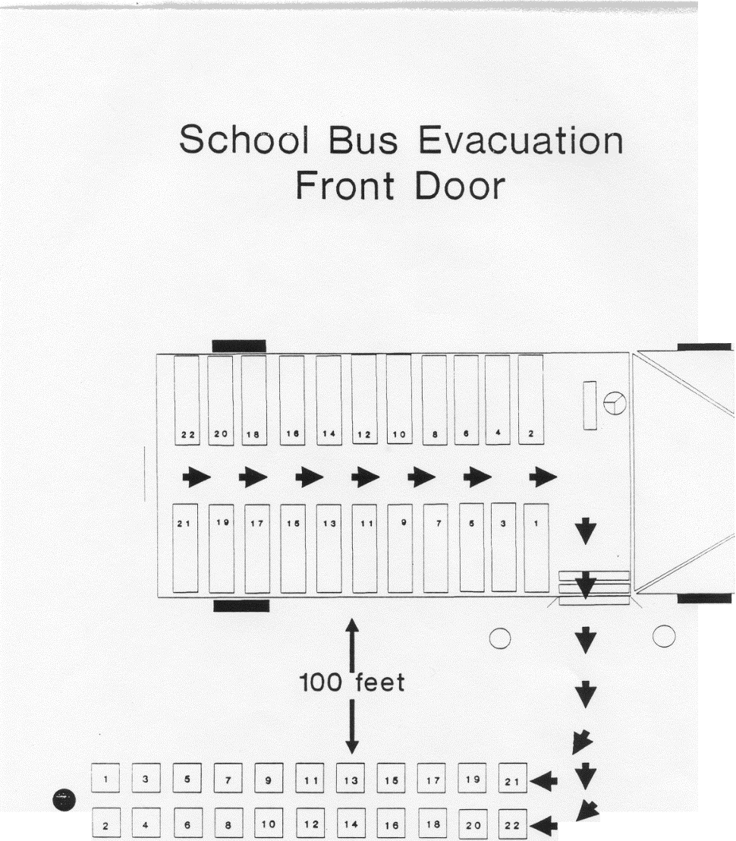
Accidents and Emergencies
Front Door Evacuation

Slide 17
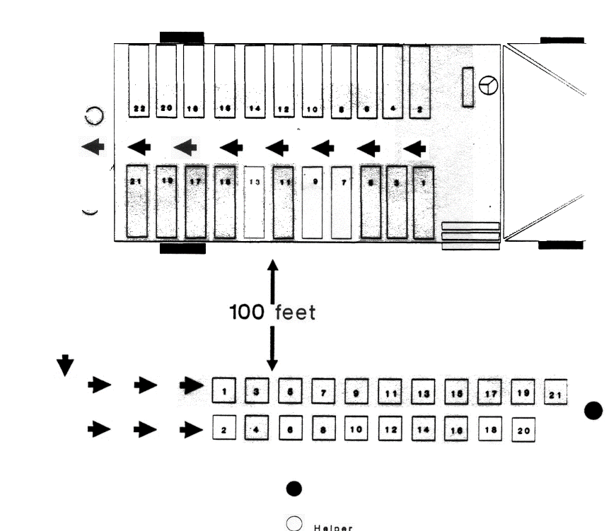
Accidents and Emergencies
Back Door Evacuation

Slide 18
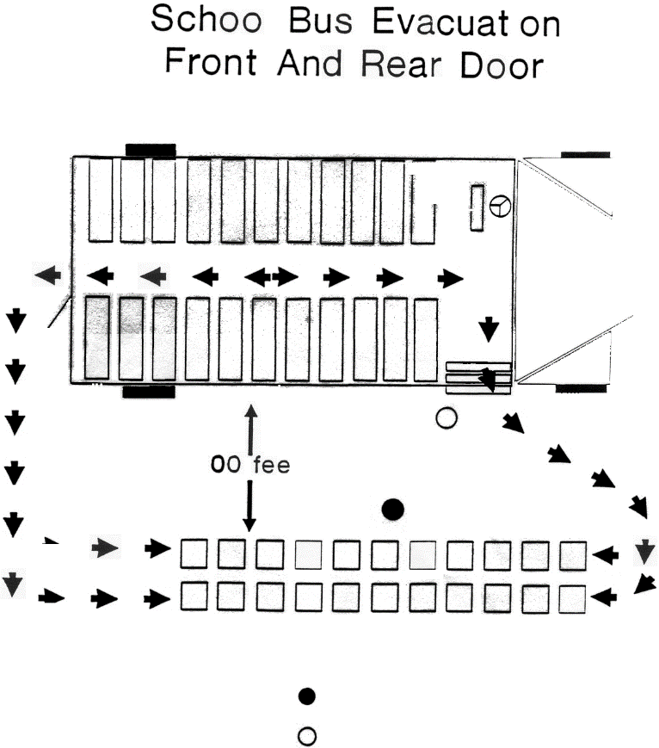
Accidents and Emergencies
Front Door and Back Door Evacuation

Slide 19



Connect with VDOE
Jackie.Johnson@doe.virginia.gov
Twitter: @VDOE_News
Facebook: @VDOENews
#VAis4Learners #EdEquityVA

