Slide 1
Unit 2:
Characteristics of Children with Special Needs

Slide 2
Characteristics or Stereotypes?
Children with disabilities are individuals
Stereotypes can limit our ability to predict children’s behavior

Slide 3
Autism Spectrum Disorder (ASD)
1 or 2 word directions, using a gentle, firm voice.
Distractions may help with unwanted behavior.
Storyboards can help.
Using a keyboard communication device can be an option.
Evacuation planning is essential.
Always pull the school bus over when safety is impacted.

Slide 4
Emotional Disturbance
Use names and learn their interests.
Don’t threaten or try to intimidate.
Enforce safety rules consistently and fairly.
Avoid taking it personally or getting trapped in a conflict spiral.
Learn non-verbal clues to anticipate and defuse and incident.
Structured daily routine helps.

Slide 5
Attention Deficit Disorder
Give clear and simple directions.
Repetition and consistency is important.
Keep children physically separated by assigning seats.
Activities may help distract a child.
Report worsening behavior, it could indicate a serious problem.

Slide 6
Hearing and Visual Impairments
Visual Impairments
  Degree of intervention needed varies.
    Independence is the goal.
    Deaf-Blind children are dependent on routine, may communicate by touch.
Hearing Impairments
  Learn and use basic signs and finger spelling.

Slide 7
Intellectual Disability
Consistency and routine are essential.
Children can be affectionate and enjoy relating to adults.
Speak simply and firmly.
Watch for patterns of things that can provoke a child.

Slide 8
Multiple Disabilities
Range and severity of disabilities vary greatly.
Children should be closely monitored during the bus ride.
Non-verbal communication may be necessary.
Positive attention can side track negative behaviors.

Slide 9
Speech or Language Impairment
Children may be targets of harassment of jokes.
Learn each child’s unique patterns of speech.
A child may say one thing and do another.
A child with a language impairment may also have a hearing impairment.

Slide 10
Other Health Impairments
Asthma – air quality on the school bus. Some children may carry an inhaler.
Hemophilia – priority seating.
Seizures and Epilepsy – seat assignment and light and temperature controls.
Diabetes – recognize low blood sugar signs. Some diabetic children carry glucose tablets.
Health impaired children must be monitored during the bus ride.

Slide 11
Specific Learning Disability
Establish trusting and respectful relationships.
May not require special transportation.
Driver sensitivity may defuse a potential behavior problem.
Be patient and understanding when giving verbal directions.

Slide 12
Traumatic Brain Injuries
Patience and compassion are essential.
Verbal communication can be limited.
Child was not born with disability may feel frustrated or angry.
Rehabilitation staff may have tips for safe transportation.

Slide 13
Orthopedic Impairment
A diverse population, ability to function independently varies.
Wheelchair loading and securement requires diligence.
Evacuation concern must be written into plan.
Occupational and physical therapists can be a good source of information for safe transportation.

Slide 14
Children who are Medically Fragile
Respiratory difficulties
Tracheostomy, gastrostomy
Colostomy, ileostomy
  Urostomy
    Ventilators
      Oxygen
        Oxygen lines, feeding tubes, and drain tubes must be checked often
Nasogastric tube
  DNR’s
    Suction devices
      Transporting medication
        Evacuation plan must be in place prior to transporting

Slide 15
Preschoolers with Special Needs
Neither compartmentalization nor lap seat belts are adequate for very young children on a school bus.
Children less than 50lbs must use and approved Child Safety Restraint System (CSRS)
Priority seating in the front of the bus.

Slide 16
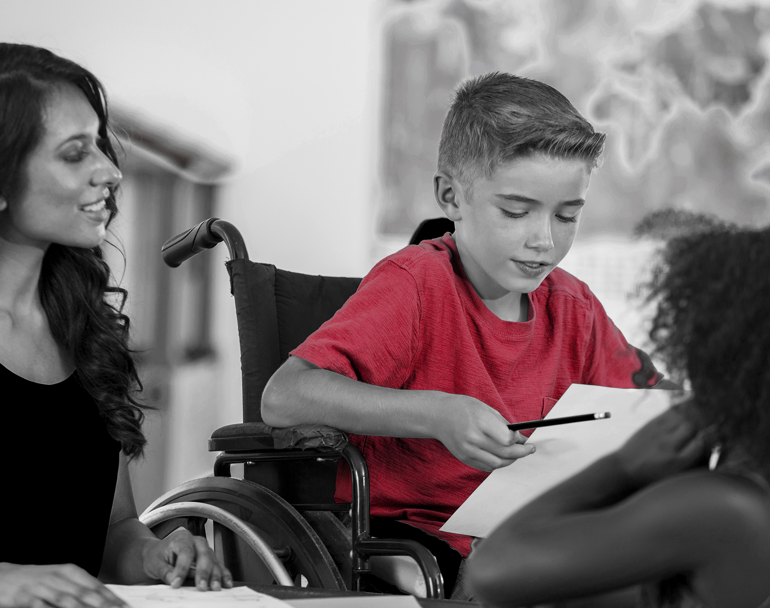
Unit 2 Review
Why is it important t treat children with disabilities as individuals?
What are the basic characteristics of each disability?
What special challenges can each type of disability present on a bus?
What’s the best strategy for safely transporting each type of child?

