Slide 1
Virtual Learning Professional Learning Series
Webinar 7: Virtual Learning in VA
Wednesday, February 22, 2023
3:00-4:00 p.m.

Slide 2
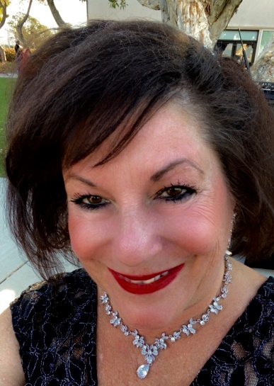




VDOE Virtual Learning Team
Dr. Meg Foley
meg.foley@doe.virginia.gov
(804) 786-0877
Coordinator of Virtual Learning
Reginald Fox
reginald.fox@doe.virginia.gov
(804) 371-5663
Virtual Learning Specialist
Twitter: @VDOE_News
Facebook: @VDOENews

Slide 3
Virtual Learning in Virginia
To provide school divisions, schools, staff, and stakeholders with information related to virtual learning in Virginia with emphasis on policies, procedures, professional development, and implementation of virtual programs.

Slide 4
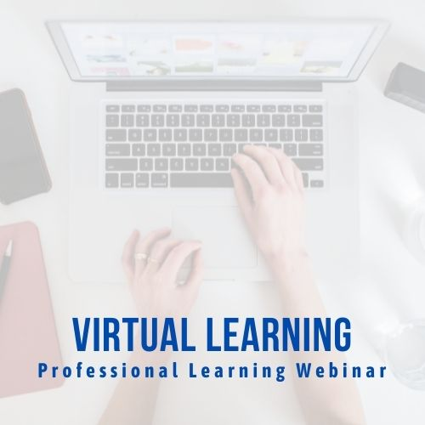
Agenda
  Welcome
  VDOE New Website
  Guest Presenter: National Standards for Online Courses, Teachers, & Programs
    by Christine Voelker, Director, K-12 Program,
    Quality Matters
  What’s Coming?

Slide 5
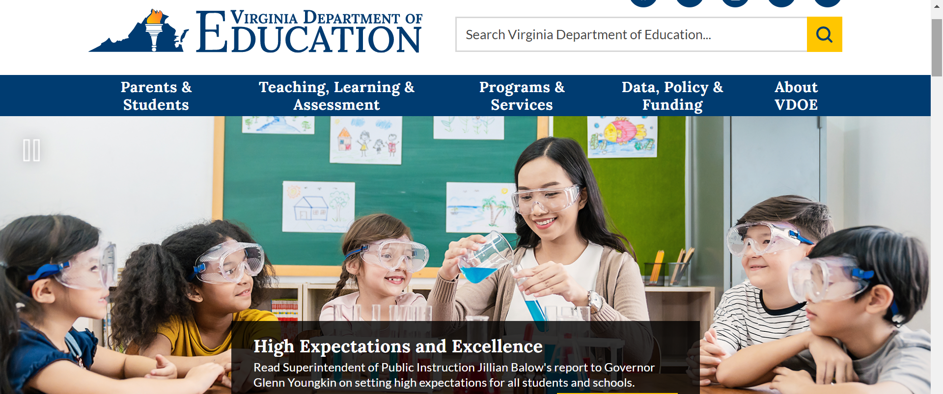
VDOE Launches a New Website
https://www.doe.virginia.gov/
Notes:
Reggie & Meg

Slide 6
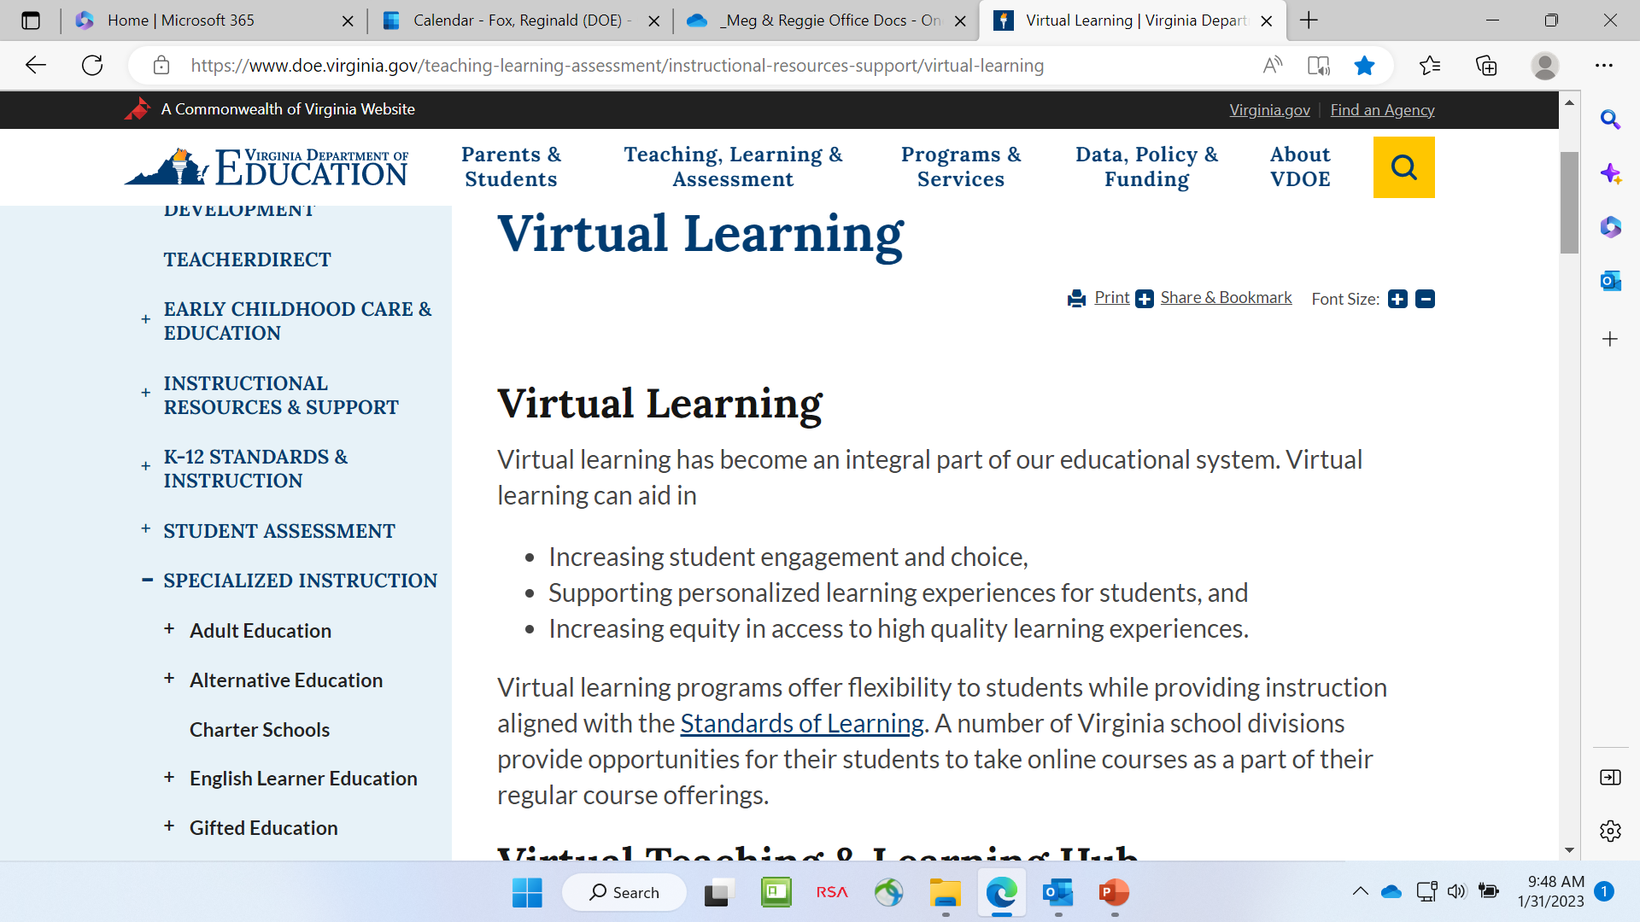
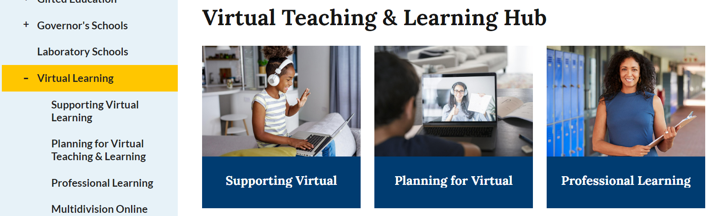
https://www.doe.virginia.gov/instruction/virtual_learning/index.shtml
Notes:
Reggie & Meg

Slide 7
National Standards for Online Courses, Teaching, & Programs
Guest Presenter:
Christine Voelker, Director, K-12 Program
Quality Matters

Slide 8
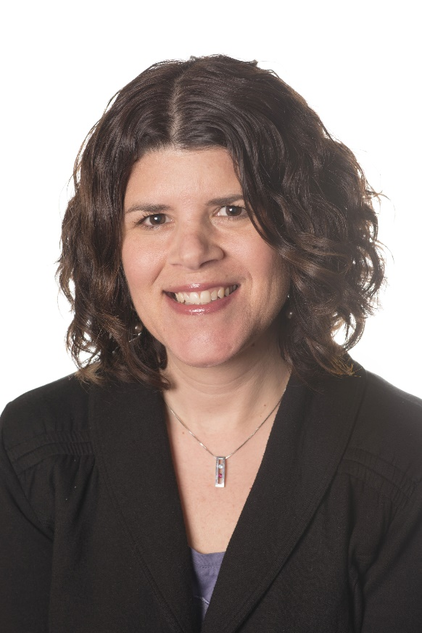
Christine Voelker
Christine Voelker is the K-12 Program Director for Quality Matters, a global non-profit dedicated to quality assurance in online and innovative digital teaching and learning environments. QM provides a scalable quality assurance system for online and blended learning used within and across organizations grounded in research and driven by best practices. Christine is also one of the Program Managers for the National Standards for Quality Online Learning. She has been involved with K-12 education for over 20 years, with an emphasis on distance learning, library media, instructional technology, and professional development. Before Quality Matters, Christine ran a statewide partnership grant in Maryland. During this time, she also served as an Educational Technology Teacher Specialist for her home district, where she developed and coordinated the first student online learning program. She holds an advanced certificate in Administration and Supervision, a Master in Library and Information Sciences, and a B.A. in both History and Social Sciences Interdisciplinary: Early Childhood Education.

Slide 9


How are your programs integrating the national standards?

Slide 10


The National Standards for Quality Online Learning
Courses * Programs * Teaching
VDOE Virtual Learning PL Webinar 7
Wednesday , February 22, 2023

Slide 11


Welcome & Introductions
Christine Voelker, K-12 Program Director, Quality Matters (QM) cvoelker@qualitymatters.org
2023
www.nsqol.org #NSQ
Notes:
Chris: Hi everyone. Thanks for having us join you remotely. My name is Christine Voelker, and I am the K-12 Program Director for the non-profit organization, Quality Matters, or QM. QM works with schools and districts to provide them with Quality Assurance Tools and processes. We also certify online and blended courses through rigorous course review.
Cindy: And I’m Cindy Hamblin, Director of the Virtual Learning Leadership Alliance, or VLLA. The VLLA is also a nonprofit an association . Our membership includes a number of innovative virtual programs in the U.S. Consisting largely of state virtual schools and several consortia, our member organizations serve over a quarter of a million online course enrollments annually. Our mission is to strengthen online learning through leadership, advocacy, expertise, and professional relationships.
Chris and I are very happy to have this chance to share the work that has been completed to update The National Standards for Quality Online Courses, Programs, and Teaching
Chris: Yes, and today, we want to share a little about the background and history of the standards, as well as the process that the community participated in to revise and release these new sets.

Slide 12
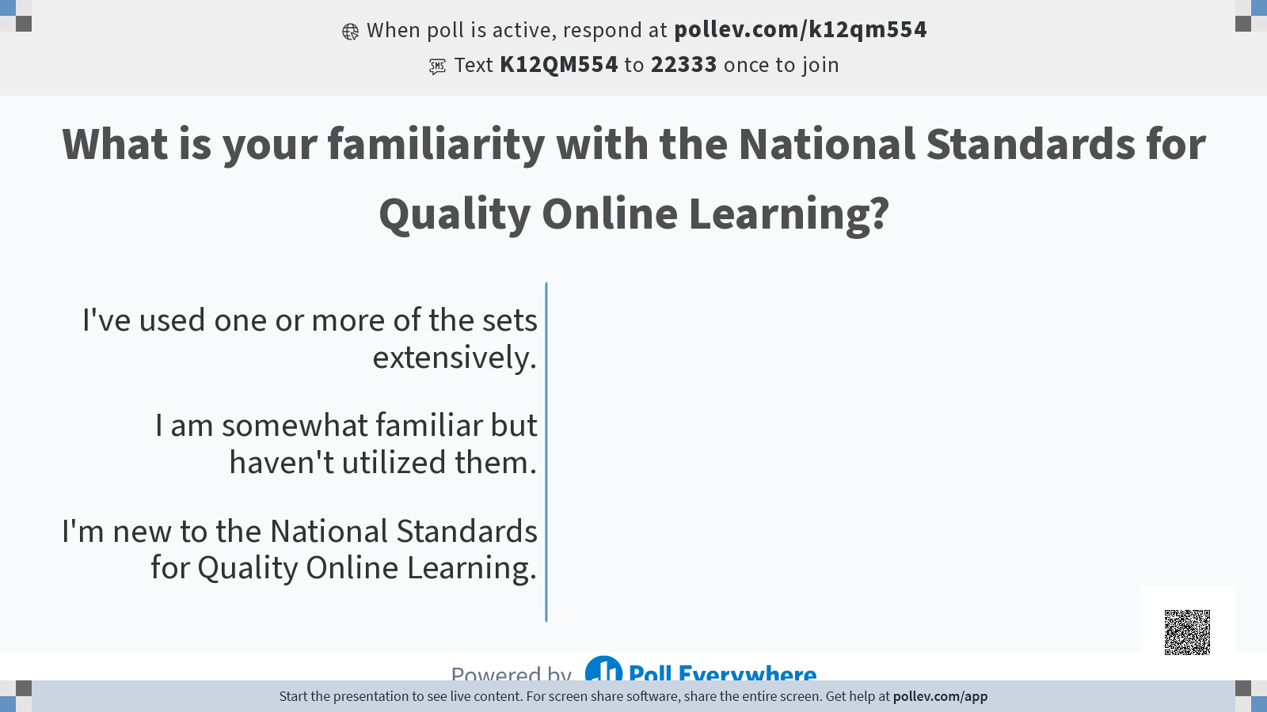

Slide 13


Partners
@cindyhamblin10
@voelkerc
www.nsqol.org #NSQ
www.nsqol.org #NSQ
2020
www.nsqol.org #NSQ
2021
2023

Slide 14
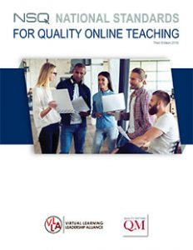


3 Sets of Standards
@cindyhamblin10
@voelkerc
www.nsqol.org #NSQ
2020
www.nsqol.org #NSQ
2023

Slide 15
The National Standards are...
Research-supported standards for quality online courses, programs, and teaching
Flexible to meet unique institutional situations and need
Continuously revised to keep the standards relevant
Revised and updated by online learning researchers and practitioners
Recommended for use in development, evaluation, and continuous improvement
@cindyhamblin10
@voelkerc
www.nsqol.org #NSQ
www.nsqol.org #NSQ
2020
www.nsqol.org #NSQ
2021
2023
Notes:
Cindy: So, based on these guidelines, what you see are standards that are:
Research-supported - Literature review was prepared as a first step for all three standard sets
Flexible, allowing unique organization to implement the standards based on their practices.
Revised and updated on a set schedule by researchers and practitioners in the field of online learning. The revision cycle planned will keep the indicators fresh and current..
And recommended for use in development, evaluation, and continuous improvement of online programs, online teaching, and online courses

Slide 16

NSQOL.ORG
@cindyhamblin10
@voelkerc
@cindyhamblin10
@voelkerc
www.nsqol.org #NSQ
www.nsqol.org #NSQ
2019
www.nsqol.org #NSQ
2020
2023
Notes:
Participants: Access the website to the standards
The NSQ Online Teaching document can be downloaded in its entirety as well as viewed online by standard . The website is www.nsqol (NSQ on line . org.
Today both the NSQ Online Teaching and Programs are available to download. The NSQ Online Courses will be released in early October and will be available to download and view at that time.
The RESOURCES section located on the menu bar is extremely helpful for individuals wanting to view the research supporting the standards. The Literature Reviews used by each revision team working on the standards have been uploaded and made available to all.r
Leaders charged with transitioning from the old iNACOL edition of the standards to the new updated edition will find a helpful Change document that details each change made when revising the standards and indicators.
We will talk more able the NSQ website later in this presentation.

Slide 17
The National Standards for Quality Online Teaching
@cindyhamblin10
@voelkerc
@cindyhamblin10
@voelkerc
www.nsqol.org #NSQ
www.nsqol.org #NSQ
2019
www.nsqol.org #NSQ
2020
2023
Notes:
Cindy The first standard set we will showcase for you today is the National Standards for Quality Online Teaching, last updated in 2011.

Slide 18
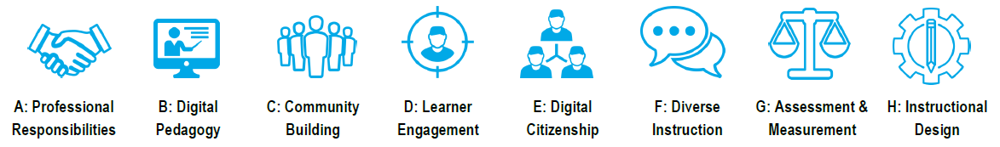
8 Standards identified for Quality Online Teaching
@cindyhamblin10
@voelkerc
@cindyhamblin10
@voelkerc
www.nsqol.org #NSQ
www.nsqol.org #NSQ
2019
www.nsqol.org #NSQ
2020
2023
Notes:
Cindy Let’s take a closer look at the 8 Quality Online Teaching standards. The standards include:
Professional Responsibilities with 9 supporting indicators
Digital Pedagogy with 5 indicators
Community Building with 5 indicators
Learning Engagement with 7 indicators
DIgital Citizenship with 4 indicators
Diverse Instruction with 7 indicators
Assessment and Measurement with 8 indicators
And an 8th standard of Instructional Design with 6 indicators. This standard is considered optional due to the fact that instructional design does not always fall under online teaching responsibilities.

Slide 19
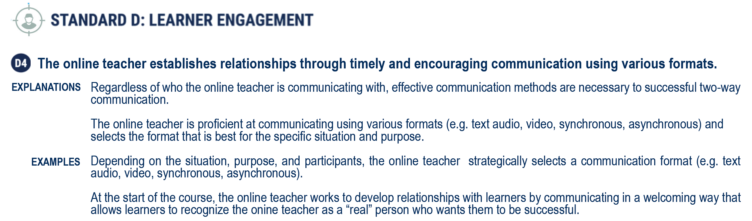
Standard Example
@cindyhamblin10
@voelkerc
@cindyhamblin10
@voelkerc
www.nsqol.org #NSQ
www.nsqol.org #NSQ
2019
www.nsqol.org #NSQ
2020
2023
Notes:
CindyThis slide provides an example of one of the indicators from Standard D, Learner Engagement.
The indicator - - “The online teacher establishes relationships through timely and encouraging communication using various formats.” - - is clearly labeled as D4 (4th indicator within the Learner Engagement standard. .
Each indicator is followed with an a more detailed explanation of the indicator as well as examples of what the indicator would look like in practice.
The same structure is used for each indicators within all three standard sets - teaching, programs and courses

Slide 20
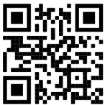
Today’s Handout/Digital Worksheet:
https://bit.ly/NSQinView
@cindyhamblin10
@voelkerc
@cindyhamblin10
@voelkerc
www.nsqol.org #NSQ
www.nsqol.org #NSQ
2019
www.nsqol.org #NSQ
2020
2023
Notes:
Chris
Question posed to the entire group - Create Mentimeter to capture characteristics of Quality Online Teacher
Show on the screen

Slide 21

www.nsqol.org #NSQ
What would you consider important characteristics of a Quality Online Teacher?
@cindyhamblin10
@voelkerc
@cindyhamblin10
@voelkerc
www.nsqol.org #NSQ
2019
www.nsqol.org #NSQ
2020
2023
Notes:
We hear things like “has to be a good community builder,” “able to facilitate and encourage engagement.” capable of personalizing the instruction.

Slide 22
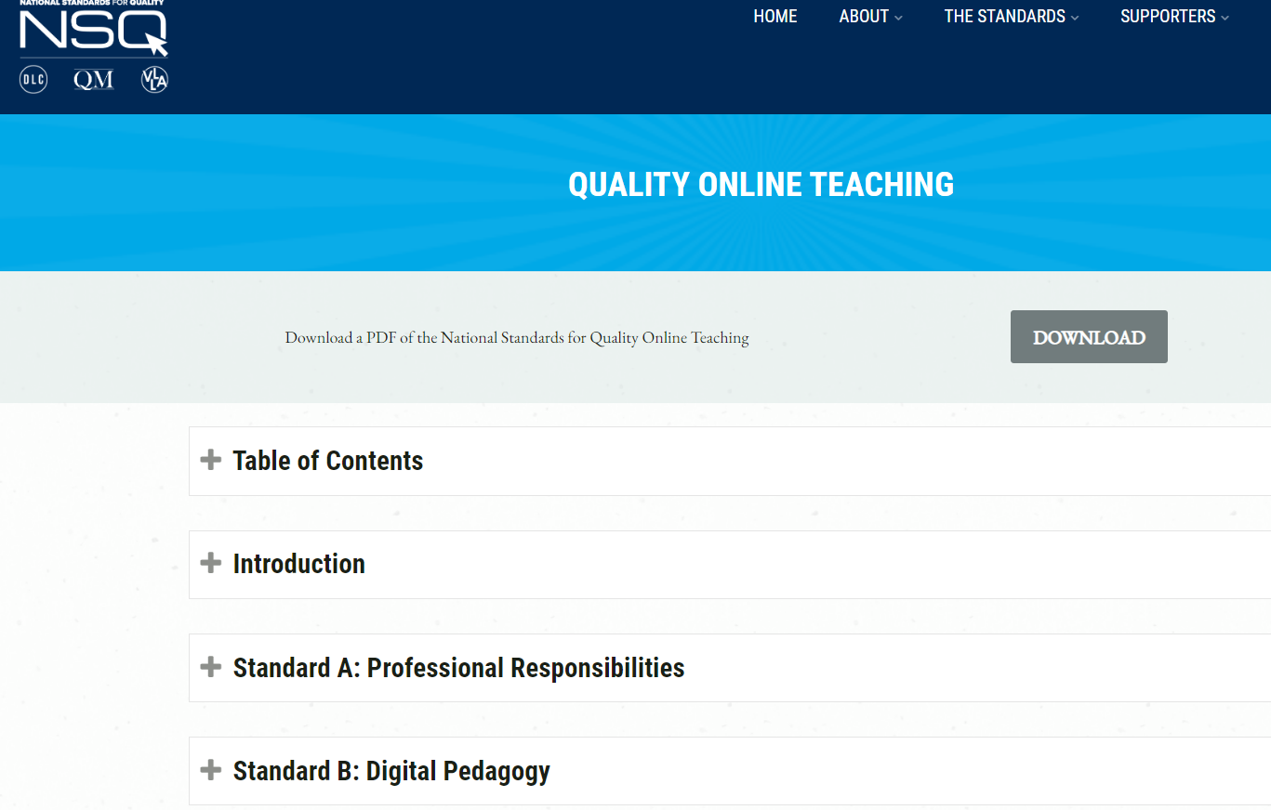
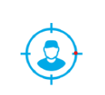
Standard D: Learner Engagement
@cindyhamblin10
@voelkerc
@cindyhamblin10
@voelkerc
www.nsqol.org #NSQ
www.nsqol.org #NSQ
2019
www.nsqol.org #NSQ
2020
2023
Notes:
TIME: 5-7 minutes
Report out by table, one new idea or takeaway after viewing the indicators

Slide 23
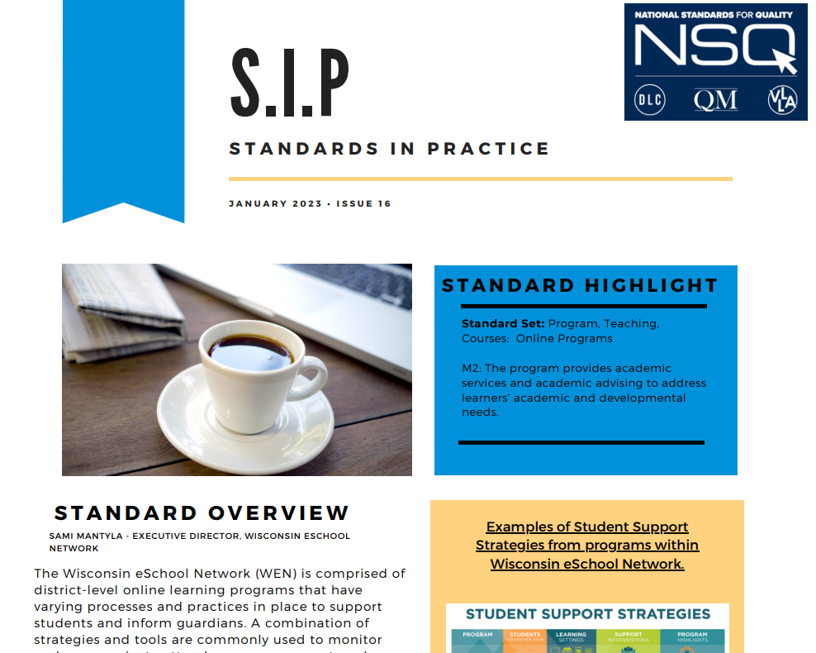
Standards in Practice
@cindyhamblin10
@voelkerc
@cindyhamblin10
@voelkerc
www.nsqol.org #NSQ
www.nsqol.org #NSQ
2019
www.nsqol.org #NSQ
2020
2023
Notes:
We are continually adding resources to help you implement the standards.

Slide 24
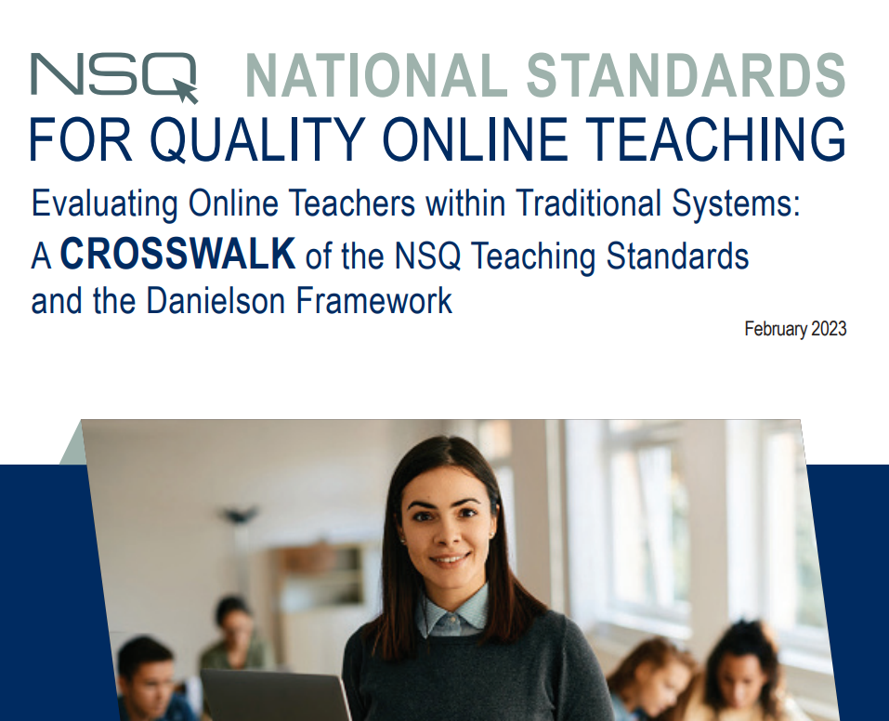
Danielson Crosswalk
@cindyhamblin10
@voelkerc
@cindyhamblin10
@voelkerc
www.nsqol.org #NSQ
www.nsqol.org #NSQ
2019
www.nsqol.org #NSQ
2020
2023

Slide 25
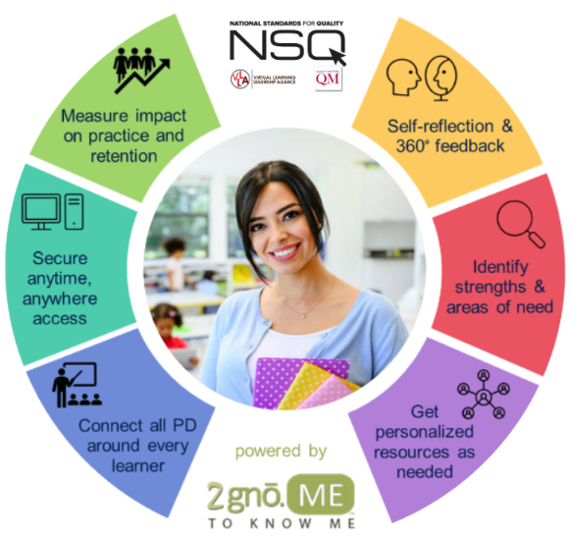
Professional Learning Portal
https://nsq.2gno.me/
Self-Assessment
Vetted Professional Learning Opportunities based on need
2023
www.nsqol.org #NSQ
Notes:
Chris

Slide 26

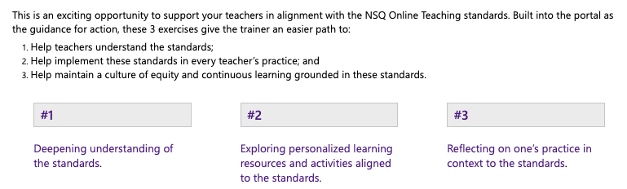
Roadmap for Putting the NSQ Online Teaching Standards into Action
https://nsq.2gno.me/nsq/online-teaching/roadmap/
2023
www.nsqol.org #NSQ
Notes:
Chris
Links to the resources on the Resources Webinar site - Demo

Slide 27

Roadmap for Rolling out the NSQ
Introduction to the NSQ
Compare NSQ with Virginia standards
Explore the NSQ
Administrative Processes
Crosswalk existing evaluation and NSQ
Revise evaluation documents
Implement new evaluation instrument
Alignment of Practices
Align walkthrough documents with NSQ
Align PLCs and PL activities with NSQ
Notes:
Virtual VA

Slide 28
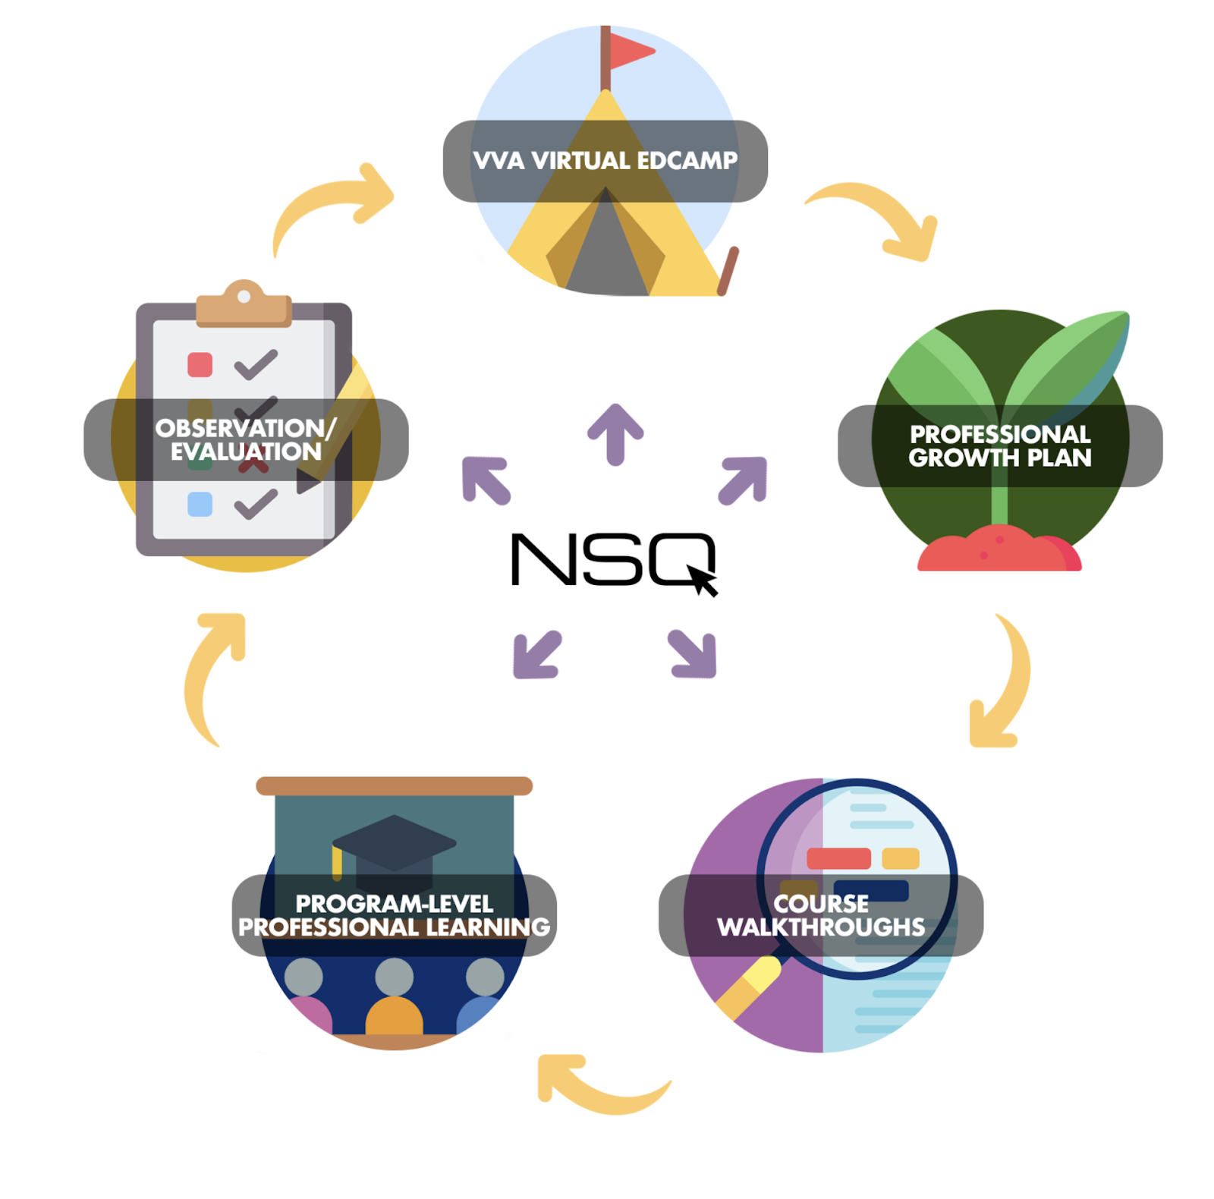
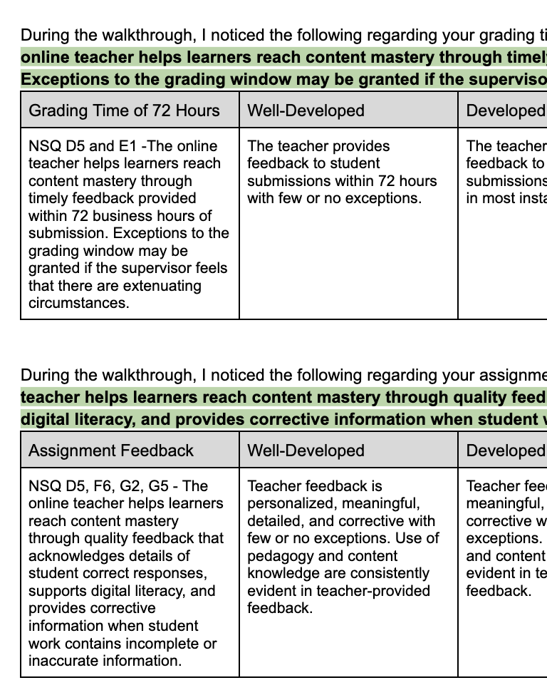
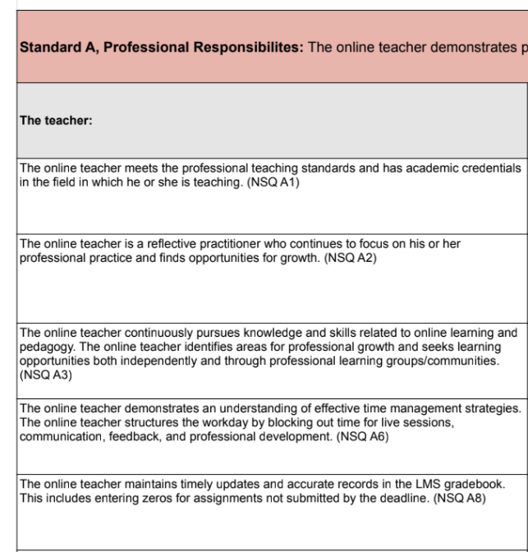
VVA Professional Learning & Evaluation Cycle
Images: Designs using icons from Sweetline Graphic, Freepik, Smashicons, Uniconlabs, and Creative Stall Premium

Slide 29
Next Steps
What is a first step you could take to introducing the NSQ to your staff?
@cindyhamblin10
@voelkerc
@cindyhamblin10
@voelkerc
www.nsqol.org #NSQ
www.nsqol.org #NSQ
2019
www.nsqol.org #NSQ
2020
2023

Slide 30
The National Standards for Quality Online Courses
@cindyhamblin10
@voelkerc
www.nsqol.org #NSQ
2020
www.nsqol.org #NSQ
2022

Slide 31
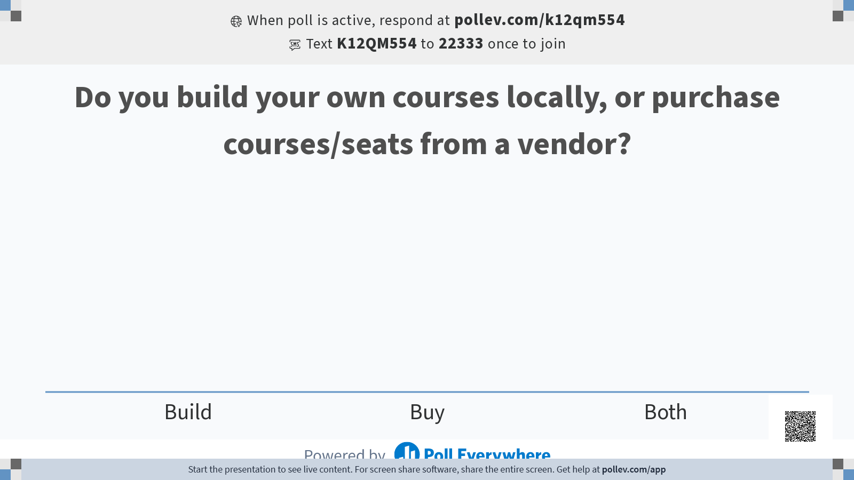
Notes:
Whether we build or buy our courses, we need to consider a lot of things.
Table 1: When developing an online course, what considerations need to be made to ensure access for all learners?
Table 2: What steps should be taken to make sure all students are setup for success?
Table 3: What course design considerations are needed to ensure the students achieve the academic goals?
The NSQ Course Standards can help us understand those considerations.

Slide 32







www.nsqol.org #NSQ
7 Standards identified for Quality Online Courses
Course Overview & Support
Content
Instructional Design
Learner Assessment
Accessibility & Usability
Course Evaluation
Technology
@cindyhamblin10
@voelkerc
2020
www.nsqol.org #NSQ
2022
Notes:
Point to change document on the website

Slide 33
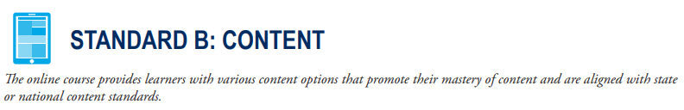
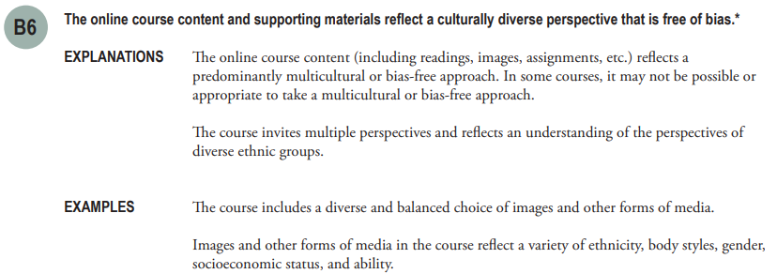
Standard Example
@cindyhamblin10
@voelkerc
www.nsqol.org #NSQ
2020
www.nsqol.org #NSQ
2023
Notes:
Chris: Instead, you will now see the Standards and Indicators presented as shown on your screen.
The measurable indicator is labeled as B6 and followed by an explanation and example. You might notice that the indicator itself in this particular example has an asterisks at the end. The asterisks indicates that this is an indicator that directly correlates to a Specific Review Standard in the QM K-12 Rubric, Fifth Edition. In some cases, it is the indicator itself and sometimes this reflects that the text in the Explanations and/or Examples come from the QM K-12 Rubric’s Annotations. The exact correlation will be available in the resources section of the NSQ website and also the QM Website once the new standards are released.. The National Standards for Quality Online Courses works in tandem with the QM K-12 Rubric. The QM K-12 Rubric has additional Annotations which expand the Explanations and Examples and provide guidance for reviewing an online course. More information about course reviews can be found on the Quality Matters website.

Slide 34

@cindyhamblin10
@voelkerc
www.nsqol.org #NSQ
2020
www.nsqol.org #NSQ
2023
Notes:
Chris: Instead, you will now see the Standards and Indicators presented as shown on your screen.
The measurable indicator is labeled as B6 and followed by an explanation and example. You might notice that the indicator itself in this particular example has an asterisks at the end. The asterisks indicates that this is an indicator that directly correlates to a Specific Review Standard in the QM K-12 Rubric, Fifth Edition. In some cases, it is the indicator itself and sometimes this reflects that the text in the Explanations and/or Examples come from the QM K-12 Rubric’s Annotations. The exact correlation will be available in the resources section of the NSQ website and also the QM Website once the new standards are released.. The National Standards for Quality Online Courses works in tandem with the QM K-12 Rubric. The QM K-12 Rubric has additional Annotations which expand the Explanations and Examples and provide guidance for reviewing an online course. More information about course reviews can be found on the Quality Matters website.

Slide 35
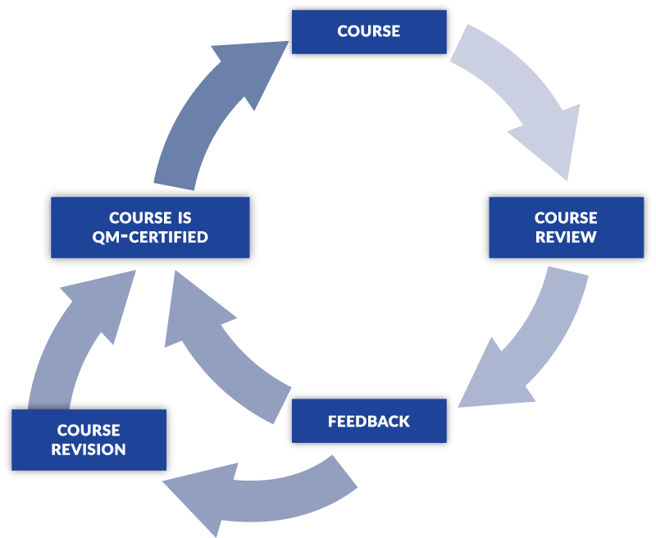
More Than A Checklist
@cindyhamblin10
@voelkerc
www.nsqol.org #NSQ
2020
www.nsqol.org #NSQ
2023

Slide 36


Official Course Certification
@cindyhamblin10
@voelkerc
www.nsqol.org #NSQ
2020
www.nsqol.org #NSQ
2023

Slide 37
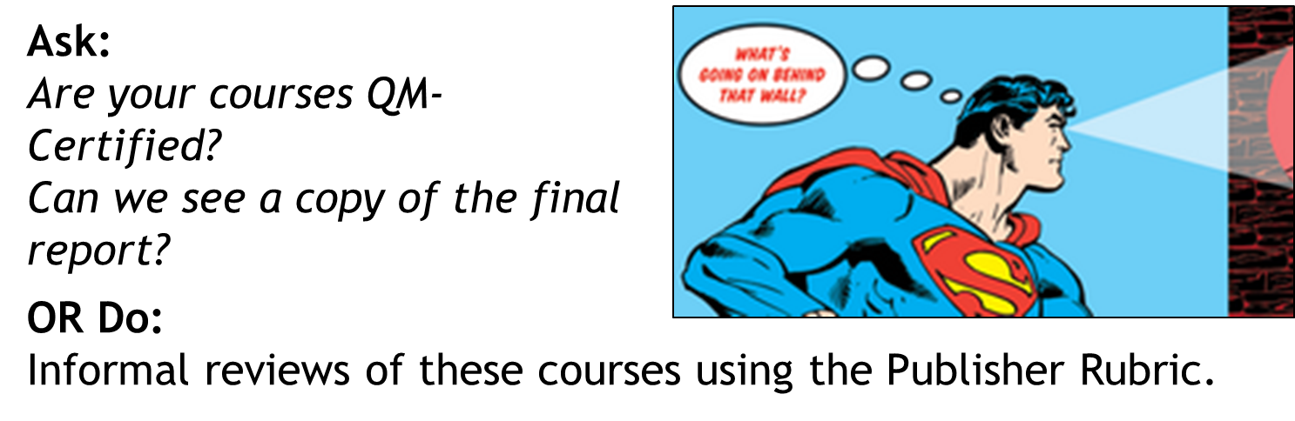
Third-Party Courses
@cindyhamblin10
@voelkerc
www.nsqol.org #NSQ
2020
www.nsqol.org #NSQ
2023

Slide 38
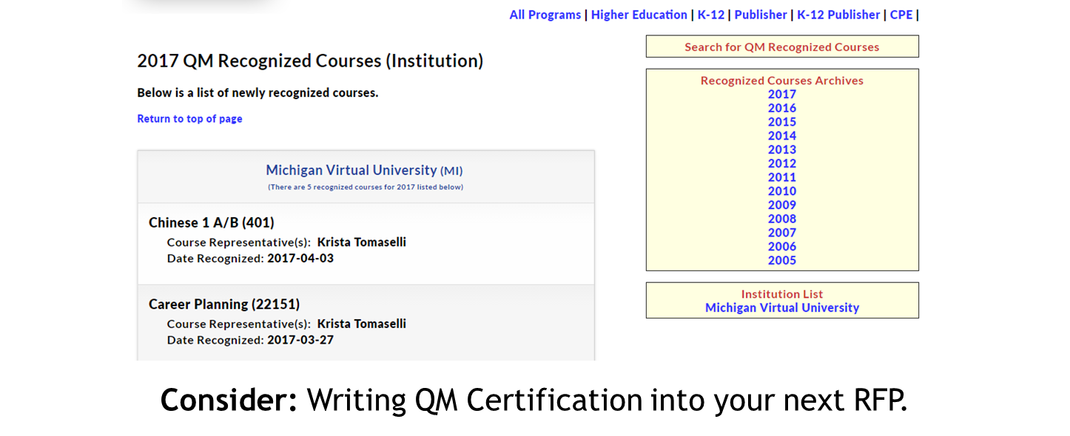
Third-Party Courses
@cindyhamblin10
@voelkerc
www.nsqol.org #NSQ
2020
www.nsqol.org #NSQ
2023

Slide 39
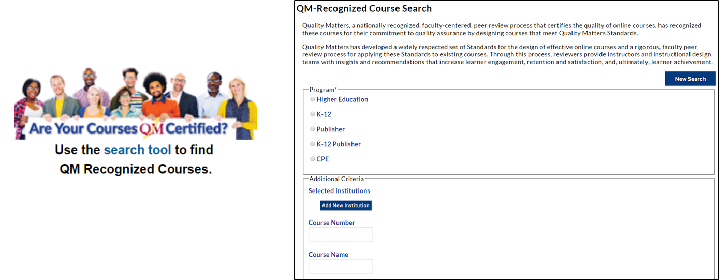
Certified Course Search Tool
@cindyhamblin10
@voelkerc
www.nsqol.org #NSQ
2020
www.nsqol.org #NSQ
2023

Slide 40
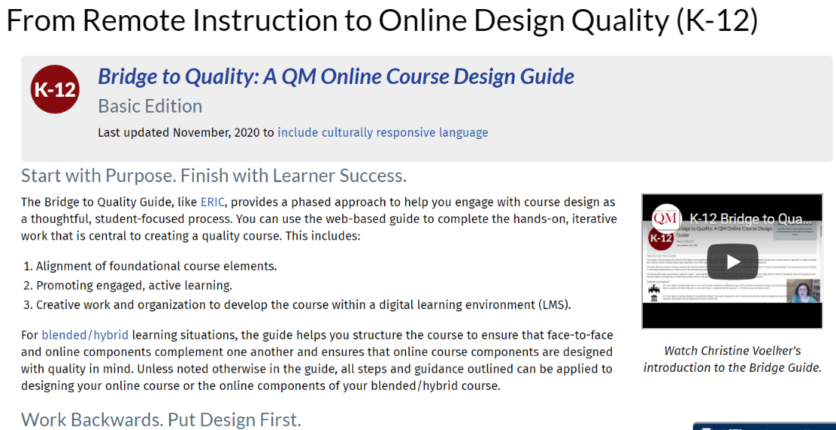
Resources to Support Implementation
Quality Matters Memberships & Course Reviews
Bridge to Quality Course Design Guide
https://www.qualitymatters.org/bridge
@cindyhamblin10
@voelkerc
@cindyhamblin10
@voelkerc
www.nsqol.org #NSQ
www.nsqol.org #NSQ
2019
www.nsqol.org #NSQ
2020
2023

Slide 41
Apply
What are the next steps?
What will be your next step in exploring and/or utilizing the NSQ Course Standards (for yourself or with your faculty)?
@cindyhamblin10
@voelkerc
www.nsqol.org #NSQ
2020
www.nsqol.org #NSQ
2022

Slide 42
Next Steps
What will be your next step in exploring and/or utilizing the NSQ Course Standards (for yourself or with your faculty)?
@cindyhamblin10
@voelkerc
@cindyhamblin10
@voelkerc
www.nsqol.org #NSQ
www.nsqol.org #NSQ
2019
www.nsqol.org #NSQ
2020
2023

Slide 43
The National Standards for Quality Online Programs
@cindyhamblin10
@voelkerc
@cindyhamblin10
@voelkerc
www.nsqol.org #NSQ
www.nsqol.org #NSQ
2019
www.nsqol.org #NSQ
2020
2022
Notes:
Cindy - The next standard set updated and released in March was the National Standards for Quality Programs. This standard set was last updated in 2009.

Slide 44
Framework for a Quality Online Program
If your district is designing a new online school (or reflect back if the school is established), what is an essential consideration?
@cindyhamblin10
@voelkerc
@cindyhamblin10
@voelkerc
www.nsqol.org #NSQ
www.nsqol.org #NSQ
2019
www.nsqol.org #NSQ
2020
2023
Notes:
Chris
BEFORE I share the standards and indicators that makeup the Online Program standard set, we’d like to get your initial thoughts on one possible scenarios.
Read slide
Please add your thoughts to the chat! (30-1 minute)

Slide 45
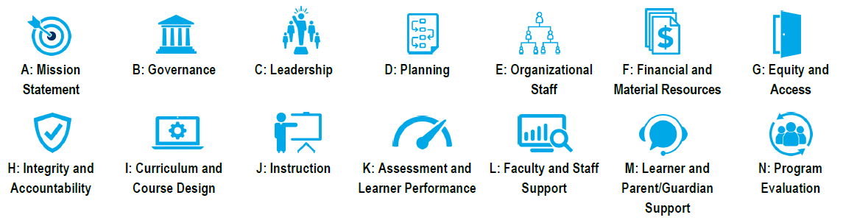
www.nsqol.org #NSQ
14 Standards identified for Quality Online Programs
@cindyhamblin10
@voelkerc
2020
www.nsqol.org #NSQ
2023

Slide 46
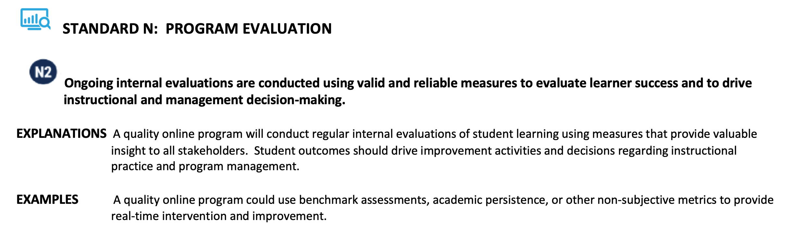
Standard Example
@cindyhamblin10
@voelkerc
www.nsqol.org #NSQ
2020
www.nsqol.org #NSQ
2023

Slide 47

Resources to Support Implementation
Online Program Toolkit, Michigan Virtual
Planning for Quality Guide, Evergreen Education Group
Planning for Quality: A Guide for Continuous Improvement of Digital Learning Program, Digital Learning Collaborative
How to Start an Online Learning Program: A Practical Guide to Key Issues and Policies, iNACOL/Aurora Institute
@cindyhamblin10
@voelkerc
@cindyhamblin10
@voelkerc
www.nsqol.org #NSQ
www.nsqol.org #NSQ
2019
www.nsqol.org #NSQ
2020
2023

Slide 48

@cindyhamblin10
@voelkerc
@cindyhamblin10
@voelkerc
www.nsqol.org #NSQ
www.nsqol.org #NSQ
2019
www.nsqol.org #NSQ
2020
2023
Notes:
TIME:
Michigan Virtual

Slide 49
Next Steps
What will be your next step in exploring and/or utilizing the NSQ Program Standards?
@cindyhamblin10
@voelkerc
@cindyhamblin10
@voelkerc
www.nsqol.org #NSQ
www.nsqol.org #NSQ
2019
www.nsqol.org #NSQ
2020
2023

Slide 50
Support the Standards!
@cindyhamblin10
@voelkerc
www.nsqol.org #NSQ
2020
www.nsqol.org #NSQ
2023

Slide 51

Before you leave...
Today I learned _____________ about the #NSQ…. @vllaonline, @qmprogram, @theDLCedu
NSQ
@qmprogram @vllaonline @theDLCedu
@cindyhamblin10
@voelkerc
www.nsqol.org #NSQ
2020
www.nsqol.org #NSQ
2023
Notes:
Create a tweet that the can send out before they leave

Slide 52

Christine Voelker, QM cvoelker@qualitymatters.org
@voelkerc
@cindyhamblin10
@voelkerc
www.nsqol.org #NSQ
2020
www.nsqol.org #NSQ
2023

Slide 53

What’s coming?

Slide 54
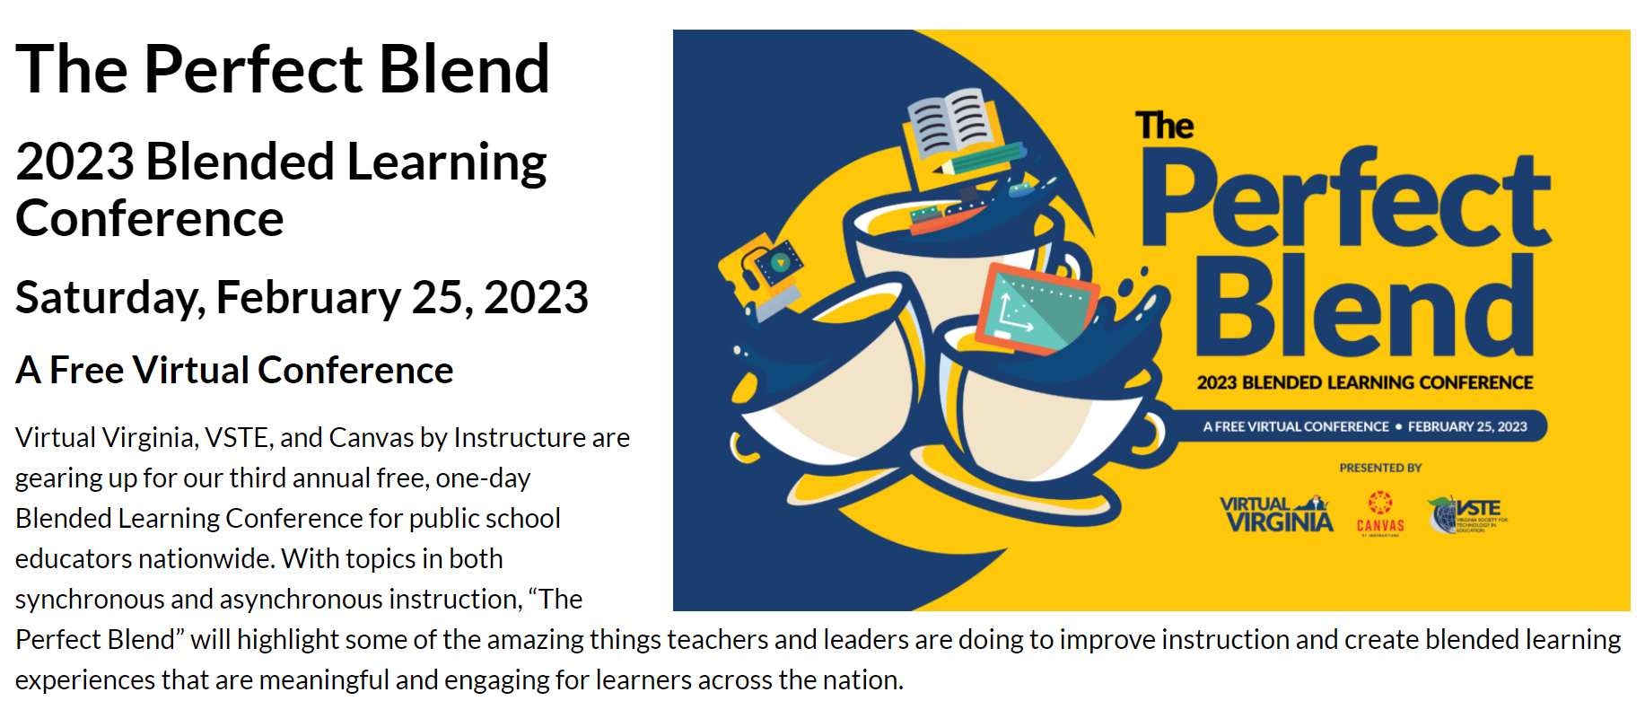
https://virtualvirginia.org/pl/blend23/

Slide 55

Webinar 8: Final Reporting (MOP)
Webinar will be scheduled in late April.
Communications will be forthcoming.
Information will be shared about Monitoring Reports, surveys, MOP renewals, and deadlines.

Slide 56
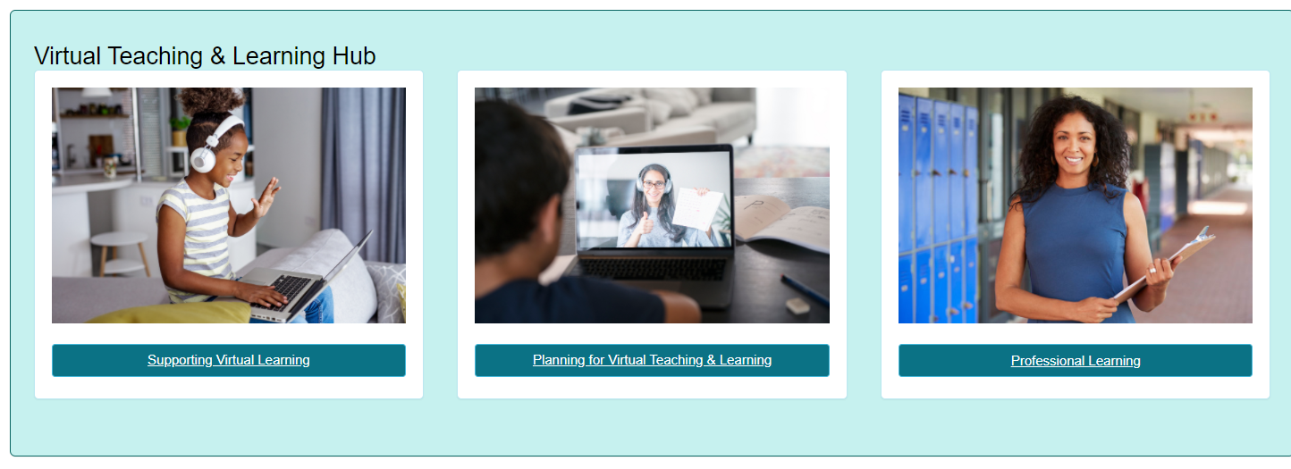
Thank you for participating!
Additional information may be found at Virtual Learning Professional Learning website.
VDOE Virtual Learning HUB
Dr. Meg Foley
meg.foley@doe.virginia.gov
(804) 786-0877
Coordinator of Virtual Learning
Reginald Fox
reginald.fox@doe.virginia.gov
(804) 371-5663
Virtual Learning Specialist

