Slide 1
Student Behavior and Administrative Response Data Collection
2022-2023 Mid-Year Review

Slide 2
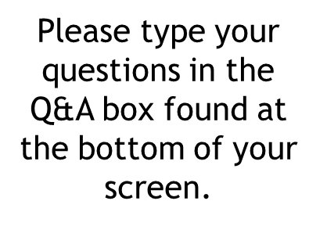


WEBINAR PARTICIPATION
This presentation will be available to participants once all webinars have been completed

Slide 3
A
AGENDA
Data Collection Overview
EOY Updates
2023-2024 School Year Updates
SBAR Resources
Questions

Slide 4
SBAR Data Collection Governance
Required by the Code of Virginia (§22.1-279.3:1) and used to satisfy federal assurances for ESSA, the Gun-Free Schools Act of 1994, and the Individuals with Disabilities Education Act (IDEA)
  Replaced the Discipline, Crime, and Violence Collection (DCV) in 2021-2022
  SBAR enables reporting of all administrative responses (behavioral interventions, instructional supports, and disciplinary sanctions) to student behaviors that occurred
    On school property, a school bus, or at a school-sponsored activity
    OR, occurred in the community with in charges filed and an administrative response from the school that resulted in the student being alternatively placed
  Allows VDOE to identify inequities in disciplinary outcomes, exclusionary practices, and school safety issues

Slide 5
File Submissions
Pre-Submission Window
  Currently open until July 4th
  The Pre-submission window allows school divisions and regional programs to continue to review data, upload files, troubleshoot fatal errors, and prepare for EOY SBAR which will open on July 5, 2023
End of Year (EOY) SBAR Window
  July 5 – EOY SBAR Window Opens
  July 28 – EOY SBAR Successful Submission Due
  August 11 – EOY Final Verification Due
    Division Superintendents and Program Directors verification and signatures are required
Notes:
Pre-submission SBAR Window - The Pre-submission window opens after the completion of Preliminary SBAR Submission and after the completion of all EOY SBAR Submissions. It allows school divisions and regional centers/programs to continue to review data, upload files, troubleshoot fatal errors, and prepare for the next SBAR data submission.

Slide 6
File Submissions Are Required
Data Reporting Guidelines
  Report the events that occur in:
    your Local Education Agency (LEA)
    private schools for special education placements, for whom your LEA is responsible, when the administrative response results in a suspension, expulsion or report to law enforcement
    the public regional programs to the students for whom your LEA is responsible
      regional programs must report your own data files; meaning that your data should not be included with the school division files

Slide 7
Regional Center Exemptions from Reporting
Does the regional program/center have a separate physical/virtual location from the student’s responsible school?
  If yes, then SBAR is required because there could be behavioral interventions and instructional supports provided by the center that are unknown to the responsible division
    VDOE is aware that the student’s responsible school determines disciplinary sanctions

Slide 8
Process for Requesting an Exemption
Answer Question 1.
Explain why your regional school/program should be exempted from submitting SBAR Data.
Specify the school where the program is housed and its location.
Indicate who is participating in the program and if the program has separate staff from the responsible school.
Email all answers to the exemption question and details to ResultsHelp@doe.virginia.gov .
*Note- this process will be available via SSWS in the Education Registry Application (ERA) in July.
Notes:
Unless there is an approved exemption on file, VDOE requires each regional center/program to submit SBAR data. To request an exemption, please complete 1 – 5. Once the information is received, it will be reviewed by our office and determine whether your Regional Center/Program is exempt from submitting SBAR data. Please email responses to exemption questions and justification to resultshelp@doe.virginia.gov. VDOE will review the request and contact you once a decision has been made.
When the window opens for ERA in July, Regional Programs will be able enter your Exemption Request in SSWS, however, until then all questions must be answered and emailed to ResultsHelp.

Slide 9
EOY Updates

Slide 10
New Edit
A new edit has been added to prevent divisions from reporting duplicate data.
The edit looks for an event with the same Local Event Id, State Testing Id, Behavior Code and Enrolled School has already been reported.
    Criticality Status: FATAL
Examples of duplicated data:
Example 1: When an event occurs at a regional program, the data should be submitted by the regional program. The data should not be included in the division’s file.
Example 2: Multiple divisions should not be reporting the same student and event. There are instances where the same event could involve students from multiple school divisions where the home schools' administrators respond, and that would require the divisions to contact VDOE to receive an assigned event id

Slide 11
Using Suspension Sanctions
Disciplinary Sanction Code | Description | Edit | Criticality Status
STS1 | Short Term Suspension with Instructional Services | Less than or equal to 10 Days Sanctioned | Warning
LTS1 | Long Term Suspension with Instructional Services | 11 – 45 Days Sanctioned 46 – 364 Days Sanctioned when Aggravating Circumstances Flag is Y | Warning
EX1 | Expulsion with Instructional Support Services | 365 Days Sanctioned | Warning
EX2 | Expulsion without Instructional Support Services | 365 Days Sanctioned | Warning

Slide 12
Using Suspensions Sanctions Cont.
Suspensions over 10 days should be reported as LTS only (not STS for days 1-10 and LTS for days over 10)
Example: The principal immediately suspended Thomas for 10 days for possession of drugs. The School Board met and decided to add 5 additional days to his suspension; meaning Thomas was suspended for a total of 15 days.
Administrative Record
Record Type D | Local Event ID | State Testing ID | Behavior Code | Behavioral Intervention Code | Instructional Support Code | Disciplinary Sanction Code | Days Sanctioned | Alternate Placement Educational Agency | Alternate Placement School
D | 4 | 1019995555 | BESO5 | 1 | 6 | LTS1 | 15

Slide 13
Code Conflict
A New Error Status as of 2022-2023 EOY SBAR
  Identifies entries that violate the Code of Virginia
    The expectation is that divisions will review and apply the 2021 Model Guidance for Positive, Preventive Code of Student Conduct Policy and Alternatives to Suspension and the Code of Virginia when responding to behaviors within events
    It is important that what actually occurred is what is reported on SBAR. Do not change the data to align with the edit if that is not what actually occurred.
  Code Conflict status acts as a Warning (not a Fatal error), and will allow for a successful submission
  An Explanation is required for Code Conflict

Slide 14
2023-2024
School Year Updates

Slide 15
Rethinking the SBAR Model
Why a new model?
  The current model requires data stewards to decide how to prioritize and connect behaviors with responses.
  As a result, we are seeing reporting similar to DCV i.e. one behavior per event and many behaviors do not have behavioral interventions, just sanctions reported.
  91% of events had only 1 behavior code reported
  22% of events had disciplinary sanctions and no behavioral interventions
  Source: 2022-2023 Preliminary SBAR

Slide 16
Rethinking the SBAR Model
2. Benefits of a new model
  Simplify reporting with clearer guidelines
    Will only consist of one record type instead of multiple record (eliminate possible over-reporting of responses)
    Will still allow for multiple behaviors, interventions, supports, and sanctions to be reported
  Increase data integrity and adherence to reporting requirements
    Will collect details regarding sanctions that allows VDOE to better identify who is sanctioning the student and for how long
    Will collect details regarding alternative placements that allows VDOE to better identify whether the placement is being applied as an instructional support or a sanction

Slide 17
Rethinking the SBAR Model
3. Implementation
  VDOE will provide a draft of the new model by 5/22/2023
  Collect feedback and comments from division data stewards by 6/2/2023
  VDOE will provide final documentation by 7/1/2023 at the latest

Slide 18
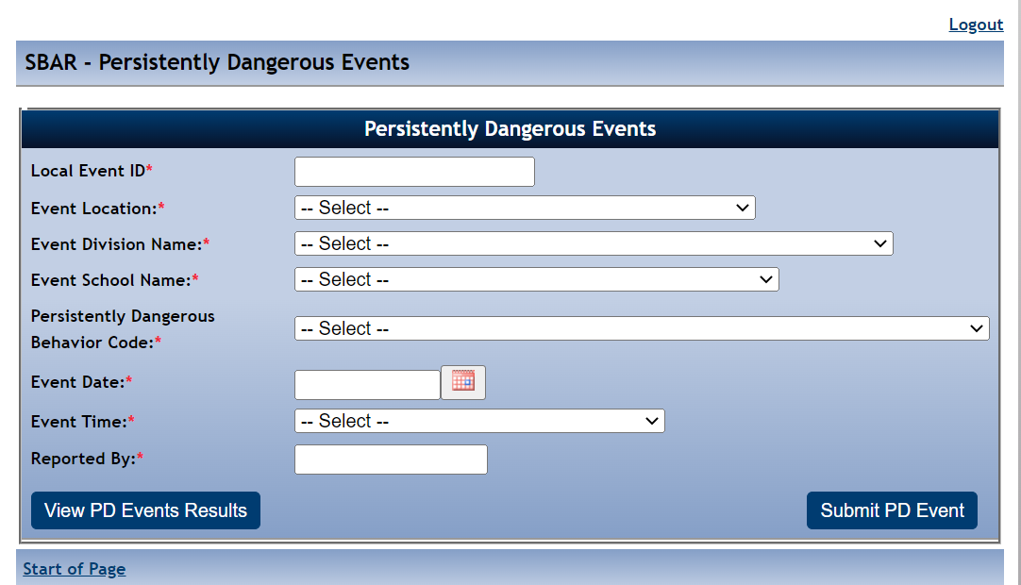
Reporting Persistently Dangerous Events
PD Event Form
PD Category 1 Behavior Codes must be entered within 10 days of the event
If there is an immediate response to a PD event that is pending investigation, then that response must be entered into SBAR
Entries in the form do not factor into the Persistently Dangerous Calculation
Entries will not be deleted and will remain as they were initially reported

Slide 19
Reporting PD Events pending investigation
New Fields in the PD Event Form
Pending Investigation (Yes or No)
  Pending Investigation "Yes" will let VDOE know that the event is being investigated and there has not been a final response
2. Post Investigation Status (Substantiated or Not Substantiated)
  Post Investigation Status indicates the outcome of the investigation
  When the outcome is Not Substantiated, the PD Behavior Code that was entered in the PD Events Form does not have to be reported in the SBAR Data File.
  The user can report the appropriate Behavior Code for the local event id in the SBAR data file
  When the outcome is Substantiated, the user must report the exact PD Behavior Code that was entered in the PD Events Form for the local event id

Slide 20
Making Corrections to the PD Events Form
School Divisions and Regional Programs
VDOE
Will be able to modify data fields
  Event Location
  Event Division Name
  Event School Name
  Event Date
  Event Time
  Reported by
  Pending Investigation
  Post Investigation
Will modify Local Event ID and Persistently Dangerous Behavior Code Fields
Require Email and/or supporting documentation to modify Local Event ID and Persistently Dangerous Behavior Code Field

Slide 21
SBAR Resources

Slide 22
SBAR Application Support
Contact your local SSWS Account or back-up Account Manager if you need assistance with the following:
Assigning the SBAR application contact in ERA
  This is critical for VDOE to contact the correct person with important updates regarding SBAR
Determining rights and privileges to the SBAR application
  This includes setting up the SBAR collection manager, local approvers, and rights to submit the data or access reports
Establishing Superintendent Data Collection Approval (SDCA) account for Superintendent or Director
Notes:
If you need help, your local co-workers can assist you.
SSWS Account or back-up account manager
ERA contact

Slide 23
VDOE Contacts
Student Behavior And Administrative Response Collection website:
https://www.doe.virginia.gov/data-policy-funding/data-reports/data-collection/student-behavior-and-administrative-response-collection
Patricia Mealy, Data Specialist, Office of Data Services
Email: patricia.mealy@doe.virginia.gov or
resultshelp@doe.virginia.gov
Rebecca Kahila, School Safety and Discipline Specialist, Office of Student Services
Email: rebecca.kahila@doe.virginia.gov
Notes:
Other contact information:

Slide 24
Thank You
Notes:
This is the end of the presentation. Thank you.

