Slide 1
Multifunction School Activity Bus
UNIT L

Slide 2
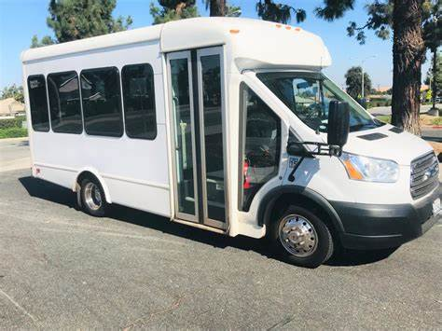
Multifunction School Activity Bus
Approved uses include; sporting events, field trips, activities other than home to school/school to home. If the passenger capacity is 16 and above, a CDL is required with a P endorsement, ELDT is required, and the vehicle meets FMVSS school bus standards and VDOE specifications.

Slide 3
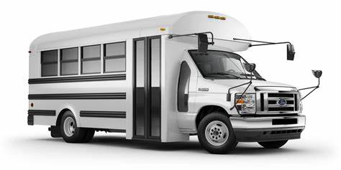
Multifunction School Activity Bus
Activity bus is not school bus yellow; it is not equipped with student warning lights, and it is not equipped with a crossing arm or stop arm. If the passenger capacity is 11-15 passengers a CDL is not required. Use applicable VDOE MFSAB training and bus must meet FMVSS school bus standards and VDOE specifications.

Slide 4
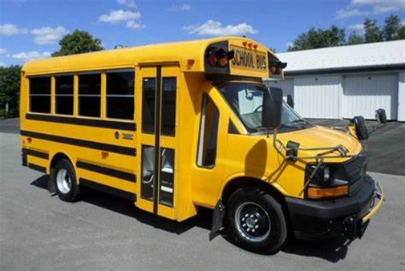
TYPE A SCHOOL BUS
Type A School Bus is approved for ALL student transportation. 16 passengers and above, this bus is National School Bus Yellow, it is equipped with student warning lights, a stop arm and crossing arm. A CDL is required with a P and S endorsement, ELDT is required, and the vehicle must meet FMVSS school bus standards and VDOE specifications.

Slide 5
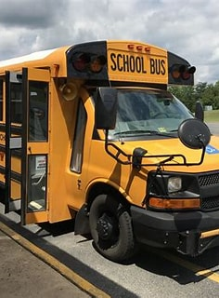
Type A School Bus
If Type A school bus is designed to carry 11-15 passengers, a CDL is not required however, a S endorsement is required on standard driver's license. Drivers should be trained per 8VAC20-70-350 VDOE school bus driver curriculum. The vehicle must meet FMVSS school bus standards and VDOE specification.
If vehicle is 10 passengers and below, a standard license with a S endorsement is required. Drivers should be trained per 8VAC20-70-350 VDOE school bus driver curriculum. Vehicle is not subject to FMVSS school bus standards or VDOE specification.

Slide 6
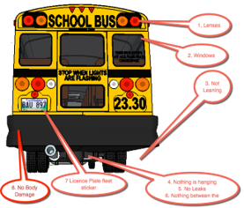
Multifunction School Activity Bus
Before and after you drive, you must always perform a PRETRIP and a POST TRIP.
The pre-trip will consist of inspecting the vehicle for any defects.
The post trip will also consist of inspecting the vehicle for defects and give you the opportunity to check for sleeping passengers or forgotten items.

Slide 7

Multifunction School Activity Bus
Passenger safety is your priority. Assuring that all passengers are aware of emergency equipment and exits.
Passenger conduct should also be addressed, prior to driving to avoid distracting behavior.

Slide 8
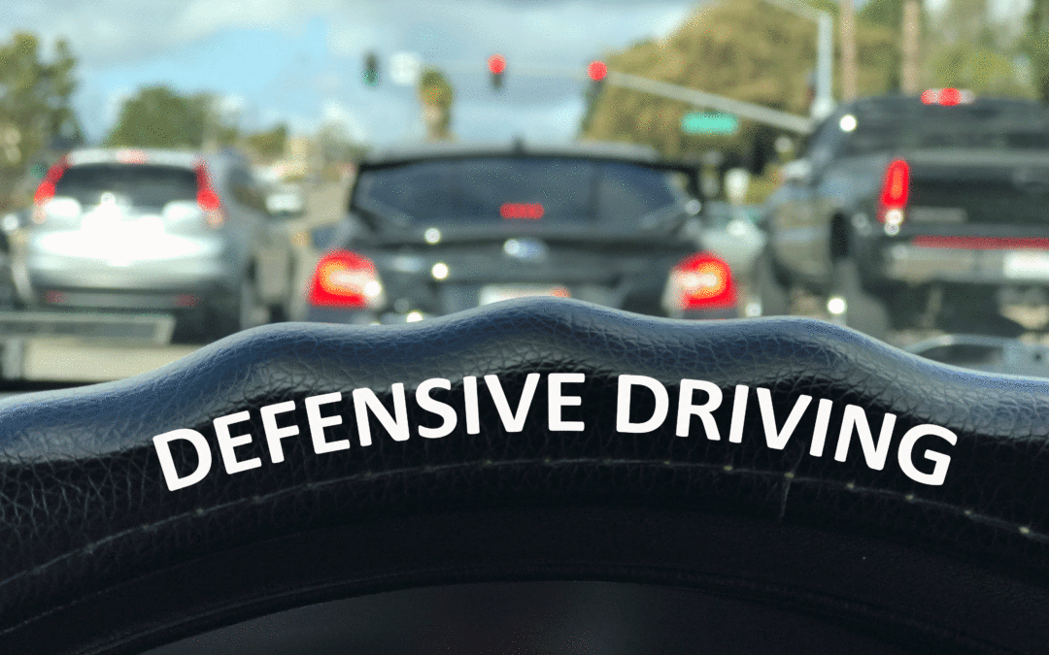
Multifunction School Activity Bus
Stay aware of your surroundings.
Anticipate what other drivers may do.
Stay focused, put away items that may cause a distraction, like a cell phone.
Drive with caution and always allow yourself a way out of a bad situation.
Follow the rules of the road and always expect the unexpected.
Section 3: Safe Driving Virginia Driver’s Manual

Slide 9
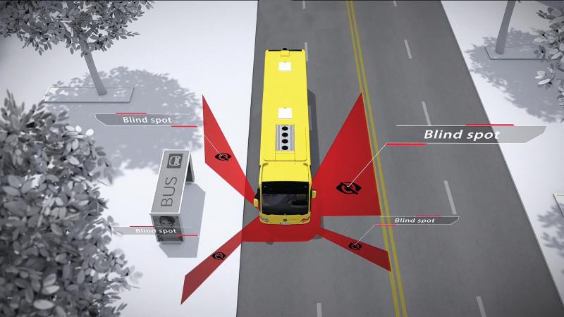
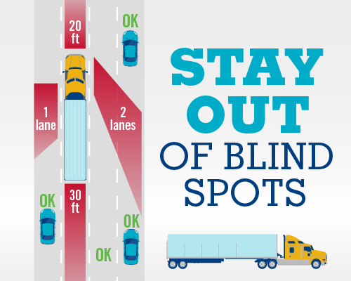
Multifunction School Activity Bus

Slide 10
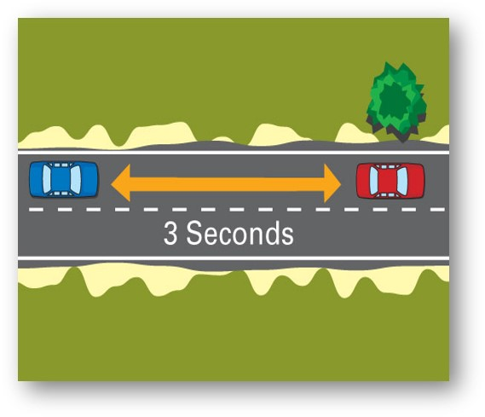
Multifunction School Activity Bus
Stopping distance consist of perception time, reaction distance and braking distance.
Perception time is the time it takes you to recognize a hazard. Reaction distance is the distance the vehicle travels between the time you recognize a problem and the time you apply the brakes.
Braking distance is the distance your vehicle travels after you apply the brakes
Weather, visibility and speed will also play a role in stopping distance.

Slide 11

Multifunction School Activity Bus
Because you can not see everything behind your vehicle, you should avoid backing when possible. If you must back you should use mirrors and back slowly, turning towards the driver’s side, whenever possible

Slide 12

Multifunction School Activity Bus
KNOW YOUR BUS SIZE If your vehicle won’t fit, don’t commit! Before crossing, be sure there is space to completely clear the tracks without stopping. Trains overhang tracks. Leave at least 15 feet between the front and rear of your vehicle and the nearest rail. Never stop on the tracks. Track heights vary. If you drive a low clearance vehicle, be aware of raised crossings.

Slide 13
Multifunction School Activity Bus

Slide 14
Multifunction School Activity Bus

Slide 15
Multifunction School Activity Bus

Slide 16



Connect with VDOE
Twitter: @VDOE_News Facebook: @VDOENews
#VAis4Learners #EdEquityVA

Slide 17
Contact Information
Jackie.Johnson@doe.virginia.gov
www.doe.virginia.gov
Twitter: @VDOE_News Facebook: @VDOENews
#VAis4Learners #EdEquityVA

