Slide 1

Elementary School Gun Safety Guidelines And Curriculum Commonwealth of Virginia
Attachment A to Superintendent. Memo 325

Slide 2
Using the PowerPoint
The slides for each grade-level correspond with the curriculum.
A slide noting the grade-level is at the beginning of each section.
Any of the slides may be printed.
The last two slides are Appendices B & C which may be used at any grade-level.
The slides are formatted in Microsoft PowerPoint 97-2003- PDF.

Slide 3
KINDERGARTEN
GUN SAFETY LESSON

Slide 4
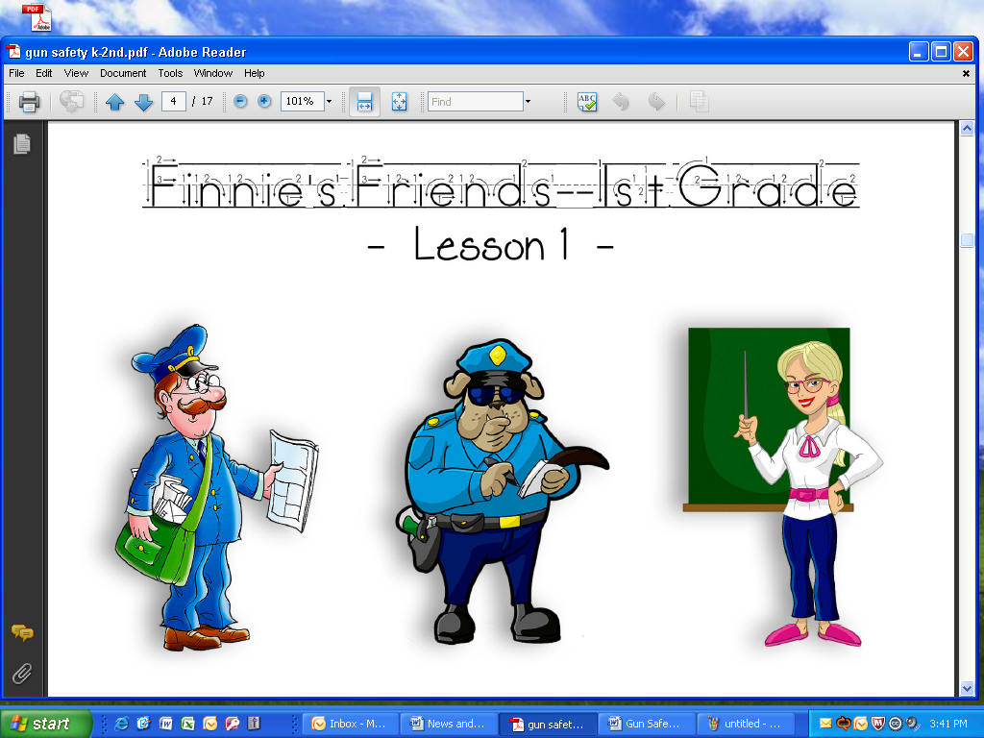
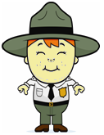
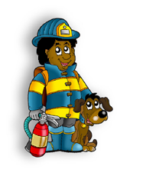
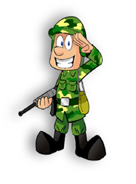
HELPERS WHO MAY USE A GUN
Directions: Circle the people that carry a gun as part of their job.

Slide 5
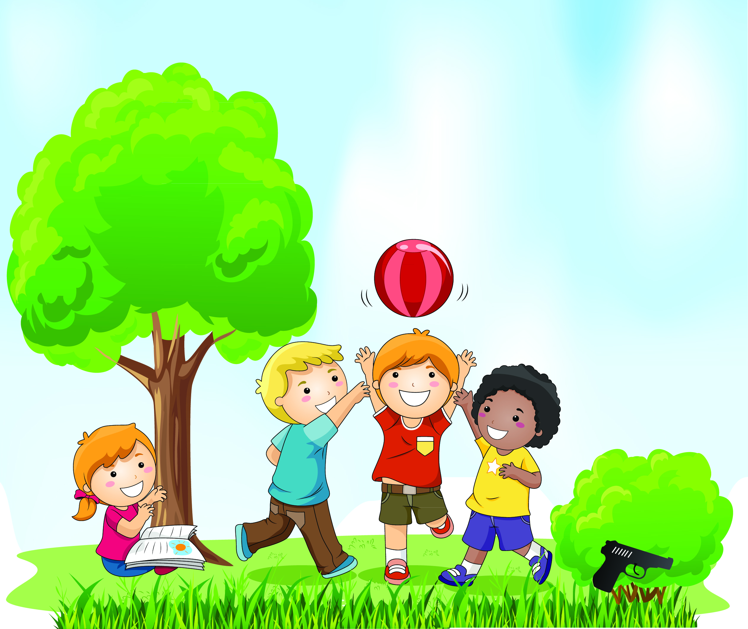
“THE BUSHES”
Kevin, Jimmy, Sarah, and Roscoe are playing in the park near their home.

Slide 6
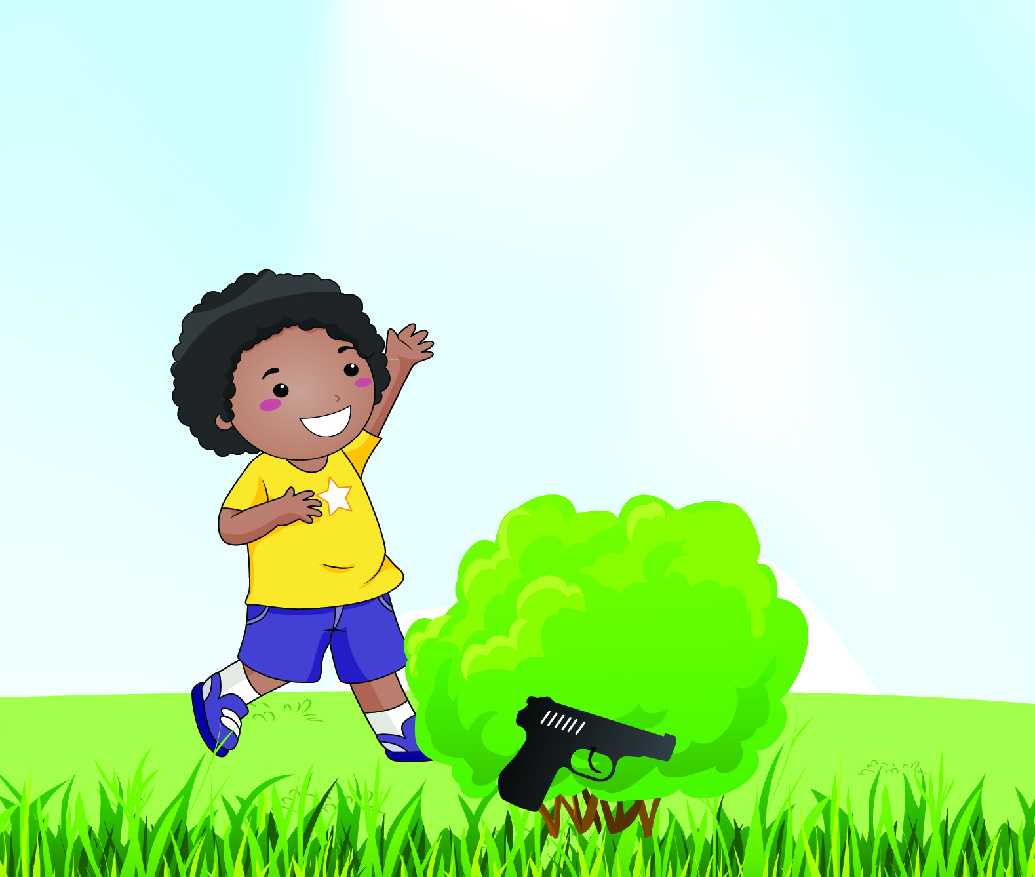
Jimmy wanders towards the bushes and spots what looks like a gun.

Slide 7
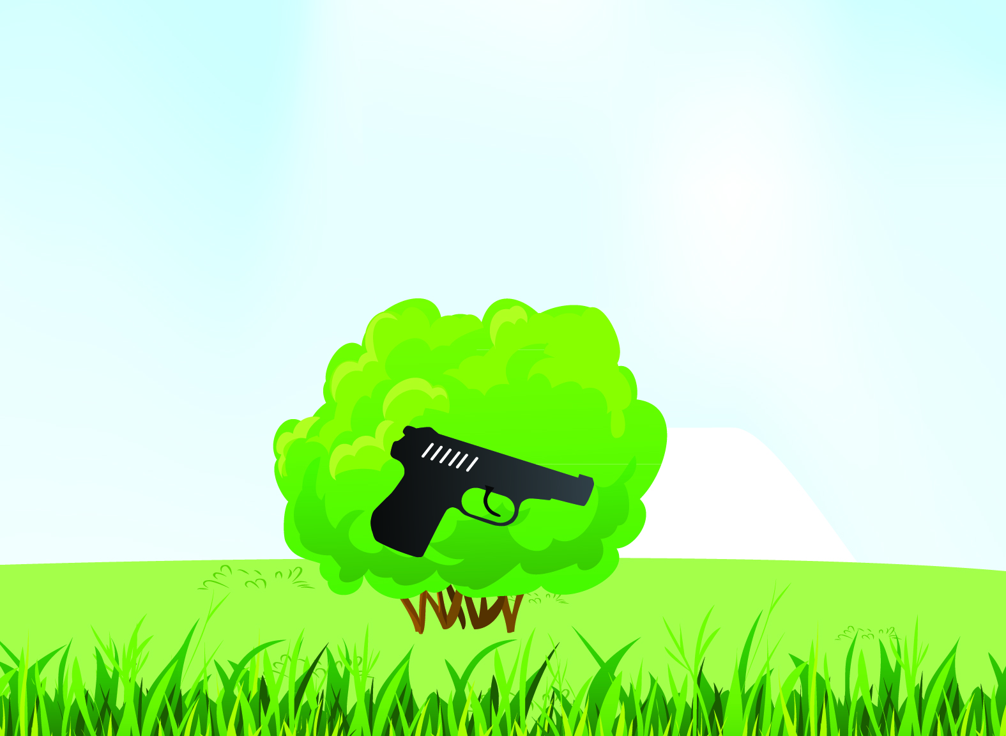
He calls Kevin, Roscoe, and Sarah over to see the gun. Sarah tells the boys, “I don’t want to see a gun unless a trusted adult is with me!”

Slide 8
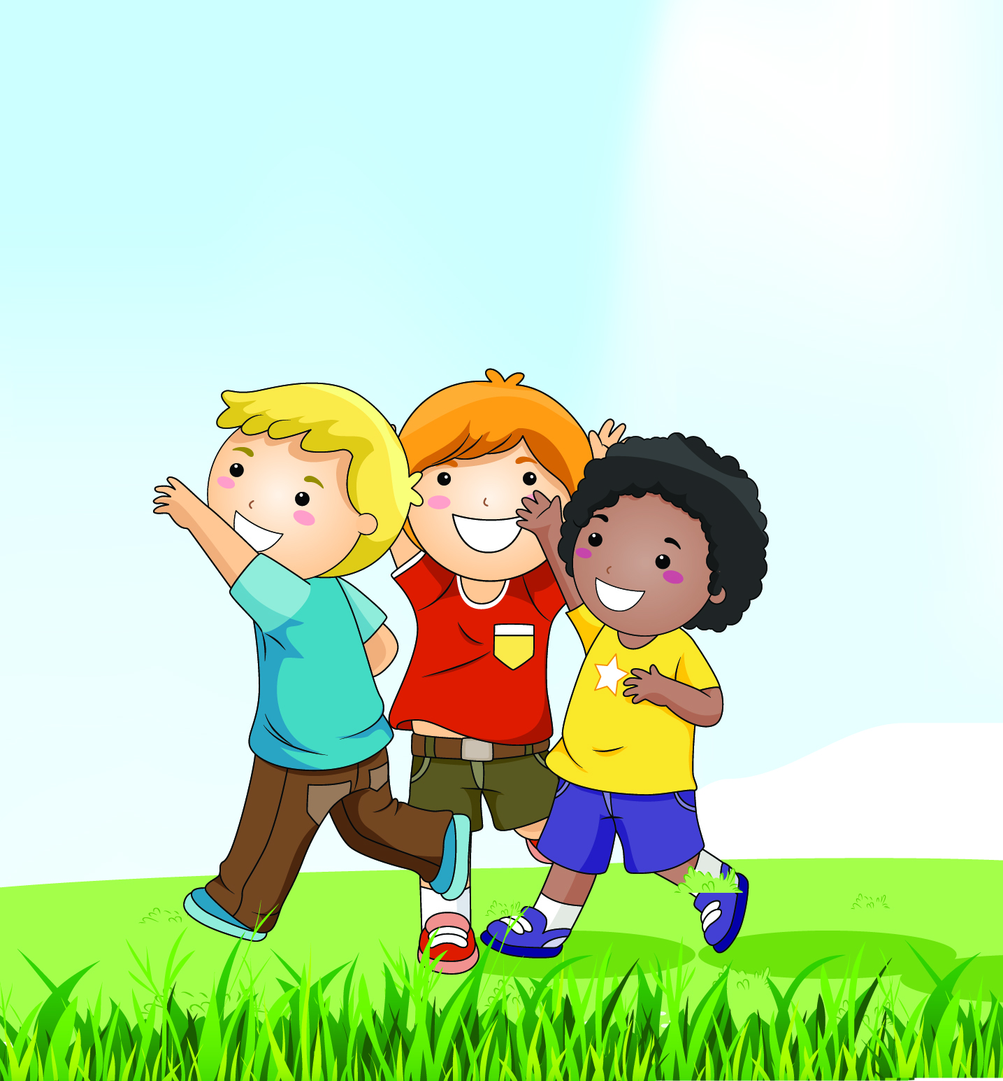
The boys quickly run to Kevin’s Mom who is nearby and tell her they have found a gun. Kevin’s Mom tells the boys she is happy they followed “Finnigan the Fox Gun Safety Rules.”

Slide 9
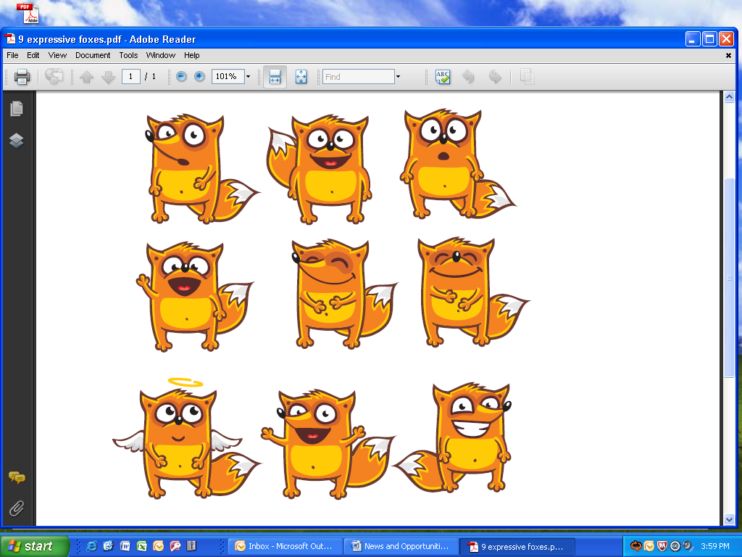



GUN SAFETY RULES
Finnigan the Fox says
LEAVE IT ALONE
LEAVE THE AREA
LET AN ADULT KNOW

Slide 10
FIRST GRADE
GUN SAFETY LESSON

Slide 11
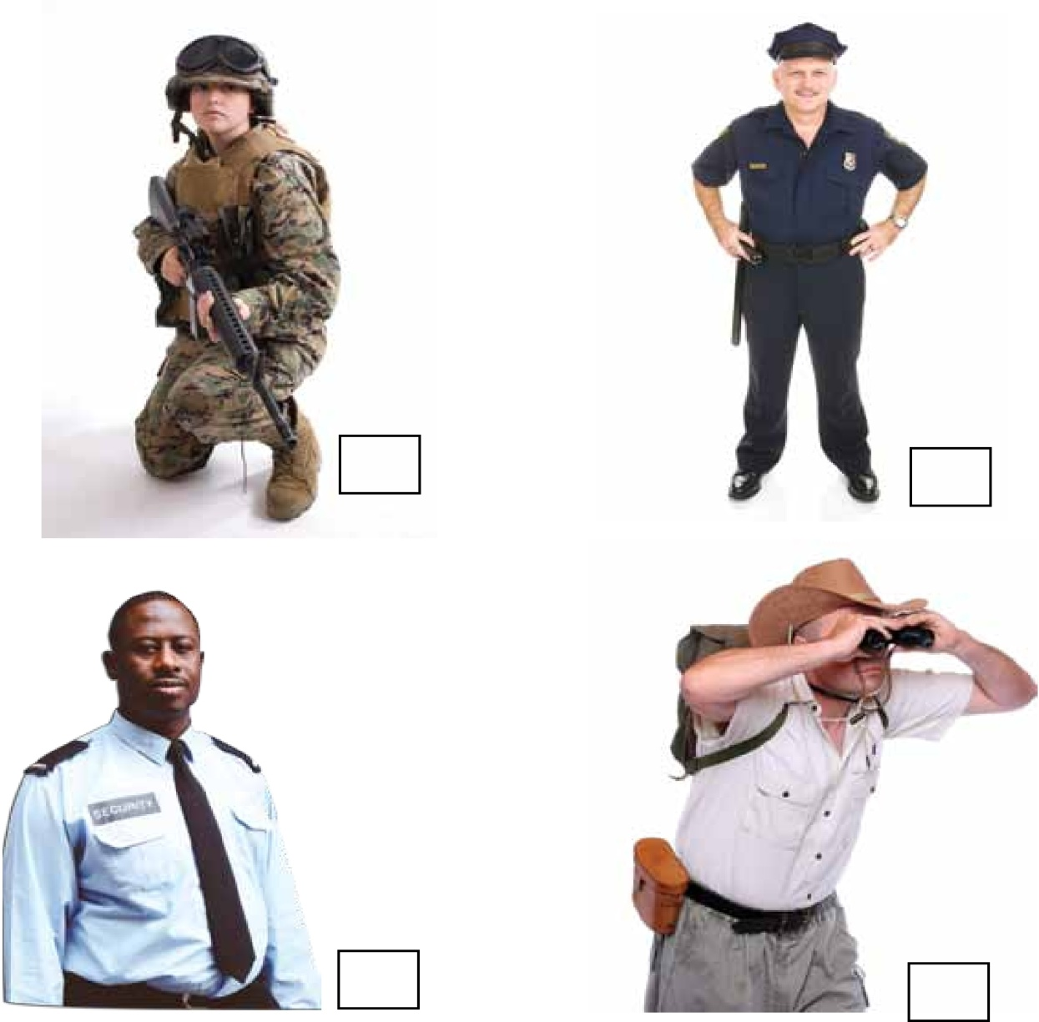
PEOPLE WHO USE GUNS TO PROTECT
PEOPLE WHO USE GUNS TO PROTECT
Directions
Put a 1 in the box by the picture of the Security Guard.
Put a 2 in the box by the picture of the Police Officer.
Put a 3 in the box by the picture of the Park Ranger.
Put a 4 in the box by the picture of the Soldier.

Slide 12
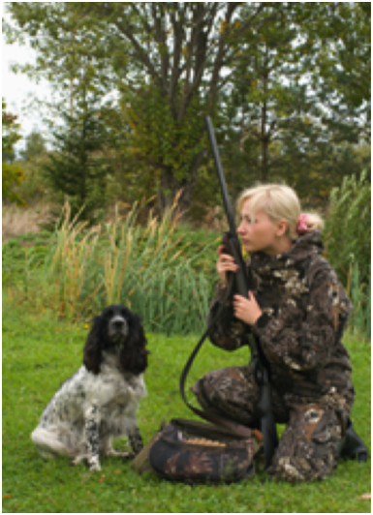
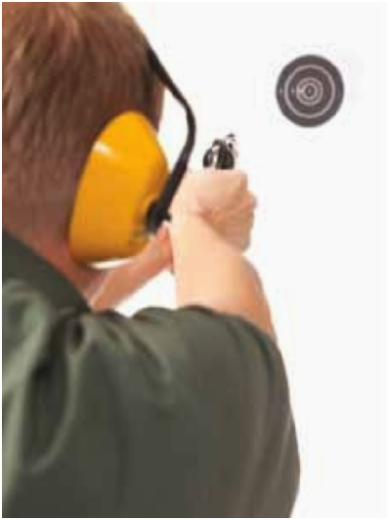
PEOPLE WHO SAFELY USE GUNS IN A SPORT
Directions
Put an O in the box by the picture of the person target shooting.
Put an X in the box by the picture of the person hunting.

Slide 13
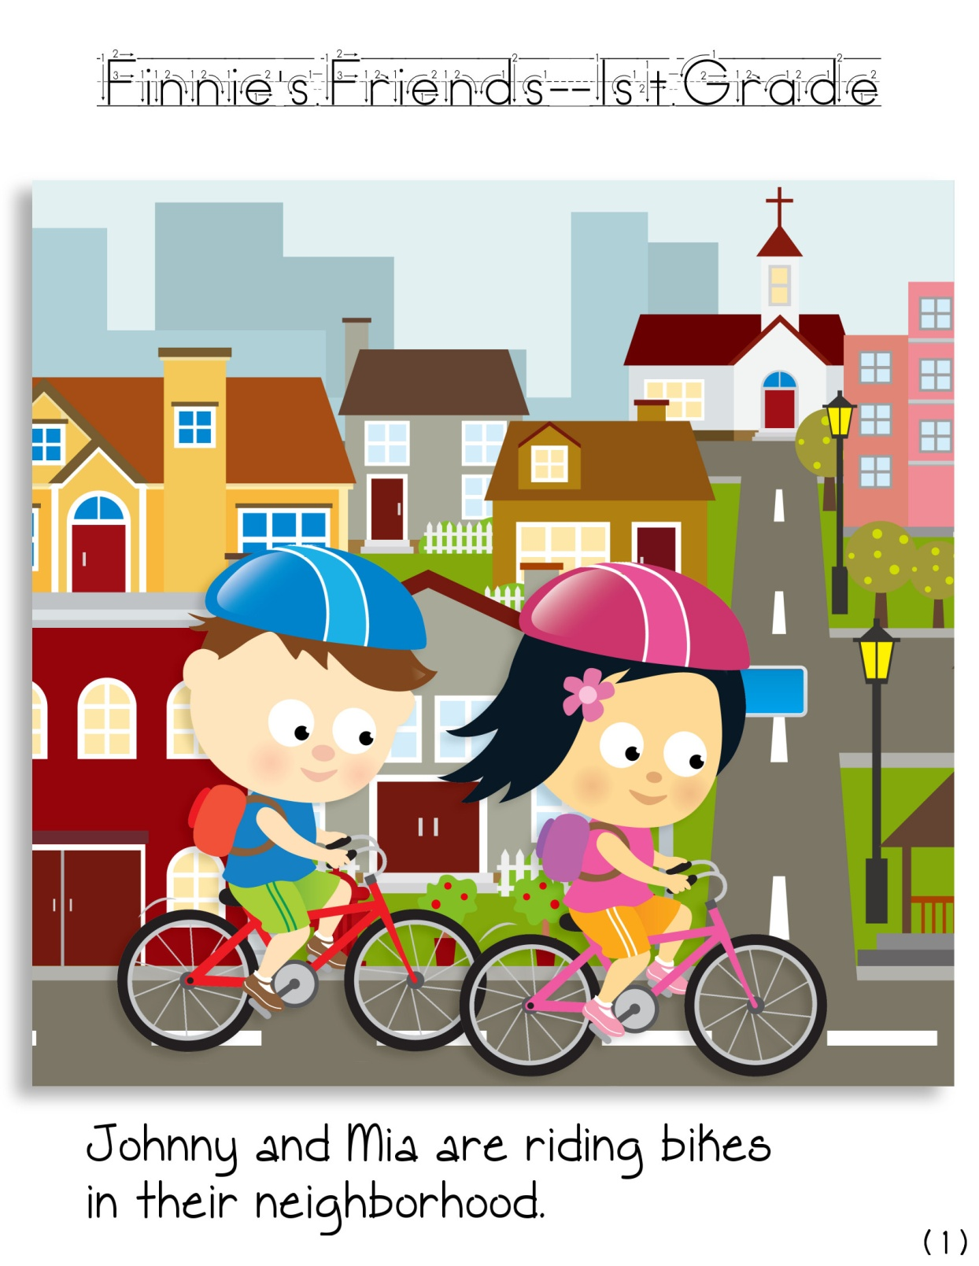
THE BOX
Johnny and Mia are riding bikes in their neighborhood.

Slide 14
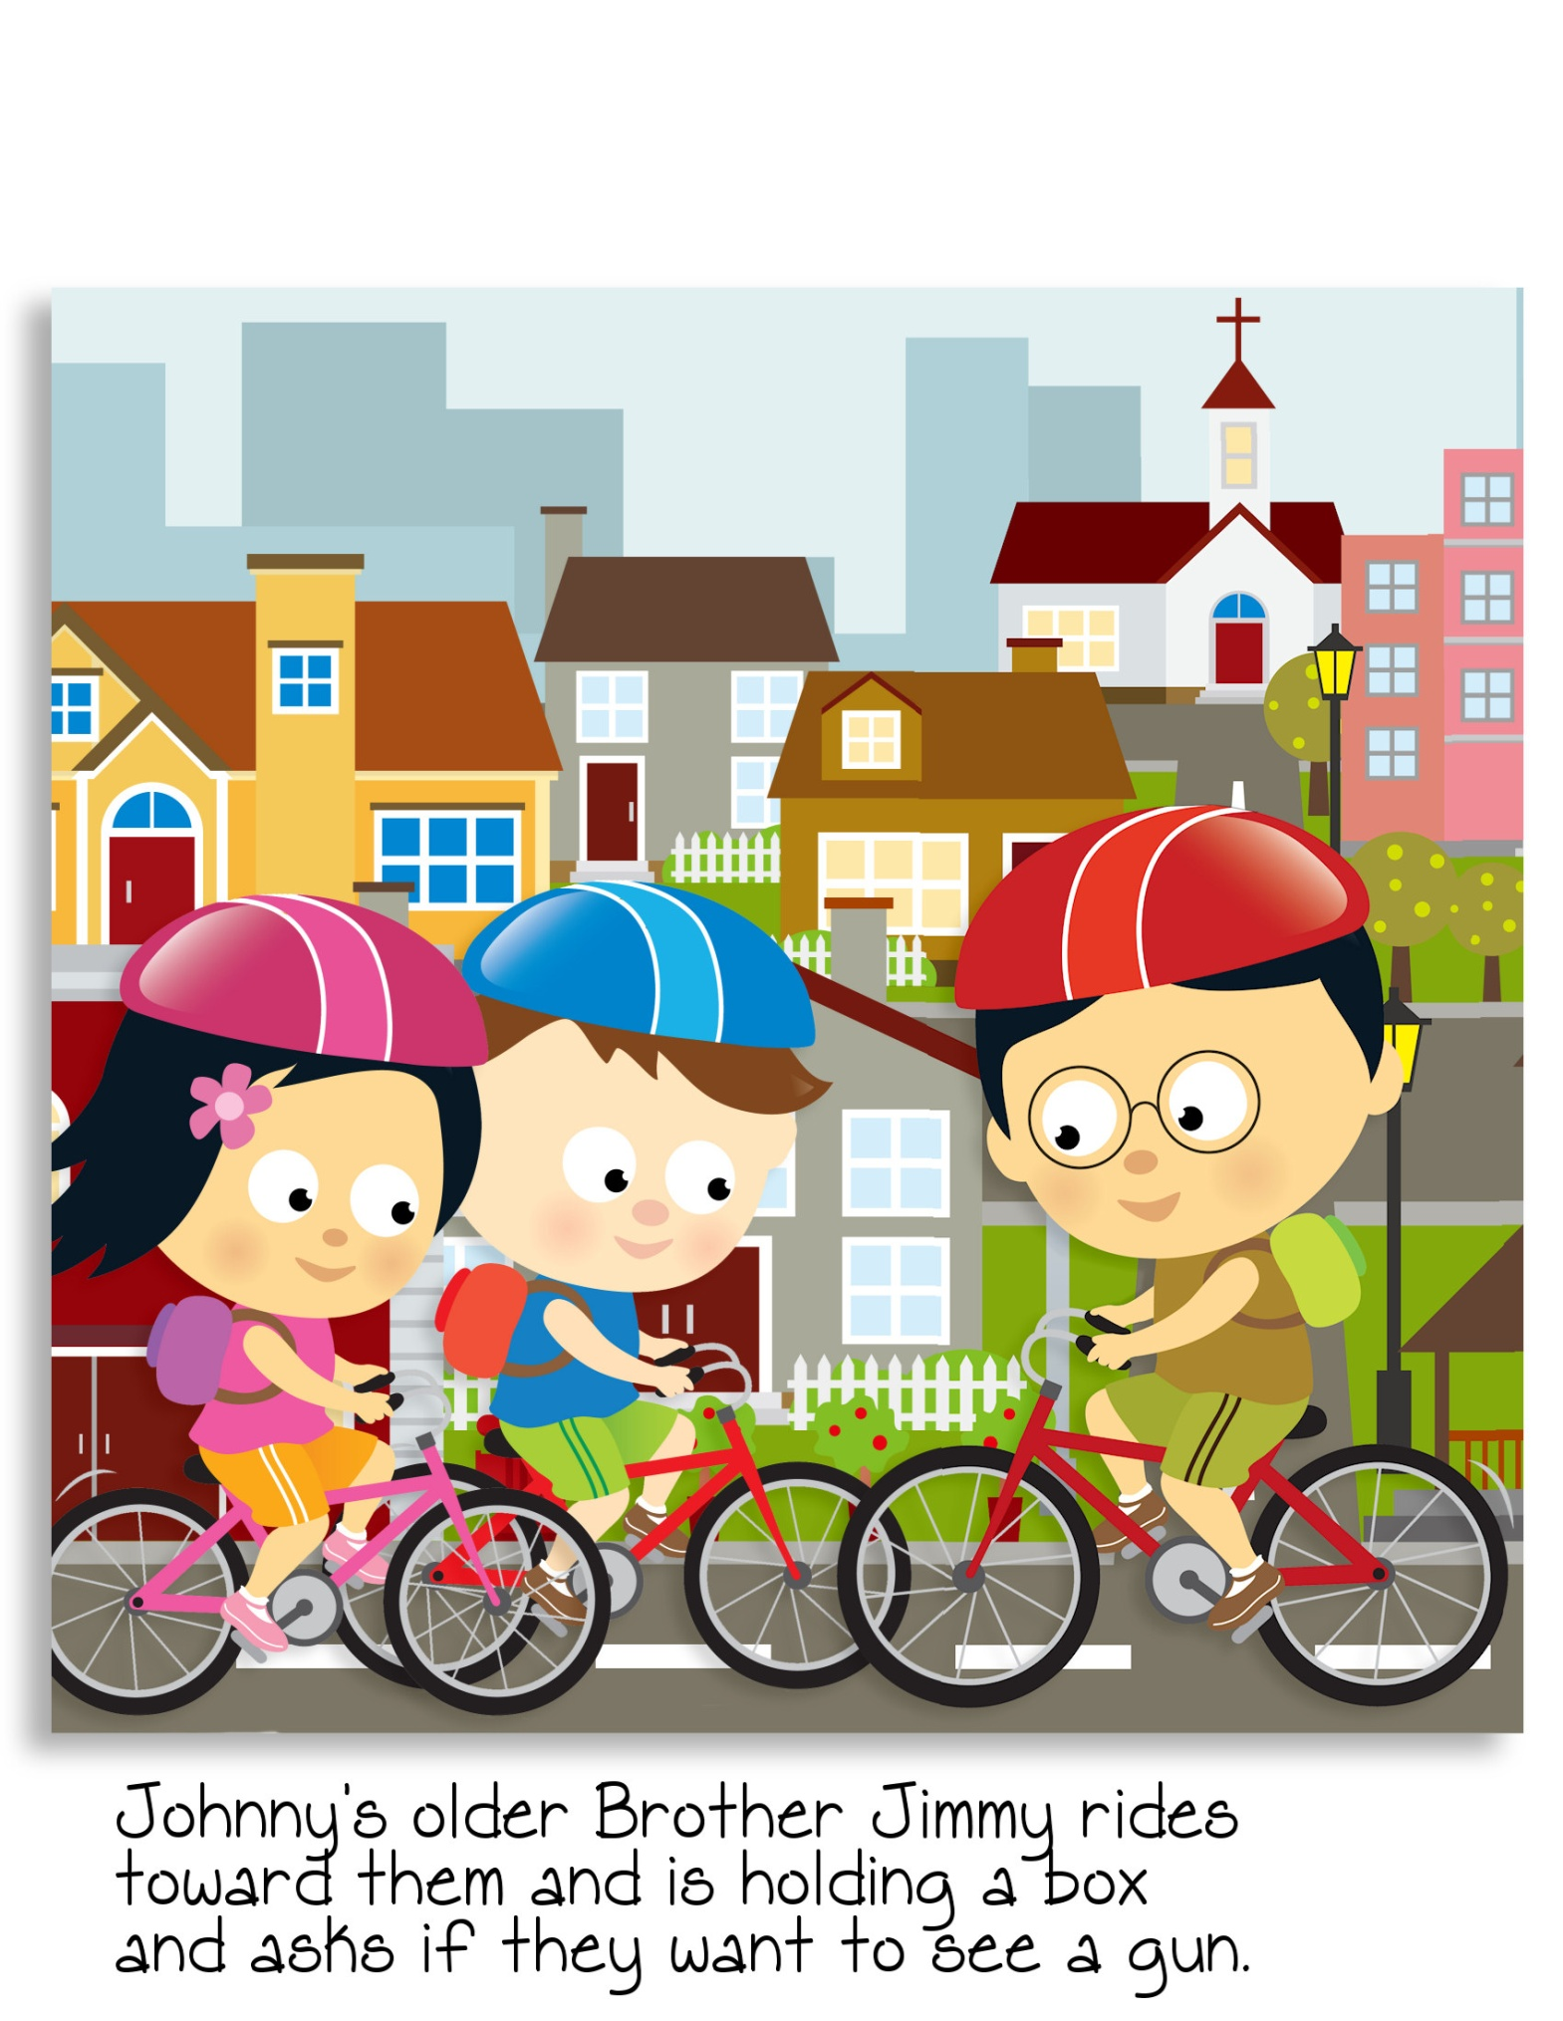
Johnny’s older brother, Fred, rides towards them. Fred asks them if they want to see something.

Slide 15
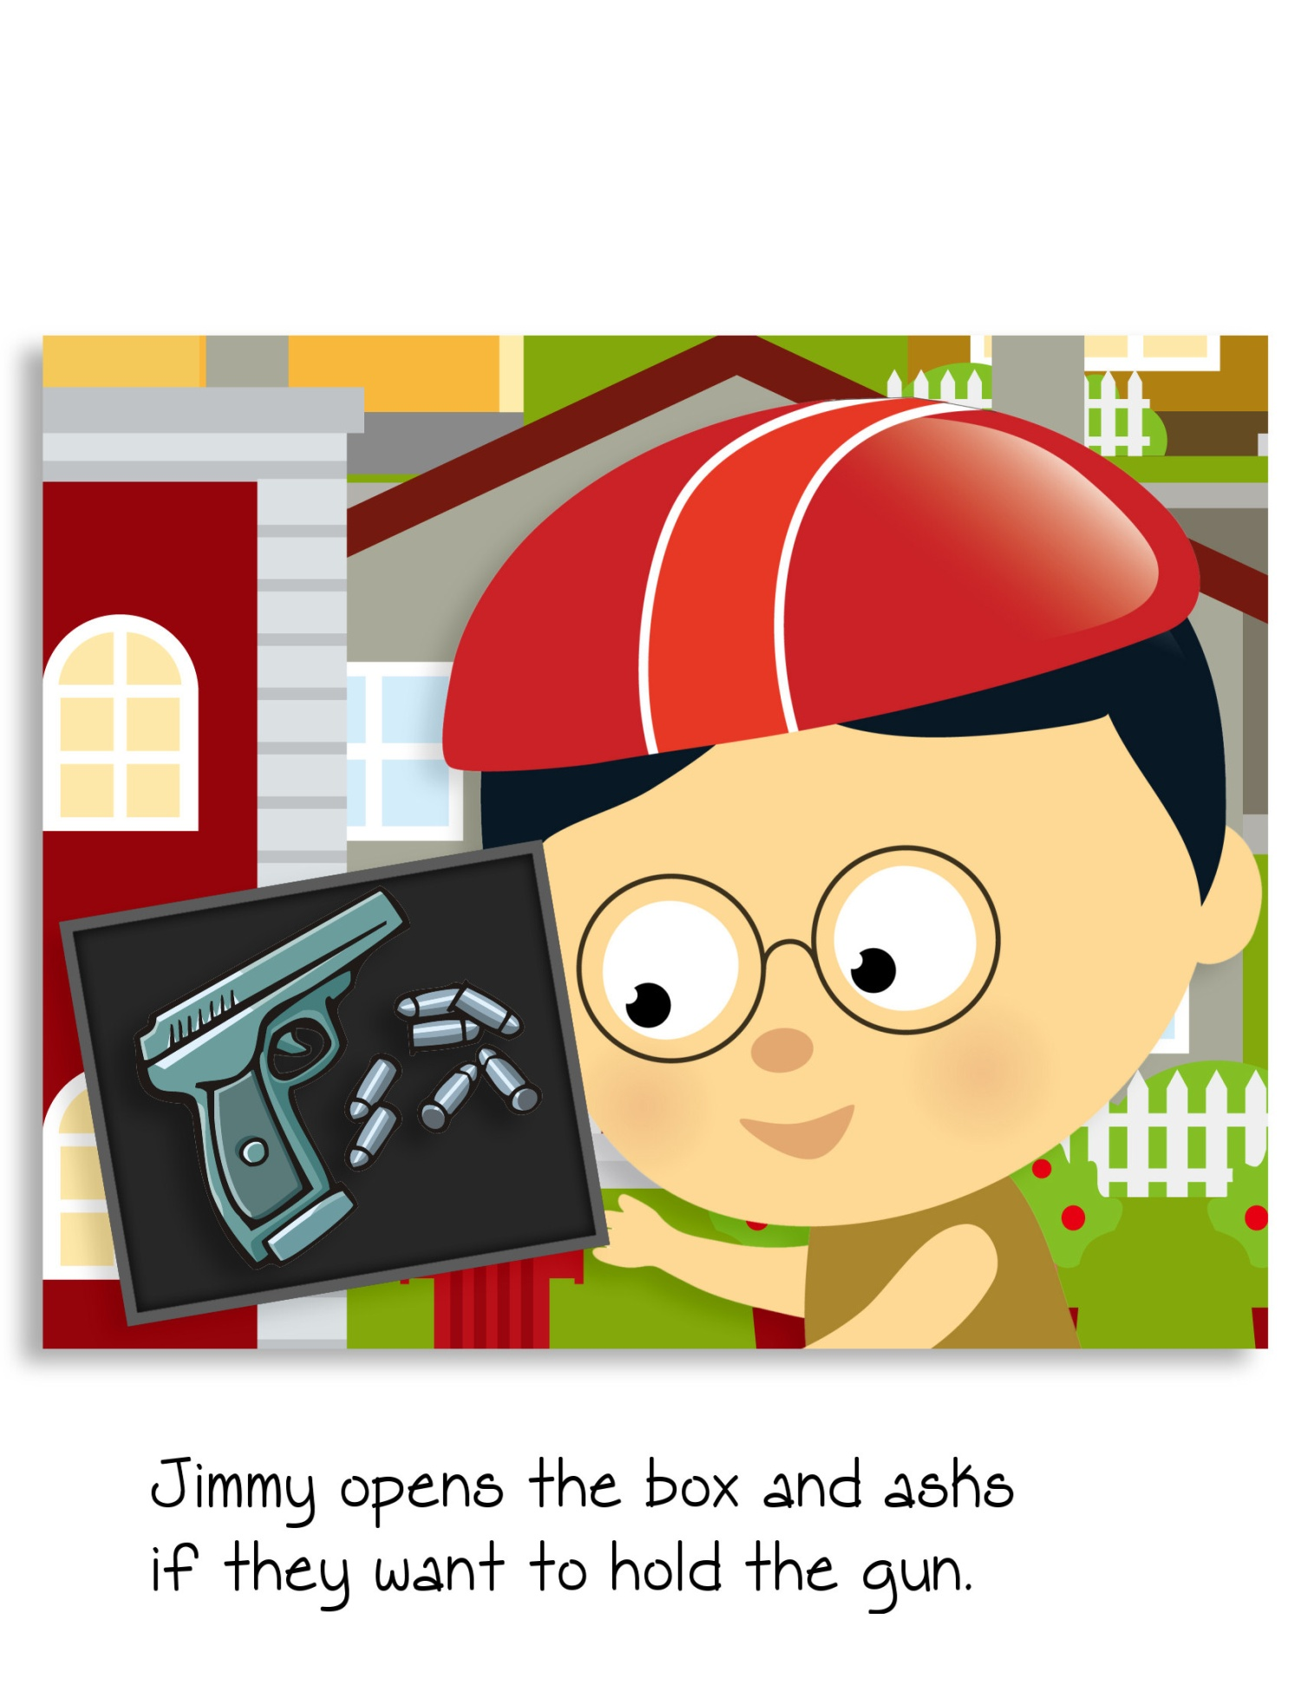
The children get off their bikes. Fred opens his backpack and takes out a box. He removes the lid off the box, and there is a gun!

Slide 16
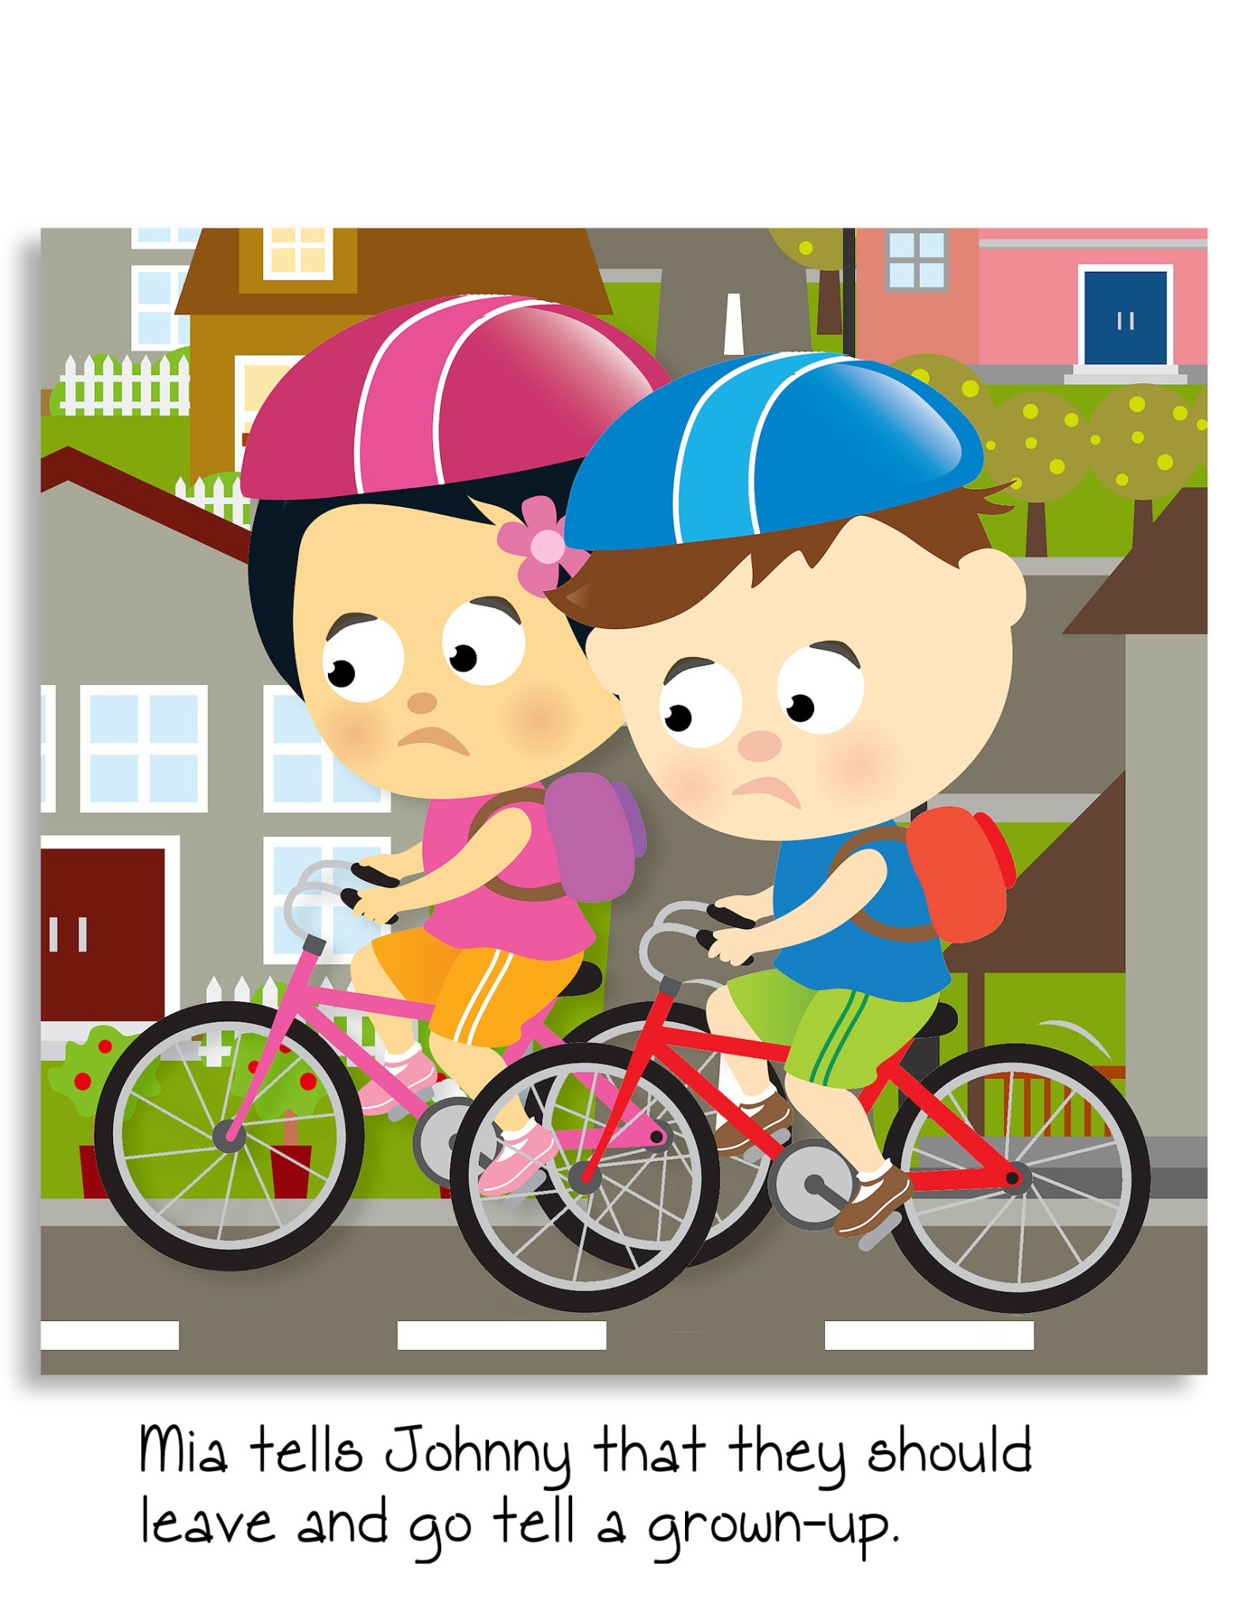
Mia tells Johnny they should leave the gun alone and not touch it. The children decide to leave and go tell an adult.

Slide 17
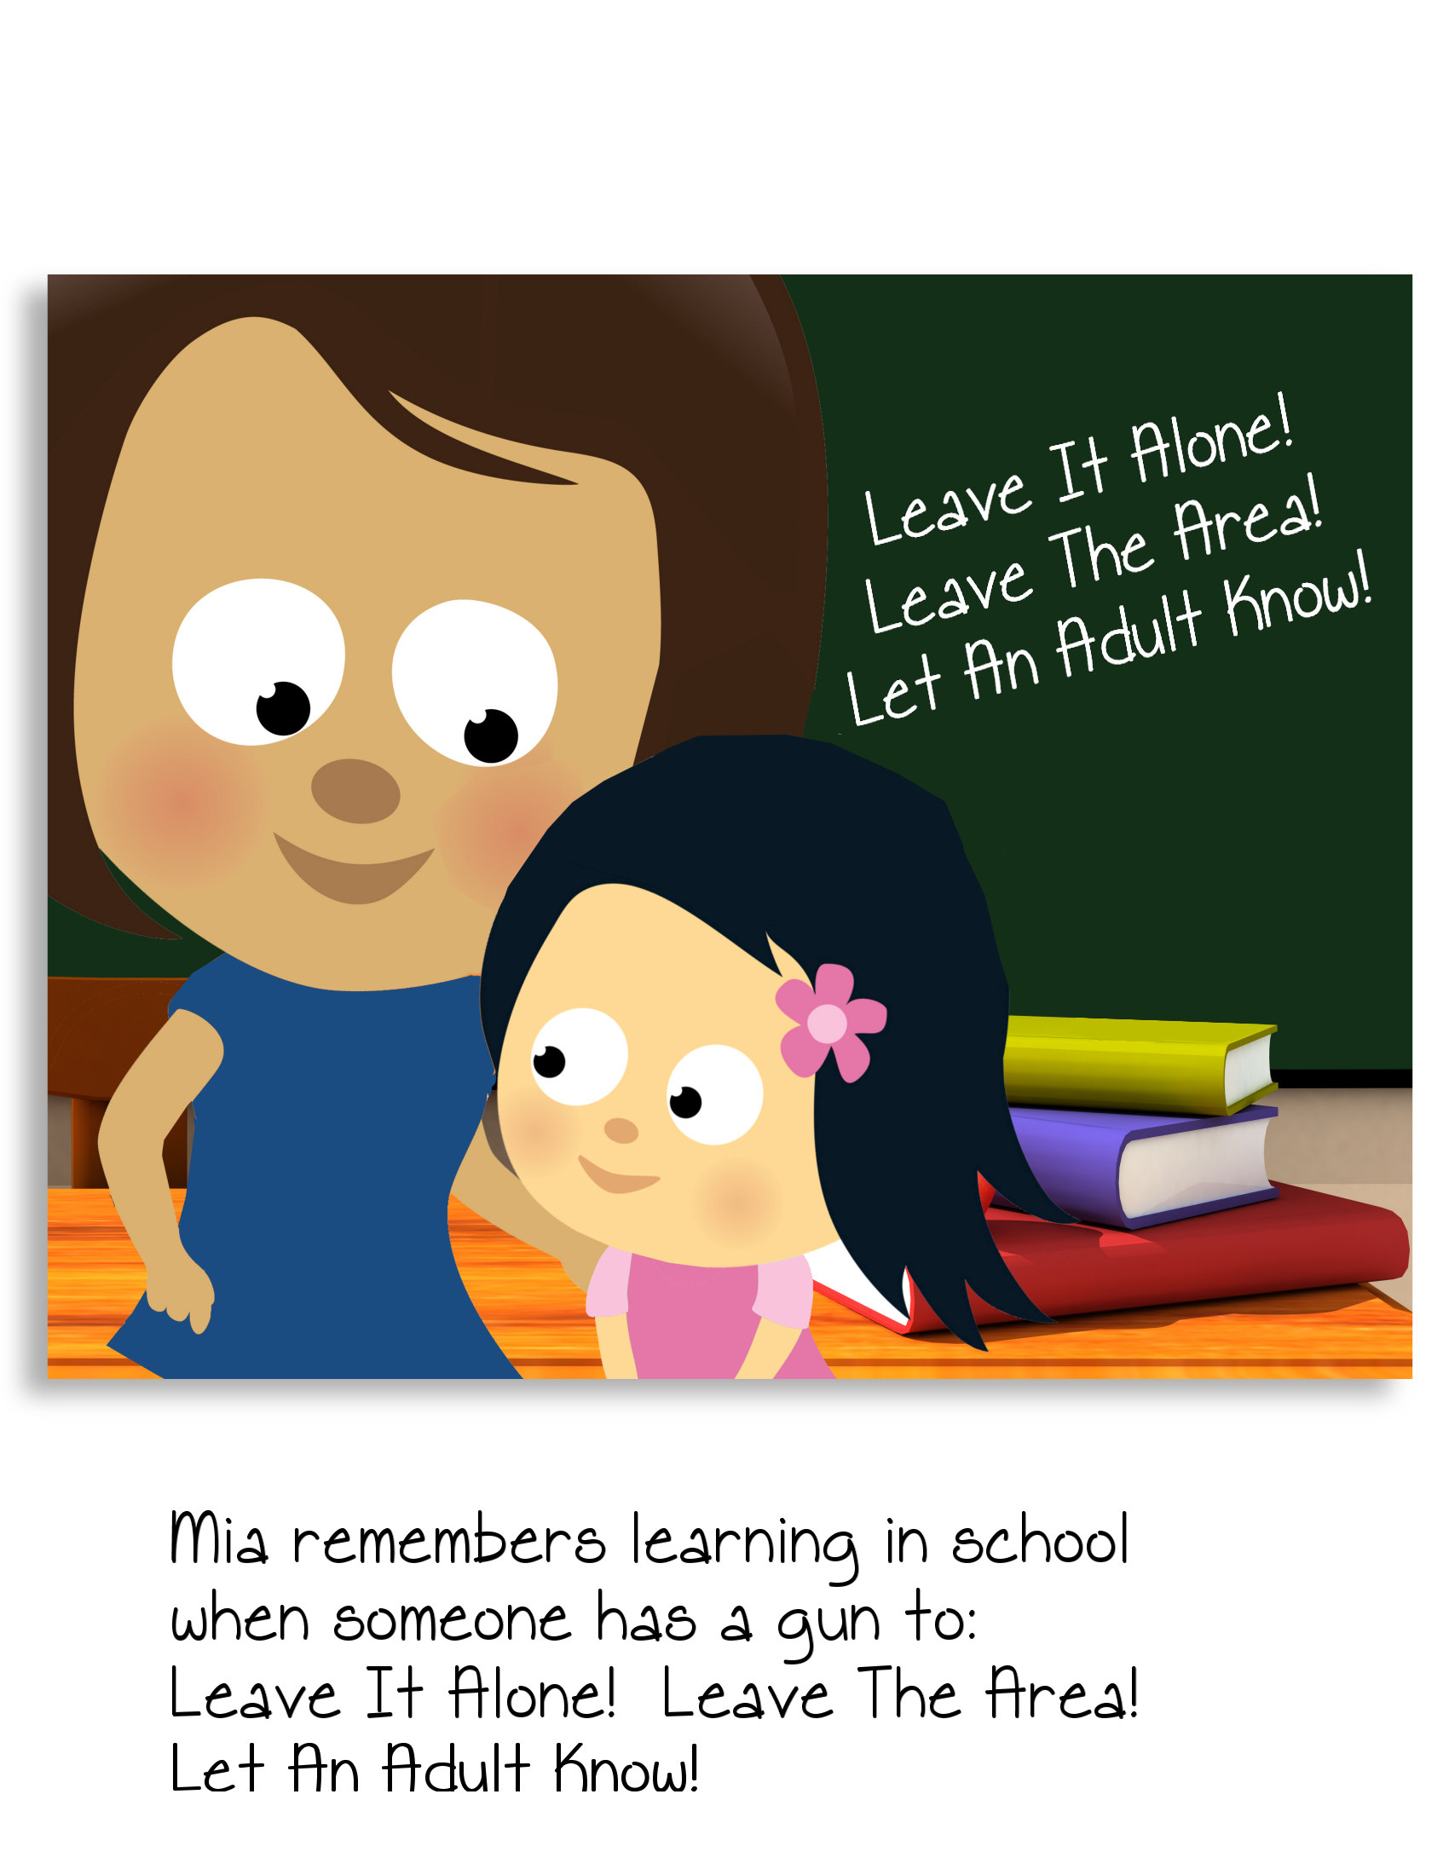
Mia remembers learning in school when someone has a gun to: Leave it Alone! Leave the Area! Let an Adult Know!

Slide 18
GUN SAFETY RULES
Finnigan the Fox says
LEAVE IT ALONE
LEAVE THE AREA
LET AN ADULT KNOW

Slide 19
SECOND GRADE
GUN SAFETY LESSON

Slide 20
WHY DO THESE PEOPLE CARRY A GUN?

Slide 21
CARRYING GUNS IS A PART OF THEIR JOBS
Directions
Circle the answer you think is correct.
1. Why would a Park Ranger carry a gun at work?
A. To protect people from danger.
B. To show the gun to park visitors.
C. To build a tree house.
Why does a Police Officer need to carry a gun?
To show people in the community.
To protect the community against dangerous people.
To make sure he/she is not late for work.
Why do Soldiers need to carry guns?
To go hunting for wild animals.
To help them travel farther.
To help protect our country and our freedoms.

Slide 22

ANDREW’S BIG SURPRISE
Sean has invited his friends Andrew and Antonio to come to his house after school to play.

Slide 23
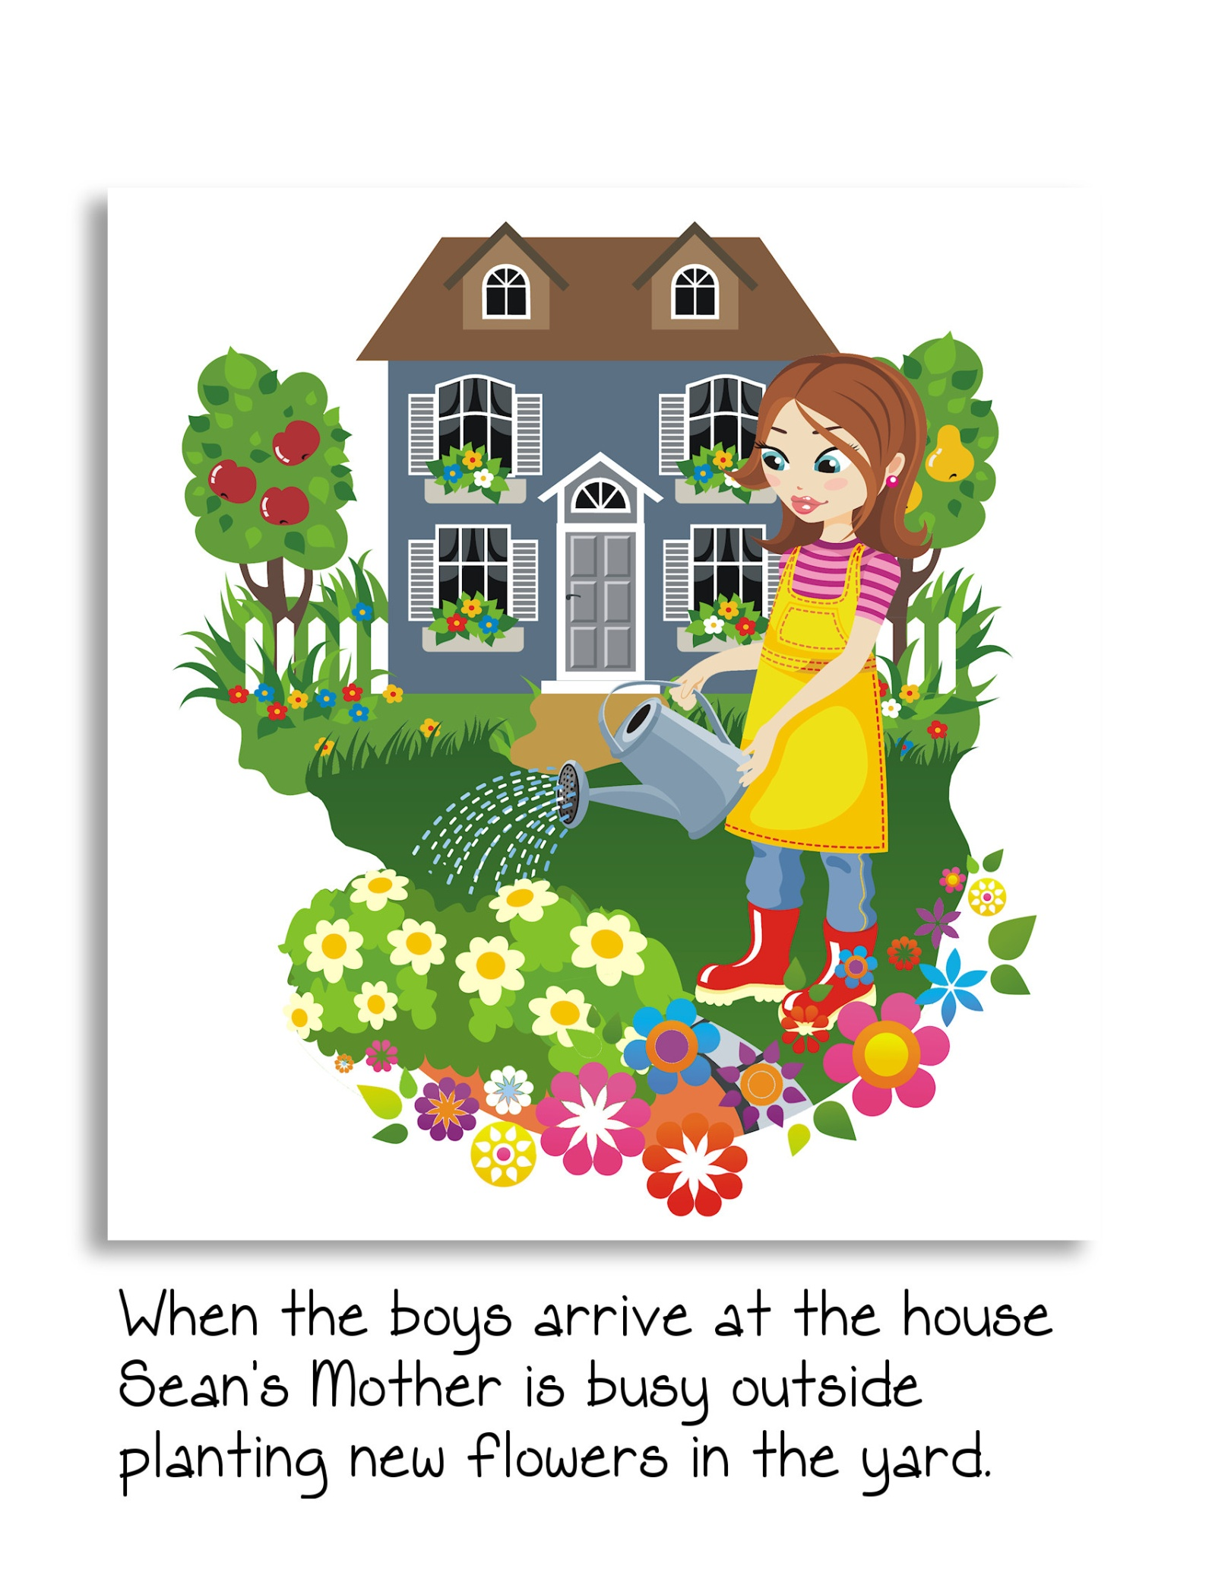
When the boys arrive at the house, Sean’s mother is busy outside watering the new flowers in the yard.

Slide 24
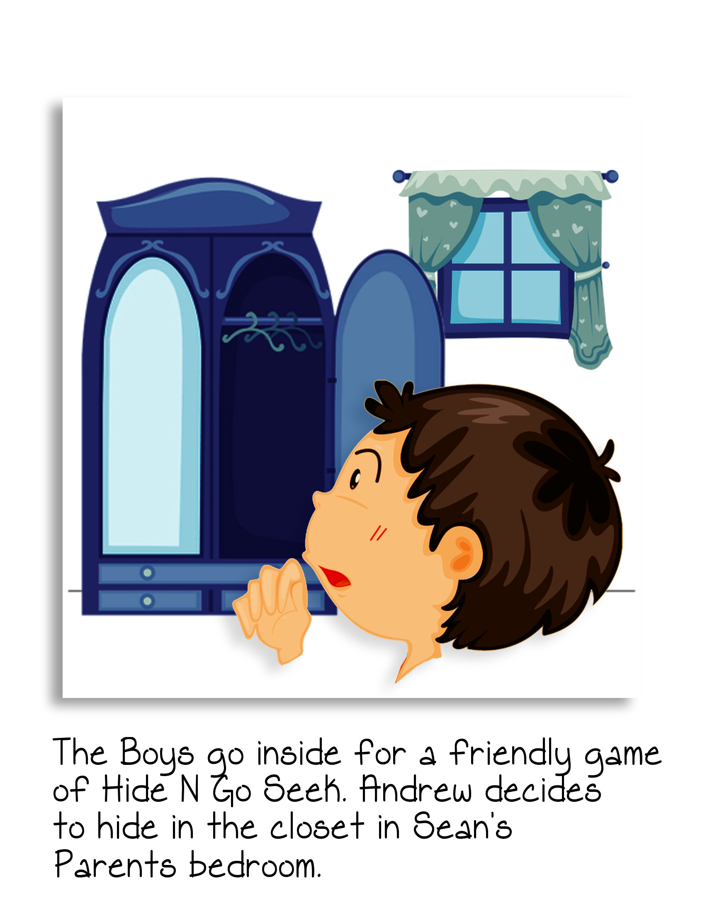
The boys go inside for a friendly game of hide-and-go-seek. Andrew decides to hide in the closet in the bedroom of Sean’s parents.

Slide 25
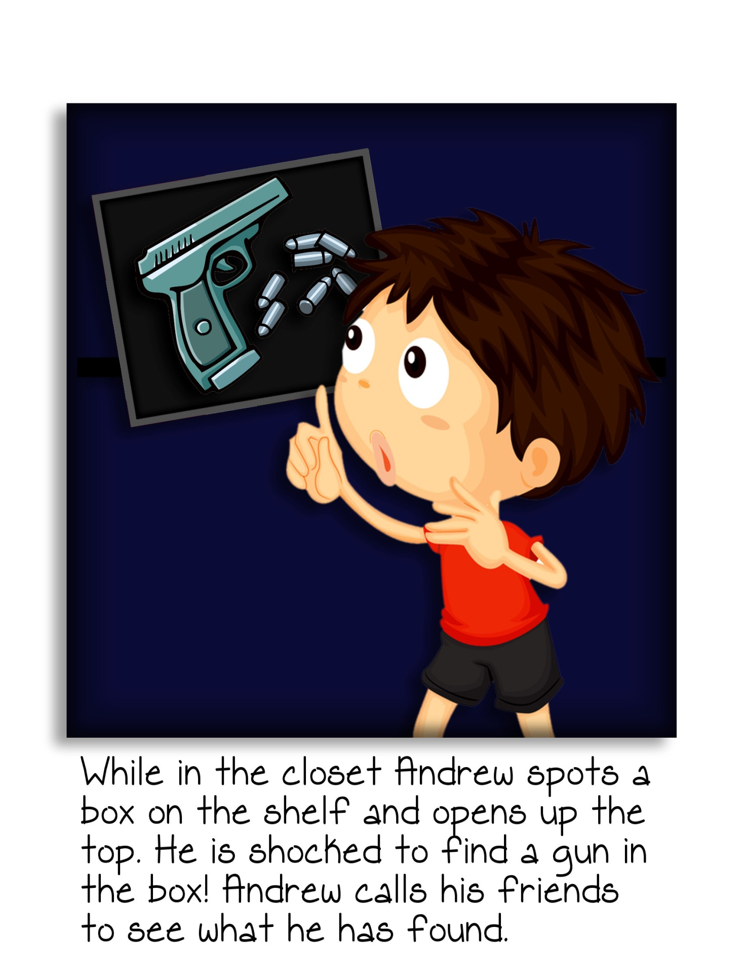
c
While in the closet Andrew spots a box on the shelf and opens up the top. He is surprised to find a gun in the box! Andrew calls his friends to see what he has found.

Slide 26
“Andrew’s Big Surprise” Discussion Questions
What should the boys do with the gun now that they have found it?
Should the boys stay with the gun until Sean’s mother comes inside?
Who should the boys call to make sure that the gun is safely put away?

Slide 27
GUN SAFETY RULES
Finnigan the Fox says
LEAVE IT ALONE
LEAVE THE AREA
LET AN ADULT KNOW

Slide 28
THIRD GRADE
GUN SAFETY LESSON

Slide 29
GUNS AND PERSONAL SAFETY
The use of guns may seem exciting when you see them on television, in the movies or, on a video game. But, in real life guns can be very dangerous, and because of the misuse of guns, people can be seriously hurt or killed.
Guns have played an important part in the history of America. Men and women have used guns to defend our freedom and protect our communities. Guns are also used for sport shooting and hunting. People who own or use guns as part of their jobs or in sports know how important it is to handle guns safely.
Guns are not toys and are very dangerous when people do not know the proper safety rules. Today you will learn a number of important safety rules to remember. If you ever see a gun without a trusted adult’s supervision, then you will know what to do to stay safe.

Slide 30

GUN SAFETY RULES AND MORE PRECAUTIONS
Finnigan says if you see a gun or someone that has one
Leave it Alone
Leave the Area
Let an Adult Know
If you come across a gun never touch it, pick it up, or handle it.
If you see a gun always treat it as if it were loaded and dangerous.
If your friend wants to show you a gun say NO and let an adult know.
If you know someone who has brought a real or toy gun to school, let an adult know right away.

Slide 31
GUN SAFETY – TRUE OR FALSE QUESTIONS
Directions: Please circle true or false for the following questions.
Guns are only for people who use them for their jobs. True or False
Guns can seriously injure or kill someone if not handled safely. True or False
All guns should be treated as if they were loaded. True or False
Hunting and sport shooting are responsible reasons for an adult to True or False
have a gun.
It is never okay to point a gun at anyone, even if you were joking. True or False
Guns have been used in history to defend our freedom. True or False
If you find a gun, you should show it to your friends. True or False
If your friend shows you a gun, you should keep it a secret. True or False
You should never touch a gun you found. True or False
If you find a gun, you should let an adult know. True or False

Slide 32
FOURTH GRADE
GUN SAFETY LESSON

Slide 33
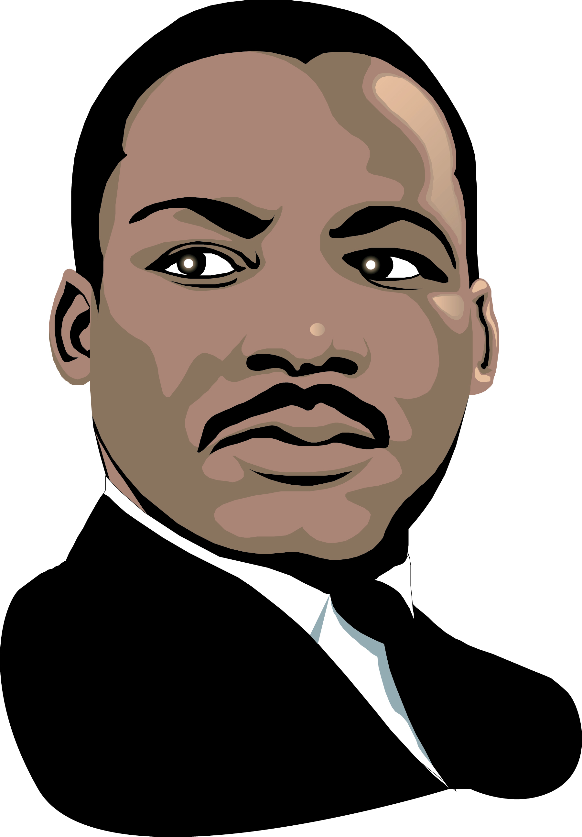
THE INFLUENCE OF GUN VIOLENCE ON
SOCIETY PART A
What do the following famous men have in common?
Abraham Lincoln
John F. Kennedy
Martin Luther King, Jr.

Slide 34
THE INFLUENCE OF GUN VIOLENCE ON SOCIETY PART B
Directions:
Write a paragraph on the contributions of one of these famous men and the impact of his death on our society.
Abraham Lincoln
John F. Kennedy
Martin Luther King, Jr.

Slide 35
GUN SAFETY IS EVERYONE’S JOB
Each year in the United States thousands of people are injured or killed by gunfire. The real tragedy in these numbers is that a number of the deaths are children who mishandle or play with guns. Unlike the movies and popular video games, people who are injured by gunfire see their lives change forever. Families who lose children from gunshot deaths are forever impacted.
Gun injuries and deaths can be prevented if everyone would follow several important gun safety rules. Gun safety is everyone’s job from parents to community leaders to each student in a school. Today you will have the chance to share how you can make your community safer by understanding the potential harm that guns can cause and by following safety rules.

Slide 36
GUN SAFETY “YOU DECIDE”
You have been asked by your community to provide a list of gun safety rules for students. Provide five (5) basic rules you feel will be important.
1.
2.
3.
4.
5.

Slide 37
FIFTH GRADE
GUN SAFETY LESSON

Slide 38
GUN SAFETY AND YOU
Some people may think guns are cool and exciting. For some people they represent a source of power. For others toy guns serve as a form of entertainment in video games, but in reality guns are serious and should be respected. The respect begins with following the gun safety rules.
Some individuals across America misuse and abuse the firing and shooting of guns. This abuse of guns leads to senseless and preventable violence.
Each year in the United States tragedy strikes within a local city or town when a gun is mishandled or fired accidentally. In a number of these situations the life of a young person ends. There is no possibility of that person reaching his or her dreams because of the mishandling of a gun.
Gun safety is a way to prevent serious injuries or the loss of a life. Gun safety begins with you and starts with your pledge to help make your community safe.

Slide 39
GUN SAFETY AND YOU
Discussion Questions
What are some examples of how the wrong attitude towards guns may contribute to gun violence?
What is meant by “respecting a gun?”
What are some examples of not respecting a gun?
Assignment
As a group, decide on some steps for promoting gun safety to keep our communities safe.

Slide 40
WHAT SHOULD YOU DO IF…
Directions
Read the following situations. Use the questions at the bottom of the page for each scenario, and prepare to discuss them with the class.
Your best friend has found a gun at the park and decides to hide it and not tell anyone.
Your parents are out of town and you are at home with your older brother who invited a friend over. The friend shows you a gun and states it belongs to his father.
Your best friend at school has been bullied for over a week by a student in another class. He has stated that he plans to bring a gun to school to scare the bully.
a. Who should you tell?
b. What will be the results of your actions?

Slide 41


Slide 42
Gun Safety Pledge
I PLEDGE TO BE AS SMART AS FINNIGAN THE FOX BY:
HELPING my community by practicing gun safety
NEVER playing with guns
TREATING every gun as if it were loaded
NEVER threatening anyone with a gun
NEVER pointing a gun at anyone
NEVER bringing a toy or real gun to school
REPORTING those who do
If I find a gun I will:
LEAVE IT ALONE
LEAVE THE AREA
LET AN ADULT KNOW
STUDENT SIGNATURE
TRUSTED ADULT SIGNATURE

