Slide 1
Virtual Learning Professional Learning Series
VL Webinar: Virtual Learning in VA
Active Multidivision Online Providers
PRE-RECORDED SESSION
MAY 2022

Slide 2




Presenters
Dr. Meg Foley
meg.foley@doe.virginia.gov
(804) 786-0877
Coordinator of Virtual Learning
Reginald Fox
reginald.fox@doe.virginia.gov
(804) 371-5663
Virtual Learning Specialist
Twitter: @VDOE_News Facebook: @VDOENews
#VAis4Learners #EdEquityVA

Slide 3

Virtual Learning in Virginia
To provide school divisions, schools, staff, and stakeholders with information related to virtual learning in Virginia with emphasis on policies, procedures, professional development, and implementation of virtual programs.
Monitoring Report
Final Surveys
Feedback
Preparation for the Upcoming School Year

Slide 4
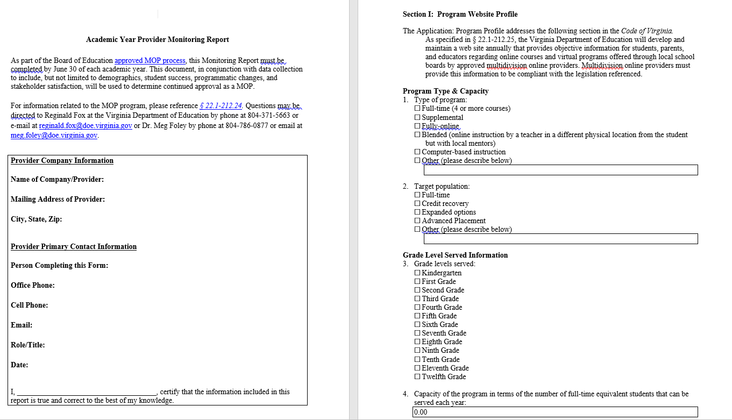
Monitoring Report Updates
Completing the Report
Page 1 – Certification
Section I – Profile Information (AMOP)

Slide 5
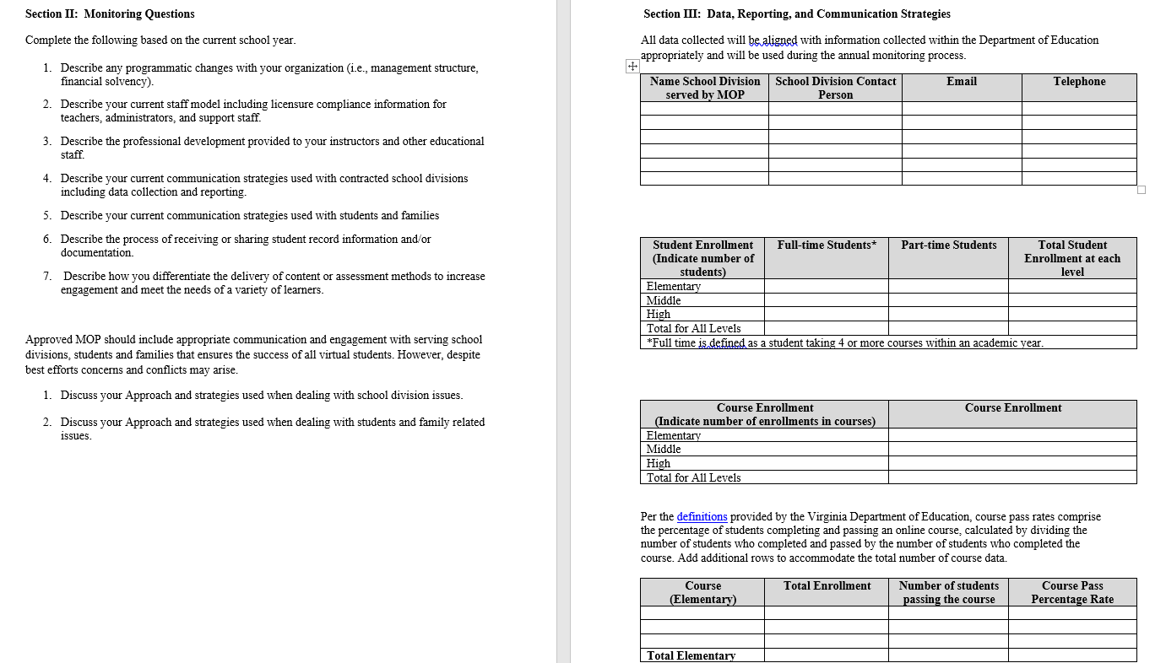
Monitoring Report Updates
Section II – Monitoring Questions
Section III – Data collection, Reporting and Communication of data

Slide 6
Annual Compliance
Renewal in 2022 whether serving students or not
Complete all sections
Providers NOT serving students in 2021-22
Complete only page 1 and Section I
Providers serving students in 2021-22
Complete all sections

Slide 7
Renewal Process
1. Based upon the Virginia Board of Education approved MOP processes (2010):
Multidivision online providers must complete a full review after three years.
Updates and changes to approved multidivision online provider programs will be submitted using the Provider Monitoring Report.
2. The oversight committee will evaluate information related to:
program changes;
information collected from stakeholder surveys;
statistical data related to course completion, student growth and achievement.
3. The oversight committee will make a recommendation within 30 business days.
Based on the recommendation of the oversight committee, a decision regarding the continued approval of multidivision online providers will be made by the Superintendent of Public Instruction within 15 business days of receipt of the monitoring report.

Slide 8

Surveys Provides excellent data and feedback from students and parents.
2021 – over 1508 participants completing surveys
6% took 1-2 online classes
18% took 3-5 online classes
76% took 6 or more online classes (full-time)
98% agree that the quality of the content is good.
82% felt that the courses were personalized to meet the individual needs of the student.
96% felt that the frequency of communication with the teacher met the student’s needs.
Would like more monitored small group sessions.
Would like more student-to-student interaction.
More synchronous time devoted to students asking questions.

Slide 9

Monitoring Report &
Surveys
June 30th

Slide 10

Planning Ahead…
Review and analysis of Monitoring Report
Communication and feedback
Preparation and compliance
Teacher of record (highly qualified teachers with approved licenses)
Contracts with LEA (school divisions)
Enrollment and communication (all stakeholders)
Student records
Approved courses listed on the website (AMOP)

Slide 11
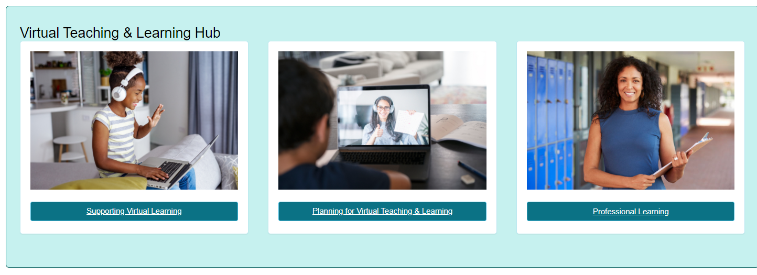

Additional information may be found at Virtual Learning Professional Learning website.
Virtual Learning Website
Dr. Meg Foley
meg.foley@doe.virginia.gov
(804) 786-0877
Coordinator of Virtual Learning
Reginald Fox
reginald.fox@doe.virginia.gov
(804) 371-5663
Virtual Learning Specialist

