Slide 1

Instructions for EOY PEC Submission File
Myesha Garnes, Education Data Specialist
Myesha.Garnes@doe.virginia.gov

Slide 2
EOY PEC Submission File
Notes:
Now that you know why the DOE requests these reports, let’s get started with the submission file. I will say submission file a lot throughout this session. The submission file is what will be turned in to the Department of Education and will represent Unfilled Positions as of 6/30/2024 and the number of exits for the school year between 7/1/2023 and 6/30/2024.

Slide 3
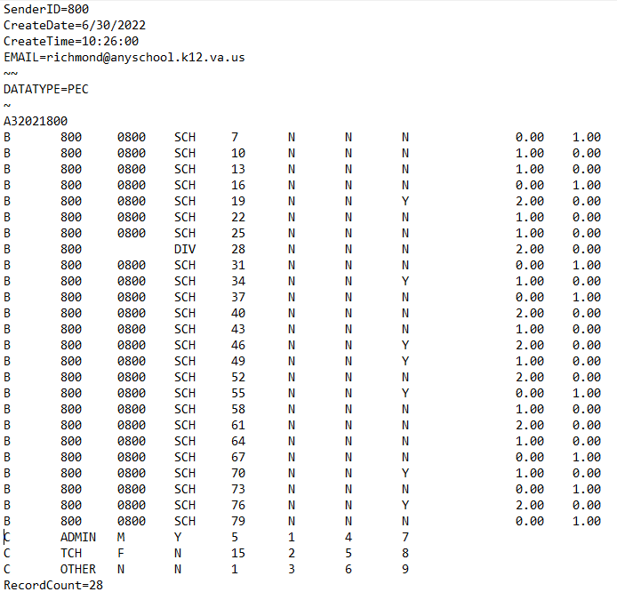
Notes:
This is what the submission file looks like. It may look daunting or technical, but it’s really pretty simple. Today we will only discuss what is required for the End of Year submission. This will include the four parts – the header, A Record, B Record and C Record. Now Let’s go over each part.

Slide 4
A Record
A
3
Current School Year
Division Number
4
Notes:
The next section is the A Record. It is nine digits long and is comprised of:
A for A record
3 for the EOY submission
The current school year
And the three digit division number. The division number here is the same as the division number in the header. Remember, your division number is always three digits.

Slide 5
Header
Division Number
Create Date
Create Time
Email Address
5
Notes:
The top of the submission file is the header. It contains the related three digit division number, the date the file is uploaded, the time it is uploaded, and email address of the responsible person. If there are any questions or problems with the submission file, we will contact this email address for clarification.

Slide 6
B Record
Number of Unfilled Positions on 6/30.
Number of Exits for the school year.
Full Time Equivalency (FTE).
Licensed Positions Only
6
Notes:
The B record is the bulk of the information. I will go over each column in the next section, but I do want to provide background information. The B Record:
Is the number of Unfilled Positions on 6/30 of the current school year and the number of exits for the school year between 7/1 and 6/30.
It is based on Full Time Equivalency or FTE.
And you only report all licensed positions held on a school or division level. This will be teachers and administrators positions that require a license.

Slide 7
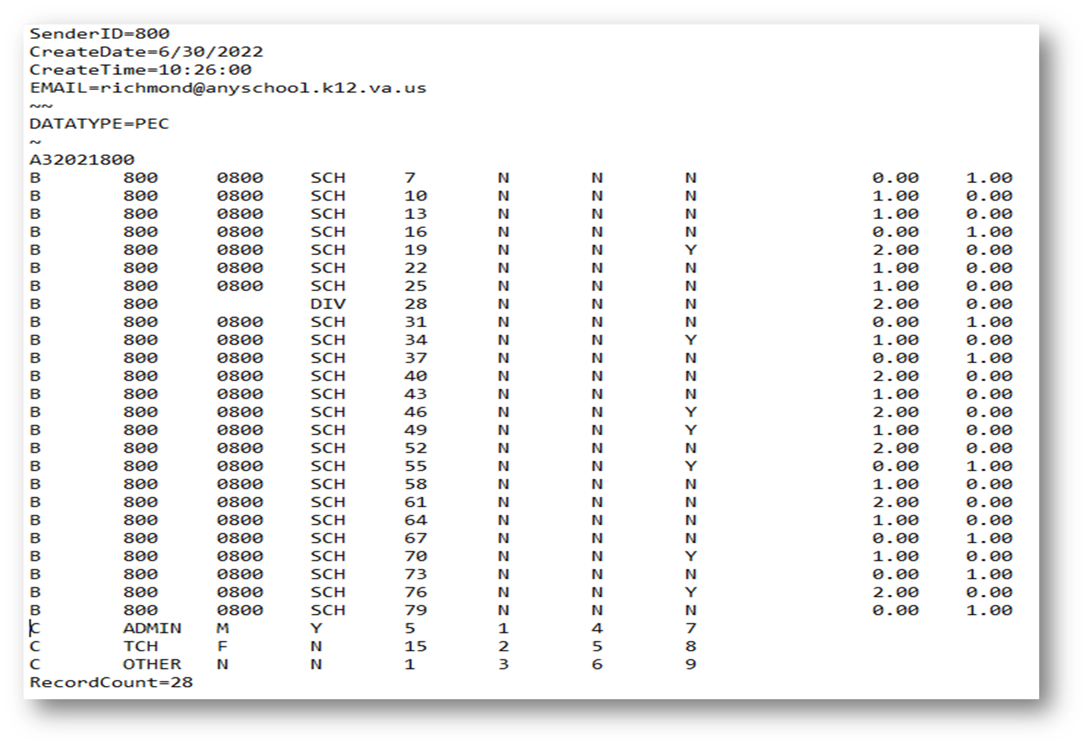
C Record
Reasons for Exits of Licensed Personnel
7
Notes:
The next record is the C record. Again, I will go over each column in the next section, but for right now, I need you to understand that the C record represents the Reasons for Exits of Licensed Personnel.
As a recap, your submission file will be comprised of four parts - the header, the A Record, B Record and C Record.
Let’s put them all together now.

Slide 8
Compile File Information
Notes:
So now that you know the four parts of the submission file, let’s go over compiling the information for the file.

Slide 9
Tools Needed
PEC Website
Data File Template
Positions with Details
Reports
Reason for Leaving Codes
Race and Ethnicity Codes
Data
Unfilled Positions on 6/30 by FTE,
Exits between 7/1 and 6/30 by FTE
Exit survey data.
Fall Verification Reports
Partner
Staffing and Vacancy Report
HR
IT
Notes:
Here is what you will need to gather the information for the submission file:
You will need three files off the PEC website. You will need the Excel file titled Header 2020-2021, the Positions with Details file, the Reason For Leaving Codes and the other is the Race and Ethnicity Codes which you can find on the Data Collection site under Student Records Code Values. Carol or Aleta will put the link to the documents in the chat box for your convenience. Go there now and download the files. We will work with this in the slides to come. I’ll give you a moment to get that done …. Just a moment more ….
Now that you have the file, you will need data to work with. The data includes the Unfilled Positions on 6/30 and the Exits from 7/1 to 6/30 of the current school year. Both are by FTE.
There are reports to help you with your data. The Fall Verification and the Staffing and Vacancy Build-A-Table Report will show what was previously submitted. Aleta or Carol will show you the Staffing and Vacancy report after the presentation.
I can not stress this enough … find a partner in your school/district that will help you with this file. While I am a resource, a local colleague will have a better idea of your set up. Human Resources and IT should work together. Your local Student Record Collection contact or Master Schedule Collection contact will also be a good reference to use.

Slide 10
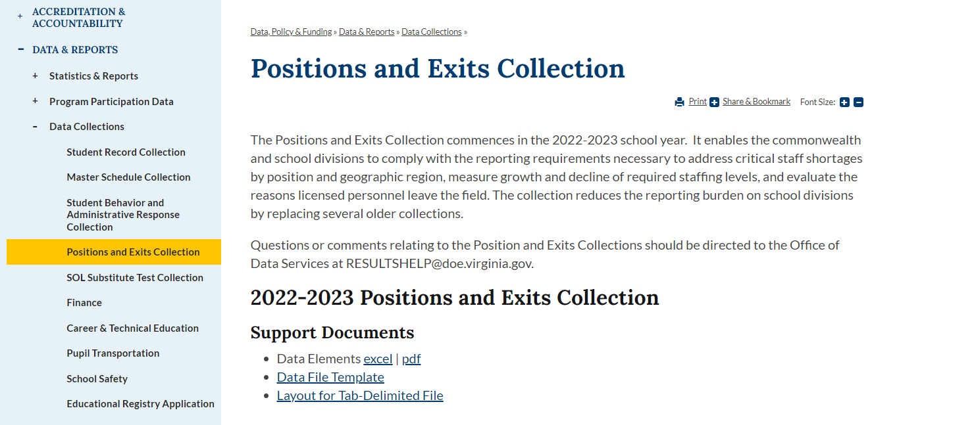
Data File Template
Notes:
Use the Data File Template to compile your data. You can find this on the PEC website under Support Documents

Slide 11
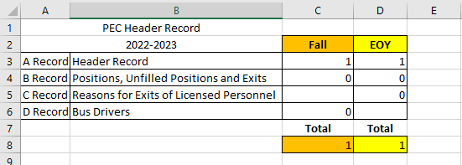
Data File Template – Summary Tab
Notes:
When you download and open the file, notice the Summary Tab. It will calculate the RecordCount for your submissions. Please note: You will be concerned with column D, which is for the EOY data.

Slide 12
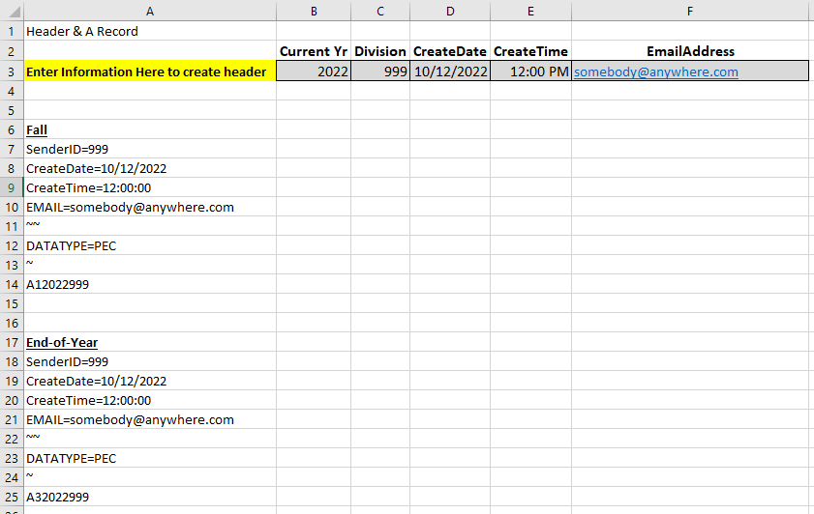
Data File Template – A Record Tab
Notes:
The next is the A Record tab. Enter the correct information on row 3 and Excel will create the header for your EOY submission. The EOY header starts at A17. You can either copy and paste this later or use it as a reference.

Slide 13
Data File Template – EOY B Record Tab
EOY B Record
Notes:
Next we will need to go to the EOY B Record tab so that we can discuss how to input the data there.

Slide 14
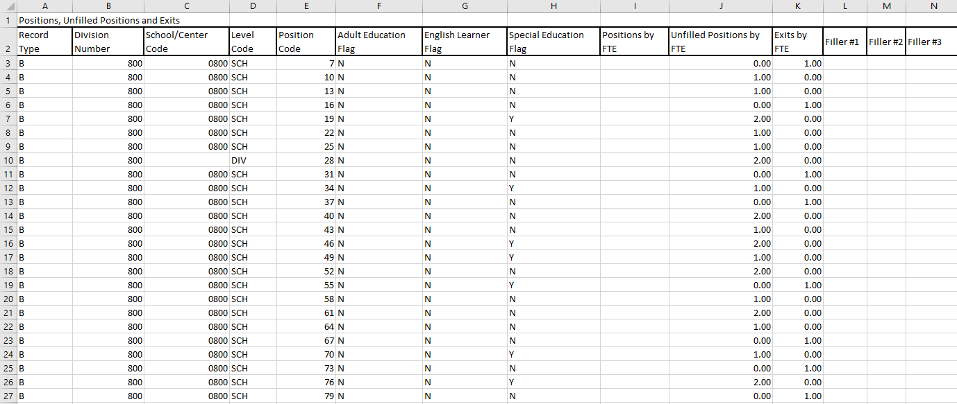
B Record – Column A
Notes:
Now that you have the tools you need, let’s start building your file! We will now be working in the Excel Data File Template that you just downloaded from the website. At the bottom of the file, make sure you are on the EOY B Records tab. I will discuss the columns right now. As I go over each column, you can right-click within the document and select insert comment to write your notes. Let me know if I am going too fast or if you need something repeated. Or, let me know if I’m going too slow.
We are in the B Record, so Column A will always have B. It is required and lets the system know the record type being submitted is a B Record.

Slide 15
B Record – Column B
Notes:
Column B is the Division Number. Each row will have this information, also. It is the same number that is in the header and A record.

Slide 16
B Record – Column C
Notes:
Column C is the School/Center Code. It represents the school or location that is assigned to the position. It is a four digit number. If a person is working more than one location or for the district, do not use a code in this column.

Slide 17
B Record – Column D
Notes:
Column D is for the Level Code. If you have a school code in column C, your level code is SCH. If you do not have a code in column C, your level code is DIV. SCH and DIV are the ONLY codes you can use in column D.

Slide 18
B Record – Column E
Notes:
Column E for the code that represents the position. You will get this information from the Position Code file that you downloaded earlier.

Slide 19
Sample of Position Codes
Position Code | Position Description | License Required | Position Type | Details or relevant SCED codes
1 | Teacher, Early Childhood Pre-Kindergarten | Y | TCH
2 | Teacher, Kindergarten | Y | TCH
3 | Teacher, Elementary Education Grade 1 | Y | TCH
4 | Teacher, Elementary Education Grade 2 | Y | TCH
5 | Teacher, Elementary Education Grade 3 | Y | TCH
6 | Teacher, Elementary Education Grade 4 | Y | TCH
7 | Teacher, Elementary Education Grade 5 | Y | TCH
8 | Teacher, Elementary Education Grade 6 | Y | TCH
9 | Teacher, Comprehensive Language Arts | Y | TCH | 1001, 1002, 1003, 1004, 1005, 1006, 1007, 1008, 1009, 1010, 1011, 1012, 1027, 1028, 1034, 1035, 1036
10 | Teacher, Literature/Reading | Y | TCH | 1047, 1048, 1053, 1055, 1057, 1058, 1059, 1060, 1061, 1062, 1063, 1064, 1065, 1066, 1067, 1068, 1069
11 | Teacher, Composition/Writing | Y | TCH | 1101, 1102, 1103, 1104, 1105, 1136, 1137, 1138
12 | Teacher, Speech and Communication | Y | TCH | 1151, 1152, 1153, 1155, 1156, 1199
13 | Teacher, Linguistics | Y | TCH | 1201
14 | Teacher, All Others in English Language and Literature | Y | TCH | 1992, 1996
Notes:
Here is a sample of the position codes. Notice the Licensed required column. If there is a Y here, use the position codes as necessary. You will not list all of them, just the ones that were included on your Fall submission.

Slide 20
B Record – Column F
Notes:
Column F notates if the position is solely responsible for Adult Education. This can ONLY be N for No, or Y for Yes. A response is required and can not be left blank.

Slide 21
B Record – Column G
Notes:
Column G notates if the position is solely responsible for English Learner. This can ONLY be N for No, or Y for Yes. A response is required and can not be left blank.

Slide 22
B Record – Column H
Notes:
Column H notates if the position is solely responsible for Special Education. This can ONLY be N for No, or Y for Yes. A response is required and can not be left blank.

Slide 23
B Record – Column I
Notes:
This column will be blank . We are not collecting Positions by FTE for the EOY submission.

Slide 24
B Record – Column K
Notes:
The last column is Exits by FTE. The format is the same as Column J - it must be a valid number greater than or equal to 0 and must contain a decimal point and two decimal places and can not be left blank.
The Number of Exits include those who left their position between July 1st of last year and June 30th of this year even if the position was filled before June 30 of last year. Some examples of exits include mid-year exit, end-of-contract, retirement, resignation and termination.
The rest of the columns L-N will not be used for this submission. We will include them later, but for right now, columns A-K are the only ones you will input data in for the B Record.

Slide 25
B Record – Column J
Notes:
Please take note of the format of Column J – it must be a valid number greater than or equal to 0 and must contain a decimal point and two decimal places.
It is reporting positions by FTE. Only positions held by school-level and division-level licensed personnel must be reported. The number of Unfilled Positions is as of the last day of school.
Unfilled positions only include those positions that were advertised as available but no one qualified was hired. If the duties of the position were given to an existing employee in lieu of hiring a new employee, the position should still be included in this count.
It is important to note, you are reporting the position, not the person.

Slide 26
Data File Template – C Record Tab
C Record
Notes:
Next we will need to go to the C Record tab so that we can discuss how to input the data there.

Slide 27
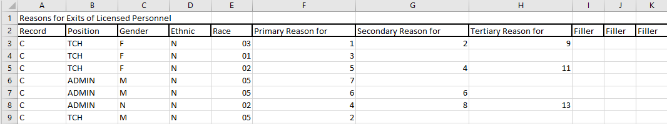
C Record – Column A
Notes:
Now … to the C Record. In the Excel file, make sure you are on the C Record tab. It is the last tab we have to complete for the EOY submission. Remember, only positions held by school-level and division-level licensed personnel must be reported.
Let’s discuss the columns. We are in the C Record, so column A will always have C. It is required and lets the system know the record type being submitted is a C Record.

Slide 28
C Record – Column B
Notes:
Column B is the Position Type – not Position Code. You will tell whether this is a TCH for Teacher, ADMIN for Administrator or Other for Other Licensed Personnel. These are the only code you can use here. However, we do not have any OTHER licensed personnel. It is an option for future positions.

Slide 29
Sample of Position Codes
Position Code | Position Description | License Required | Position Type | Details or relevant SCED codes
1 | Teacher, Early Childhood Pre-Kindergarten | Y | TCH
2 | Teacher, Kindergarten | Y | TCH
3 | Teacher, Elementary Education Grade 1 | Y | TCH
4 | Teacher, Elementary Education Grade 2 | Y | TCH
5 | Teacher, Elementary Education Grade 3 | Y | TCH
6 | Teacher, Elementary Education Grade 4 | Y | TCH
7 | Teacher, Elementary Education Grade 5 | Y | TCH
8 | Teacher, Elementary Education Grade 6 | Y | TCH
9 | Teacher, Comprehensive Language Arts | Y | TCH | 1001, 1002, 1003, 1004, 1005, 1006, 1007, 1008, 1009, 1010, 1011, 1012, 1027, 1028, 1034, 1035, 1036
10 | Teacher, Literature/Reading | Y | TCH | 1047, 1048, 1053, 1055, 1057, 1058, 1059, 1060, 1061, 1062, 1063, 1064, 1065, 1066, 1067, 1068, 1069
11 | Teacher, Composition/Writing | Y | TCH | 1101, 1102, 1103, 1104, 1105, 1136, 1137, 1138
12 | Teacher, Speech and Communication | Y | TCH | 1151, 1152, 1153, 1155, 1156, 1199
13 | Teacher, Linguistics | Y | TCH | 1201
14 | Teacher, All Others in English Language and Literature | Y | TCH | 1992, 1996
Notes:
We are back to the Position Code file for this column. This is where you are getting your Position Type codes. Only Use TCH, ADMIN.

Slide 30
C Record – Column C
Notes:
Column C is the Gender Type – Your options for this column are M for Male, F for Female and N for Non binary. These are the only code you can use here.

Slide 31
C Record – Column D
Notes:
In Column D, you will indicate if the person identifies as Hispanic/Latino. This can ONLY be N for No, or Y for Yes. A response is required.

Slide 32
C Record – Column E
Notes:
Column E describes the race of combination of races in which the person identifies. You can only use the codes from the state’s list of valid state assigned race codes, which are the same as the list used for the Student Record Collection and the Master Schedule Collection. This field can be blank.

Slide 33
C Record – Columns F-H
Notes:
Use columns F-H to list the reasons why an employee is no longer with the Division. The values here are valid reasons selected from the Reason for Leaving codes document. The primary reason column (column F) cannot be blank. Secondary and Tertiary reason can be blank. However, You must have a secondary before you can list a tertiary reason. The three columns must have unique values … they cannot be the same.

Slide 34
Reasons for Leaving Codes
Reason for Leaving Code | Description
1 | Retirement
2 | Family/personal considerations (health, caring for others, career break, or other)
3 | Family/personal relocation
4 | Demanding workload/too prescriptive
5 | Dissatisfaction with administrator/supervisor
6 | Dissatisfaction with school or division climate: discipline/classroom control
7 | Dissatisfaction with school or division climate: duties incompatible with educational training
8 | Dissatisfaction with school or division climate: salary/compensation
9 | Outside pressure from parents, community, social media
10 | Employment in the education field/accepted another job in a Virginia public school division
11 | Employment in the education field-accepted a position in a non-VA public school or out-of-state
12 | Employment outside of the field of education
13 | Accepted a non-teaching position within the same division
14 | Reduction in force/layoff
15 | Certification issue/lost credential
16 | Nonrenewal or termination
17 | Death
18 | Housing (Distance, Cost, Location, Other)
Notes:
Here are the list of codes for a quick reference.

Slide 35
Submission File
Notes:
The Submission File

Slide 36
Tools Needed
Microsoft Word Blank File
Excel Header File
.txt File (NotePad)
Notes:
These are the tools you will need:
The Excel Header File that has all of your data
A blank Word File
A .txt file.

Slide 37
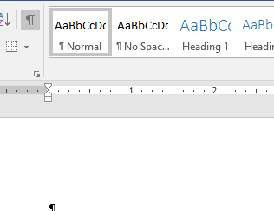
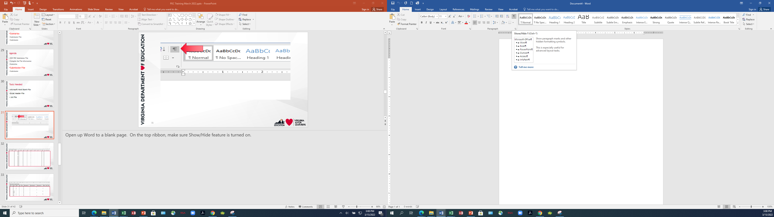

Notes:
Open up Word to a blank page. On the top ribbon, make sure Show/Hide feature is turned on.

Slide 38
Notes:
Highlight the data from the Excel file on the B Record tab. Make sure you get columns A-N – even though the last four do not have any information in them, and go all the way down to the last row in column N.
Copy that into the Word File

Slide 39
Notes:
Highlight the data from the Excel file on the C Record tab. Make sure you get columns A-K – even though the last ones do not have any information in them, and go all the way down to the last row in column K.
Copy that into the Word File under the B records.

Slide 40
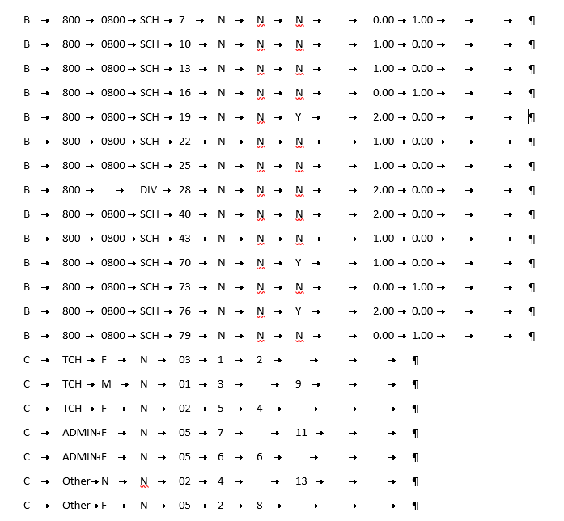
Notes:
Your Word file should look like this Notice how things line up … Notice how there is a tab character or placement when there isn’t any information …. Notice how the B records go beyond the C records. Everything is in place.

Slide 41
Notes:
Next we will add the header and the A record. Then save it as a .txt file. You can also copy the entire Word file and paste it into NotePad and then save it.
We have come full circle! Here’s the file we started with.

Slide 42
Submission
Notes:
After you have compiled the information and created the submission file, you are ready to turn your data over to DOE. Here are the steps to get that done.

Slide 43
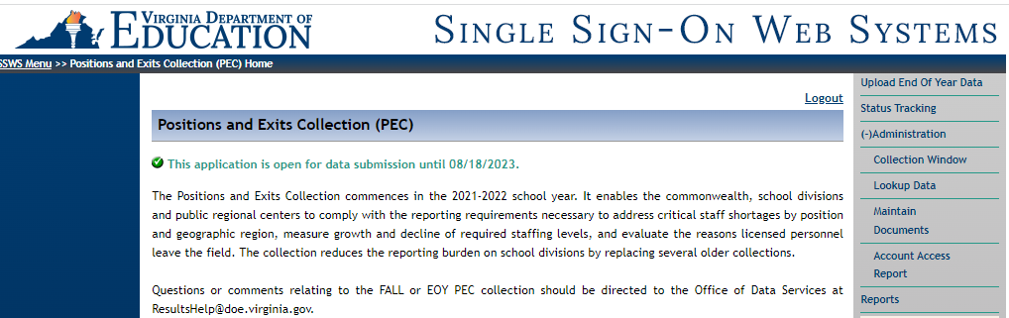
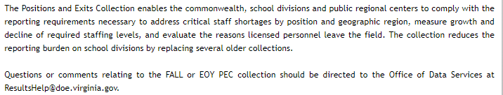
Notes:
Log on to SSWS, select the Positions and Exits Collection, on the right hand menu, select Upload EOY Data. Follow the step to upload the text file.

Slide 44
Upload Data
Resolve All issues
Submit For Local Approval
Local PEC Data Approver
Submit For Verification
Goes to Superintendent
Review Verification Report
Local HR Approver
Notes:
After you upload, resolve any issues and review the verification report. Once that is done, the collection manager needs to submit the file for local approval. This will send the file to the Local PEC Data Approver and the Local HR Approver for their signatures. From there, the Collection Manager will submit it for Verification, and this will send the file to the Superintendent for approval. You will not have a Special Ed Approver for the EOY submission.

Slide 45
Contact Information
Positions & Exits Collection web site
https://www.doe.virginia.gov/data-policy-funding/data-reports/data-collection/positions-and-exits-collection
Myesha Garnes, Education Data Specialist, Office of Data Services
Email: myesha.garnes@doe.virginia.gov or
Dr. Bryan Jackson, Director, Office of Licensure
Email: bryan.jakcson@doe.virginia.gov
Notes:
Other contact information:

