Slide 1
Master Schedule Collection
Virginia Department of Education
Office of Data Services

Slide 2
Agenda
Fall Updates
Introduction and Background
SEDF and IPAL
Approval and Verification Process
Resources

Slide 3
Fall Updates

Slide 4
New Data Element
Responsible School – New 2024-2025 SY
The Responsible School is the four-digit number that identifies the school responsible for the students.
Edit checks for Responsible School
Must be Alphanumeric
Must be four characters
Valid four-digit, state-assigned number
Must be a valid membership school within the responsible division
Blanks are not permitted
Report in the last filler field in the F Record

Slide 5
Work Based Learning
Work Based Learning
Student must be >=14 years old on Oct 1st for codes 1, 2, 9 and 12.
Code | Description
1 | Cooperative Education+
2 | Registered Apprenticeship+
3 | Internship+
4 | Mentorship
5 | Job Shadowing
6 | Service Learning+
7 | Clinical Experience+
8 | Supervised Agriculture Experience
9 | Youth Registered Apprenticeship +
10 | Externship+
11 | School-Based Enterprise+
12 | Entrepreneurship+
13 | Mentorship (140 Contact Hours)+

Slide 6
Credit Awarded Flag
Updated Description
The Credit Awarded flag indicates whether the student:
Successfully completed a credit-bearing course required for graduation OR
Successfully completed a course required for graduation (noncredit-bearing).
Report ‘Y’ for students who successfully meet the objectives of a course that appears on a high school transcript. Elementary and noncredit-bearing middle school courses should have a ‘N’ flag, even if the student completed the class. Only courses designated as secondary level courses are used with accreditation and CCCRI calculations.

Slide 7
Introduction and Background

Slide 8
What is the Master Schedule Collection (MSC)?
The Master Schedule Collection (MSC) identifies teachers and administrators along with their licenses and endorsements
It includes student-level transcript information, including types of courses completed and grades awarded
Courses are reporting by SCED code to show a student's course and academic experience
Comprised of 80 active data elements, 12 retired elements and 10 filler fields

Slide 9
Why is this collected?
To meet the requirements of the State Fiscal Stability Fund (SFSF)
Indicator (b)(1)
Indicator (b)(2)
Indicator (b)(3)
IPAL data collected in the B record is used to ensure certified teachers are being hired.
The SEDF portion of the collection pertains to CTE and funding.

Slide 10
Reporting Rules
Divisions must report all courses and teachers, including those taught by:
Non VDOE licensed private providers that are exempt from reporting MSC.
Regional centers that don’t maintain their own scheduling with their own teachers (regional center is exempt from reporting MSC)
Alternative and special education centers if the center does not maintain their own scheduling with their own teachers (center is exempt from reporting MSC)
Regional centers and private schools must report all courses and teachers unless exempted from reporting by VDOE approval.

Slide 11
Reporting Rules
Record Type | Description | Collection
B | IPAL - Identify all teachers, administrators, and pupil service providers | Fall Only
C | Courses - Identify all courses that are being taught | Fall & EOY
D | Teachers - Identify all sections taught and the teacher providing instruction | Fall & EOY
E | Other Provider - Identify Private Providers as well as individuals or entities without a Virginia Teaching License | Fall & EOY
F | Students - Connects the student, section and teacher | Fall & EOY
G | Administrators and Pupil Personnel - Used to report other teaching staff and administrators | Fall Only
I | Connecting Sections - Connects CTE sections taught at the same time | Fall & EOY
J | Co-op – teacher and number of students monitored | Fall & EOY
K | Interdisciplinary Connecting Sections - 2 courses a division combines to form one local course | Fall & EOY

Slide 12
Fall MSC
What to report?
Snapshot on Oct 1st
Non-teaching staff and school administrators
Current and future courses enrollment
Reporting Timeline
Opens September 16, 2024
Successful file submission due November 13, 2024
Closes December 13, 2024 – all verifications due
Reopens for resubmission January 27 – 31, 2025

Slide 13
Primary Products from Fall
School Quality Profiles
Teacher Quality
VVAAS – Virginia Visualization and Analytics Solution
4th to 8th grade VLP Pilot
Funding
CTE SOQ
Perkins funds
CRDC – Civil Rights Data Collection
Course enrollment total subgroup
Course offerings

Slide 14
IPAL & SEDF

Slide 15
IPAL
The B record identifies all teachers, administrators, and pupil service providers in public schools, regional centers, contracted MOPs, and private providers.
Reports
IPAL Verification Report
Static and only pulls data from the submitted Fall MSC file
Updated IPAL Verification Report
Dynamic with updated data each time it’s generated
IPAL Verification Report (Excel)
Excel version of the verification report broken down into different worksheets

Slide 16
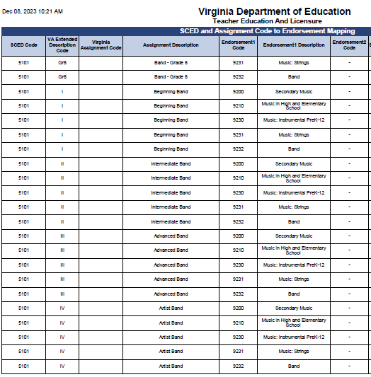
IPAL
IPAL Reports cont.
Provides a listing of the current valid SCED and the corresponding license endorsement(s) that are required for an individual to be deemed as properly endorsed to teach that assignment.

Slide 17
SEDF
Secondary Enrollment Demographic Form
Uses the B, C, D, F, I, and J records
Used with
SOQ Funding
Perkins
Non-traditional Career Preparation Enrollment

Slide 18
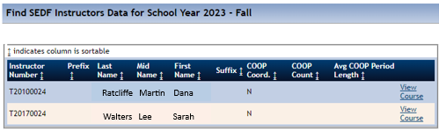
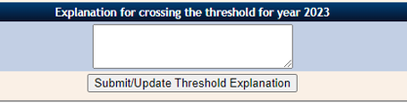
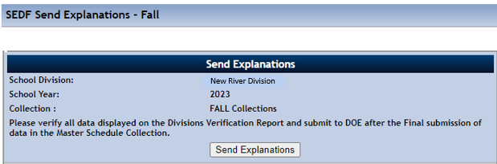
SEDF Explanations

Slide 19
Approval and Verification Process

Slide 20
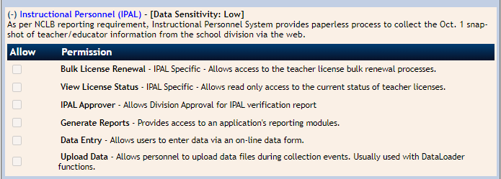
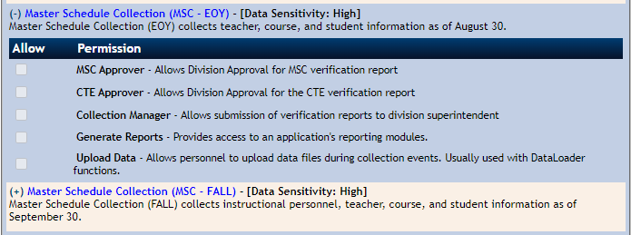
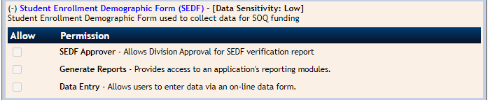
SSWS Roles
The division SSWS Account Manager can assign permissions for each collection
MSC, IPAL and SEDF applications contain local approvers

Slide 21
Upload Data
Resolve all errors
Submit For Local Approval
All Local Approvers review appropriate reports
Submit For Verification
Select Submit for Verification
Review Verification Report
Must have access to MSC, IPAL or SEDF Application
Collection Manager monitor the process until all approvals are complete
Sends the reports to SDCA

Slide 22
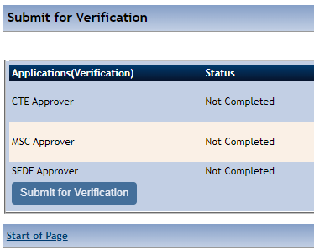

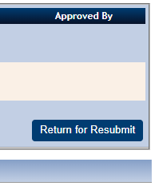


Data Resubmission Steps
Contact the Office of Data Services
Collection Manager returns the data
File Uploader can submit a new file
Collection Manager must submit for Local Approvals again
Collection Manager must submit for verification
Throughout the collection, Data Services allows resubmissions to correct verified data.
Note: If you do not see the File Upload button, step 2 has not been completed.

Slide 23
Resources

Slide 24
Support Documents
The MSC web page contains all current documentation
Specifications for Completing the Master Schedule Collection
Details every data element, contains data edits, and reporting rules
Data Elements
Excel table containing the data elements
Use for quick reference and for file submission type information
Data File Template
Follows the layout of the text file submitted
Used to find and resolve errors
Virginia Active SCED Codes
Lists all valid Va SCED codes and attributes

Slide 25
Contact Information
Dana Hannifan, Educational Data Specialist, Office of Data Services
Email: Dana.Ratcliffe@doe.virginia.gov or
ResultsHelp@doe.virginia.gov 7:30 am to 4:00 pm, Monday through Friday except for state holidays
Carol Wells Bazzichi, Director of Data Collections, Office of Data Services
Email: Carol.WellsBazzichi@doe.virginia.gov
Joseph Ryder, Office of Career, Technical, and Adult Education
Email: Joseph.Ryder@doe.virginia.gov
Bryan Jackson, Office of Licensure
Email: Bryan.Jackson@doe.virginia.gov

