Slide 1
Understand Scoring
August 2024

Slide 2
Purpose
This presentation provides information about Understand Scoring, the online application developed to share information about Virginia’s writing assessments and to provide practice for educators with Virginia’s scoring rubrics.
The presentation can be used by school divisions for local training or by individuals who wish to know more about how Virginia’s writing assessments are scored.

Slide 3
Overview of Topics
What is Understand Scoring?
Accessing Understand Scoring
Using Understand Scoring
Understand Scoring User Reports

Slide 4
Earning a Verified Credit in Writing
Students can earn their verified credit in writing through the EOC Writing SOL assessment, the local high school performance assessment collection, or from one of the substitute tests approved by the Virginia Board of Education.
The EOC Writing SOL assessment training materials remain available in Understand Scoring for Virginia educators (EOC tab).
The EOC Writing SOL test blueprint contains additional information about this assessment option.

Slide 5
What is Understand Scoring?
Understand Scoring is an online application hosted by the Virginia Department of Education (VDOE) and Pearson.
Understand Scoring was originally created to provide additional information about scoring the short paper component of the Grade 5, Grade 8, and End-of-Course (EOC) Writing Standards of Learning (SOL) assessments.
The most recent changes to the application support implementation of the Integrated Reading and Writing (IRW) component of the Grade 5, Grade 8, and EOC Reading SOL assessments
Each time Virginia’s writing assessments have changed, the resources and supports within Understand Scoring have been updated to reflect those changes.

Slide 6
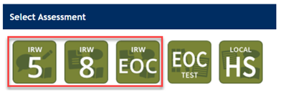
What has Changed?
In February 2024, new sections to support the IRW component of the Reading SOL tests at Grade 5, Grade 8, and EOC became available.
In March 2024, the practice sets and verification sets in each IRW section became available.
Sections supporting the EOC Writing SOL assessment and Local High School performance assessments were not updated since requirements for these assessments have not changed.

Slide 7
Accessing
Understand Scoring
Links to Understand Scoring on the VDOE Website

Slide 8
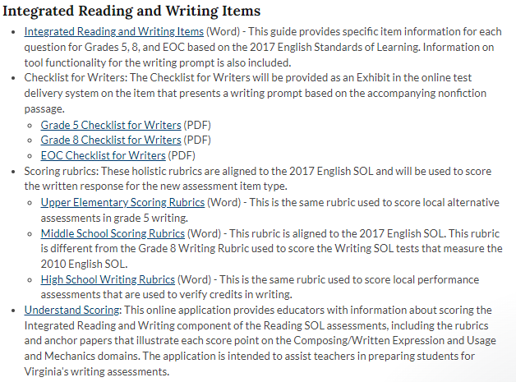
Links to Understand Scoring (1 of 4)
Several links on the VDOE website may be used to access Understand Scoring.
On the SOL Practice Items web page, scroll to the Integrated Reading and Writing Items section.

Slide 9
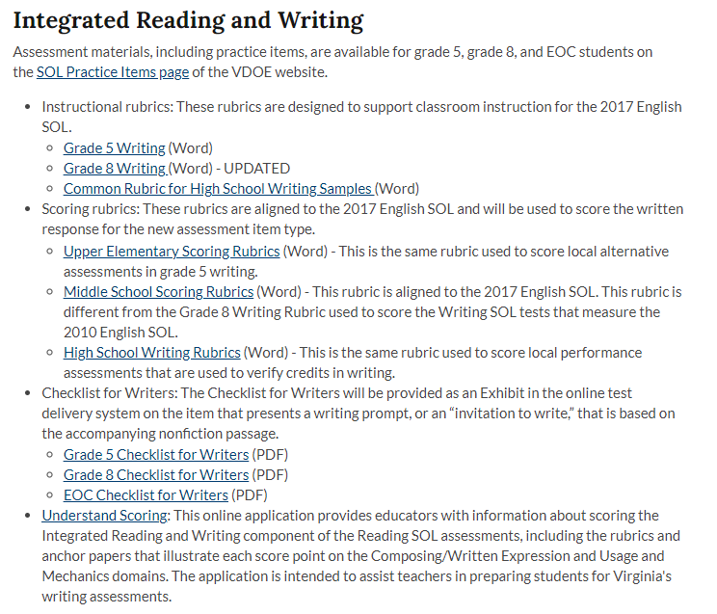
Links to Understand Scoring (2 of 4)
On the English, Reading, & Literacy: Assessment Resources web page, go to the Integrated Reading and Writing section.
The link to Understand Scoring is the last resource listed.

Slide 10
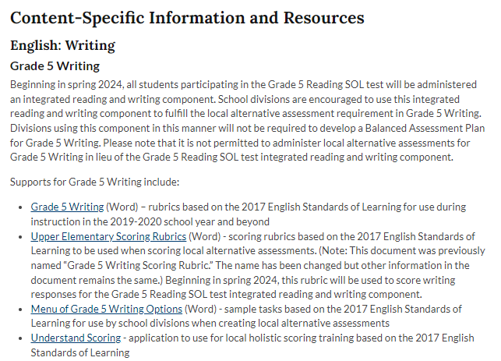
Links to Understand Scoring (3 of 4)
On the Performance Tasks and Local Alternative Assessments web page, go to the Content-Specific Information and Resources section for Grade 5 Writing.

Slide 11
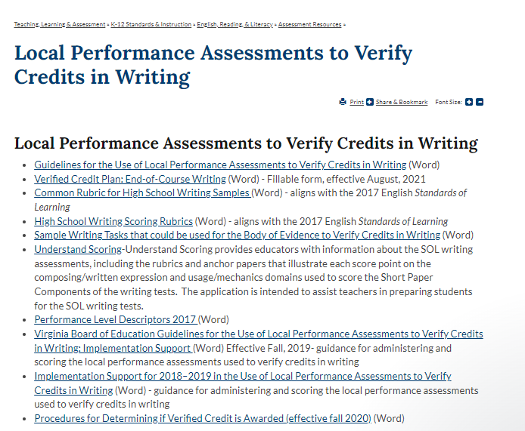
Links to Understand Scoring (4 of 4)
Local Performance Assessments to Verify Credits in Writing web page

Slide 12
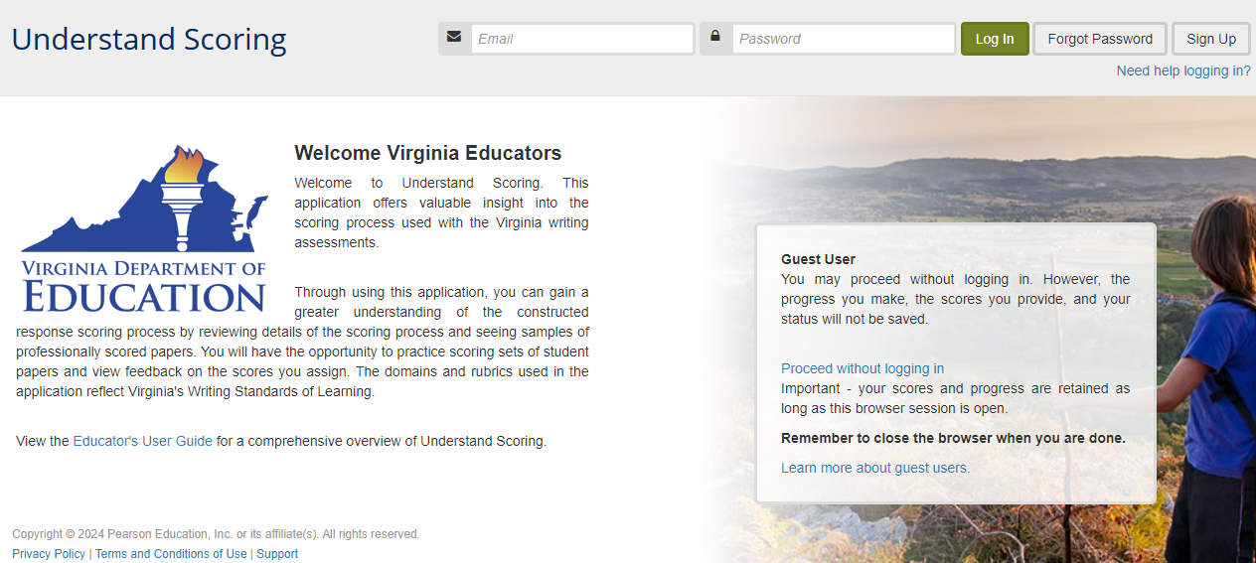
Getting Started

Slide 13
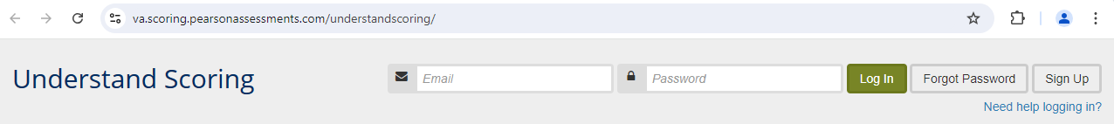
Signing Up
Choose “Sign Up” in the upper right corner to create an account.
Users may access Understand Scoring as guests, but their work will not be saved.
All accounts are purged each summer to accommodate users who must qualify annually for Local High School Performance Assessment scoring. Users who wish to have work saved will create a new account each school year.

Slide 14
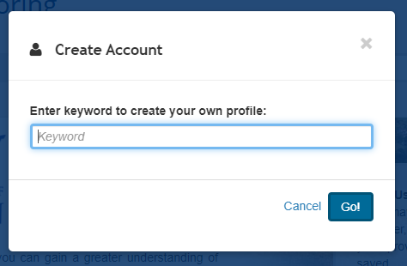
Keyword
A keyword is required to create an account.
Teachers from Virginia public school divisions must use the keyword “Virginia” to create a new user account.
Enter the keyword and select “Go!”

Slide 15
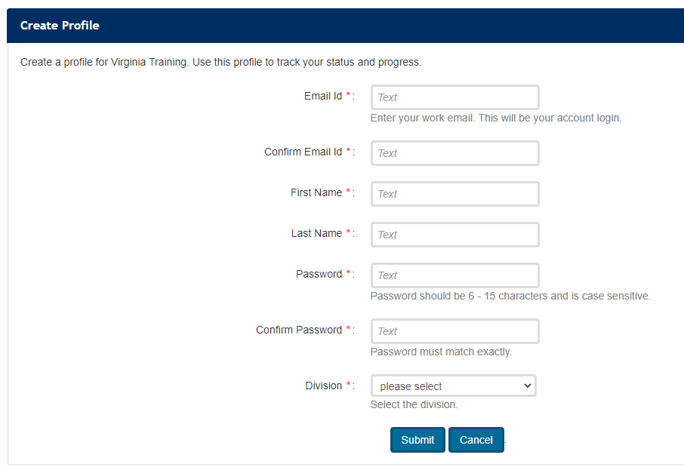
Creating a Profile
Selecting “Go!” on the keyword popup takes the user to the “Create Profile” screen.
Be careful to select the correct school division from the dropdown.
Complete all fields and select “Submit.”

Slide 16
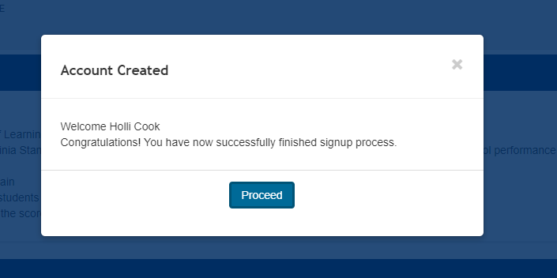
Account Created
A welcome message lets users know their accounts have been created.
Selecting “Proceed” opens the Understand Scoring application.

Slide 17
Using Understand Scoring

Slide 18
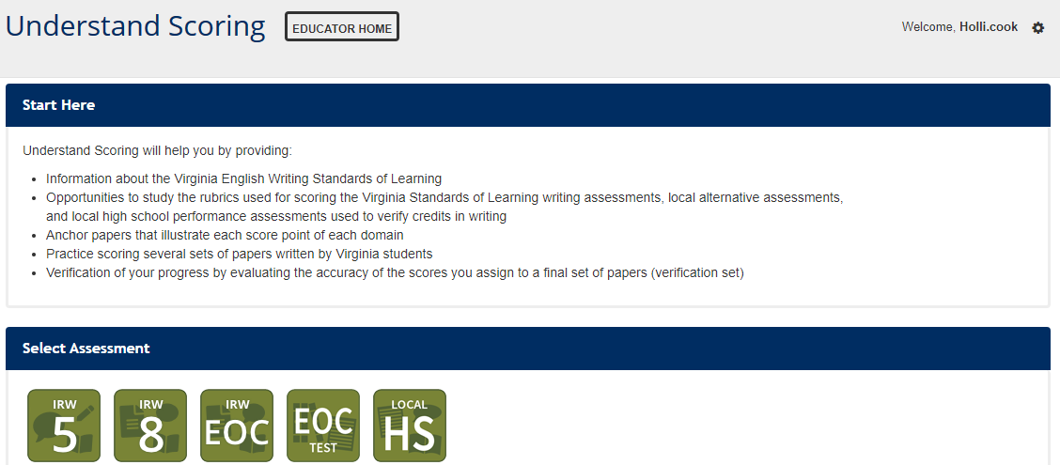
Understand Scoring Home Page
Separate assessment sections include materials to support training for scoring:
Grade 5 IRW,
Grade 8 IRW,
EOC IRW,
EOC Writing SOL Test, and
Local High School Performance Assessments.

Slide 19
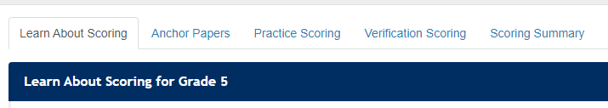
Assessment Sections
Each assessment section includes the same tabbed subsections:
  Learn About Scoring
  Anchor Papers
  Practice Scoring
  Verification Scoring
  Scoring Summary

Slide 20
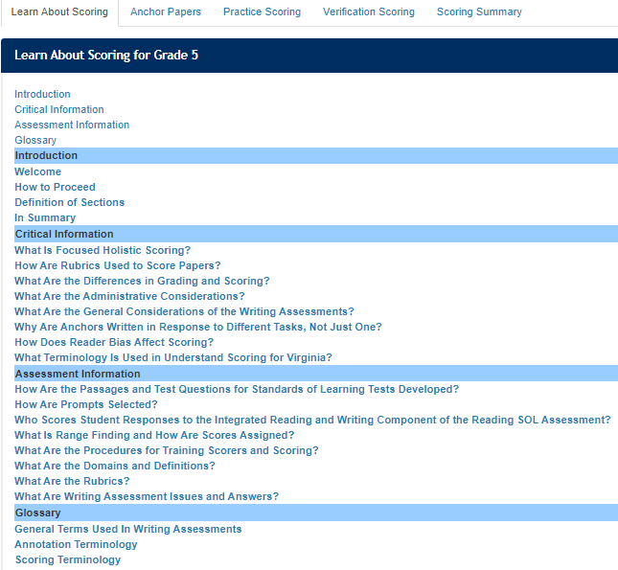
Learn About Scoring
A descriptive overview of scoring is provided in each section through “Learn About Scoring.”
It is important to read and understand information in this section before viewing the anchor papers or attempting the practice sets.

Slide 21
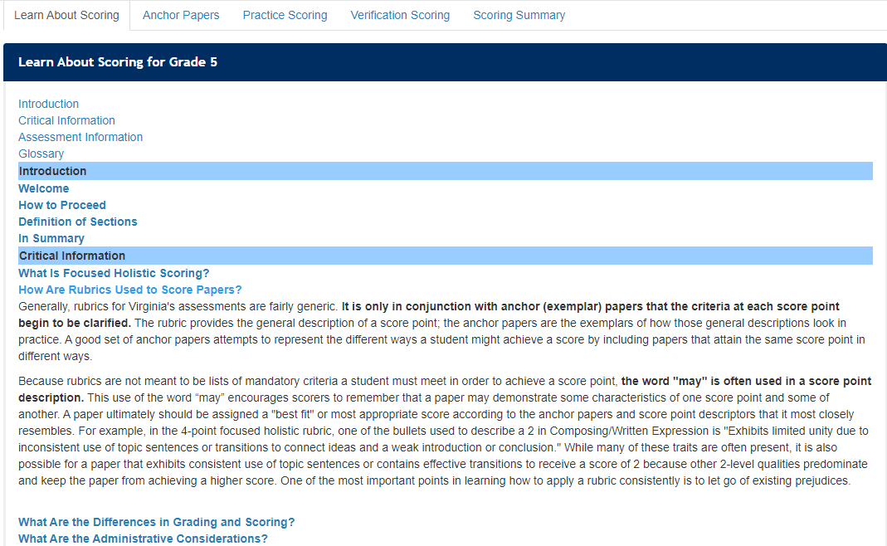
Topics in Learn About Scoring
Select a topic from the list to learn more about that topic.
Select the topic again to close the description.

Slide 22
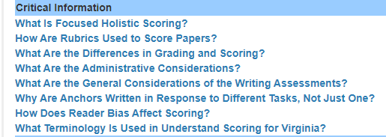
Critical Information: Overview
The Critical Information section provides a closer look at some details related to administering and scoring Virginia’s writing assessments.

Slide 23
Focused Holistic Scoring
Written responses for these assessments are scored, not graded.
Information included in the Focused Holistic Scoring section begins to differentiate scoring and grading.

Slide 24
Focused Holistic Scoring: Definition
Focused holistic scoring is the evaluation of writing proficiency based on specific elements or domains of writing.
  Each domain is scored holistically, independently of the other.
  The score for each domain reflects the reader’s overall impression according to the rubric’s features.
  The scorer weighs the relative strengths or weaknesses and then assigns a score point for each domain that most accurately describes the attributes of the paper.

Slide 25
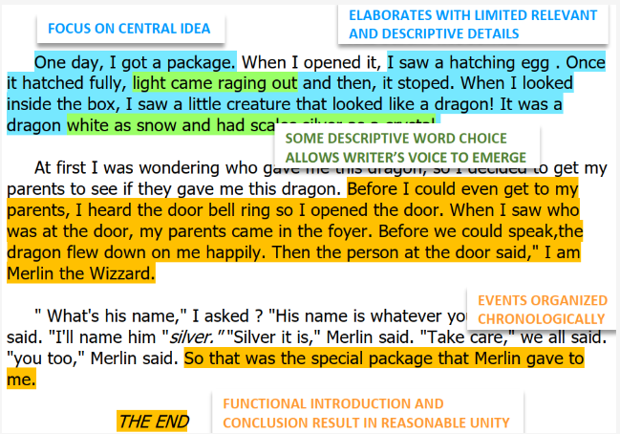
Overall Impression Example
A paper assigned a score of 3 in Composing/Written Expression, for example, might have some characteristics of a 2-level paper and some characteristics of a 4-level paper, but overall, its 3-level characteristics predominate.
Notes:
Image of Composing/Written Expression exemplar 3A with overlay

Slide 26
Nonscorable Papers - Learn About Scoring
Nonscorable Papers
All papers, no matter how brief, must be scored, unless they are off-topic, incoherent, or in a language other than English. Papers that express a student’s refusal to respond to the assessment are also considered nonscorable.
Readers should only score what was written by the student. Written here may also include information from the reading passage that a student appropriately attempted to embed in the response. Scorers should evaluate only the student's work and not information that has been copied and pasted from the passage without an attempt to use the information in a logical manner or address the prompt in some manner.

Slide 27
Accessing the Scoring Rubrics
On the Learn About Scoring tab under “Assessment Information,” select “What Are the Rubrics?”
Scoring rubrics for the Composing/Written Expression and Usage and Mechanics domains will open.
Scoring rubrics may also be accessed on the SOL Practice Items web page, the Assessment Resources web page for English, Reading, & Literacy, and the Local Performance Assessments to Verify Credits in Writing web page.

Slide 28
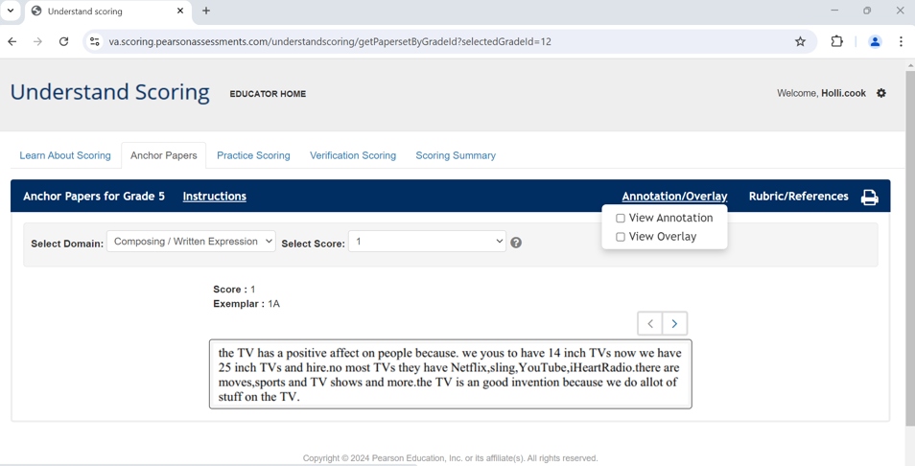
Anchor Papers (1 of 3)
Anchor paper exemplars are available for each domain at each score point.
The exemplars for each score illustrate the range of achievement for that score.
Exemplars are ordered by score from least to greatest. For example, exemplars 1A, 1B, and 1C are each assigned a score of “1” for the domain, and exemplar 1C demonstrates more consistent control of the domain than both 1A and 1B.

Slide 29
Anchor Papers (2 of 3)
Instructions: Select to view a document that describes each feature of the rubric.
Annotation/Overlay: Select to view the annotation and/or overlay for the anchor paper exemplar.
Rubric/References: Select to open the scoring rubrics.
Printer Icon: Select to print the anchor paper exemplar and/or annotation.

Slide 30
Anchor Papers (3 of 3)
All anchor paper exemplars are authentic examples of Virginia students’ responses to prompts, approved by Virginia educators with expertise and experience in the grade level and SOL content.
Anchor papers can be used to help teachers (and students) become more familiar with the rubric and with characteristics of writing that may be demonstrated at each score point.
Annotations are included to provide explanations for each score point, using text culled from the writing sample.
Overlays highlight information within the anchor paper exemplar that is referenced in the corresponding annotation.

Slide 31
Anchor Paper Annotations
The annotation accompanying each anchor paper exemplar describes how that paper meets the expectation outlined in the rubric for the specific score point.
Annotations were developed using feedback from Virginia teachers and other educators serving on the 2012, 2020, and 2023 rangefinding committees. For writing, these committees:
  Review and discuss the writing rubrics and previous anchor papers.
  Read and assign scores to new writing samples completed by Virginia students.
  Evaluate scored papers within a specific score point: ex. high 3, low 3, etc.

Slide 32
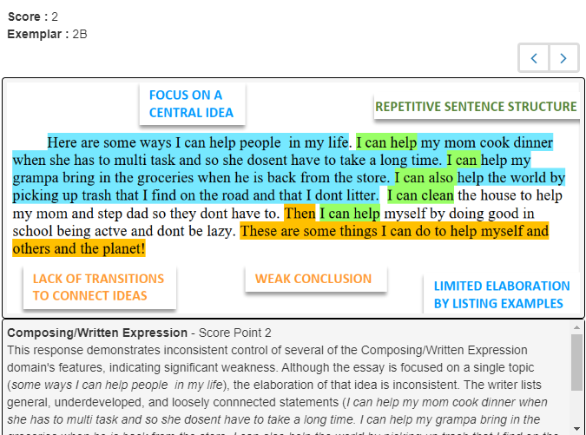
Anchor Paper Annotation/Overlay
While viewing each anchor paper exemplar, educators may choose to view the annotation and a highlighted overlay.
This example shows the highlighted overlay and the annotation for Composing/Written Expression Exemplar 2B.

Slide 33
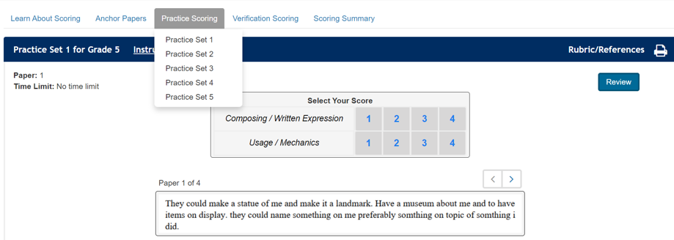
Practice Scoring (1 of 2)
Five practice sets with 4 papers per set provide Virginia educators experience with scoring papers written by Virginia students.

Slide 34
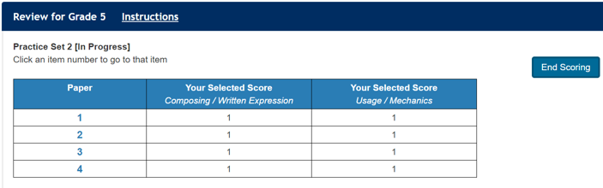
Practice Scoring (2 of 2)
Users are encouraged to reference the Anchor Papers as needed when completing the practice sets.
After a practice set is completed, select “End Scoring” on the review screen and select “Yes” to confirm the scores are final via a pop-up.

Slide 35
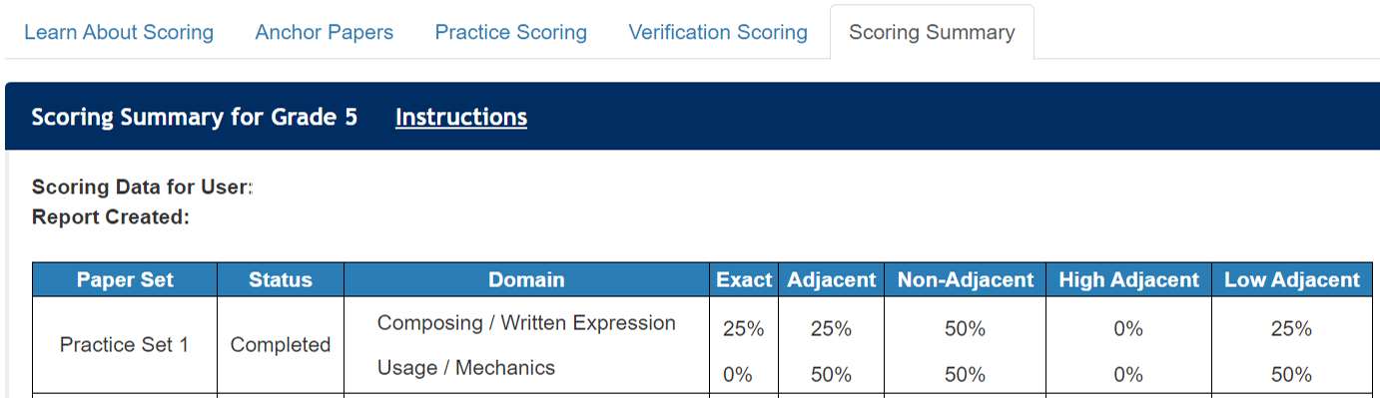
Scoring Summary
The Scoring Summary tab opens when a user indicates the practice set scores are final, ending that practice session.
To increase scoring accuracy, review the scoring summary alongside the actual scores and annotations for each paper in the practice set before attempting the next practice set.
Notes:
The scoring summary serves as formative feedback that will assist the scorer in becoming more aligned to the scoring rubrics, which is necessary to meet qualifying in verification sets.

Slide 36
Using the Scoring Summary (1 of 2)
The Exact column shows the percentage of scores assigned that matched the practice papers’ actual scores.
The Adjacent column shows the percentage of scores assigned that were within one score point of the practice papers’ actual scores.

Slide 37
Using the Scoring Summary (2 of 2)
In this example, 50% of the scores were non-adjacent in each domain, meaning the score assigned was more than 1 point away from the paper’s actual score. Also, 50% of the adjacent scores for Usage and Mechanics were low (one point lower than the paper’s actual score). This scorer should:
Review the practice set annotations for Practice Set 1 to gain a better understanding of why each score point was assigned.
Review the anchor sets and annotations again with these results in mind before attempting the next practice set.

Slide 38
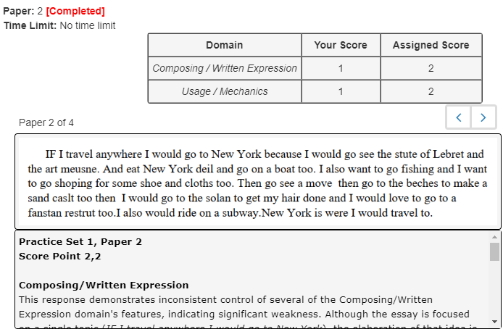
Reviewing the Practice Sets
After a practice set is submitted, the user may then again select the set from the dropdown menu to review the assigned scores and annotations.

Slide 39
Adjacent and Non-Adjacent Scores
Adjacent scores are within one point of each other.
  For a practice set paper with a score point 3 in Usage and Mechanics, a low adjacent score would be 2, and a high adjacent score would be 4.
Non-adjacent scores are more than one point away from the target score.
  For a practice set paper with a score point 3 in Usage and Mechanics, a non-adjacent score would be 1.

Slide 40
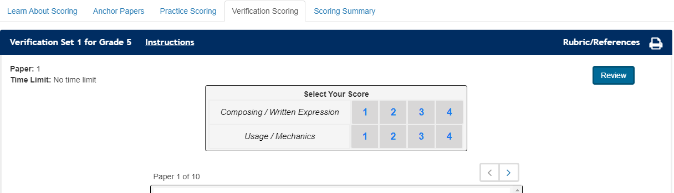
Verification Scoring (1 of 2)
There are two verification sets in Understand Scoring within each section that may be used to verify consistency among scorers after training or to qualify scorers (Local HS).

Slide 41
Verification Scoring (2 of 2)
Verification sets serve as a scoring assessment to ensure that scores assigned by educators are consistent with performance expectations established by the scoring rubrics and supported by the anchor paper exemplars.
Divisions using local performance assessments to verify credits in writing must use the verification sets in the Local HS section to qualify scorers. Qualification to score occurs annually in these divisions.

Slide 42
More Uses for Understand Scoring
(1 of 2)
Information in Understand Scoring may be helpful to anyone producing, teaching, or scoring student writing.
  Model for what teachers will look for when they score student writing
  Model for providing peer feedback, self assessment
  Cross-curricular opportunities – feedback about not only the subject (e.g., history) but also on the writing (score for history, scores for writing)
  Convenient platform to show scored examples of writing samples, written by Virginia students, to students

Slide 43
More Uses for Understand Scoring
(2 of 2)
  Share exemplars with students during instruction to enhance students’ understanding of how the rubrics will be applied to their writing.
  Use examples and annotations to identify (and help students recognize) strengths in students’ writing and to provide examples of how students might improve their writing.

Slide 44
Local Performance Assessments to Verify Credits in Writing
Materials and resources to support school divisions that exercise the option to verify credits in writing using local performance assessments are housed on the Local Performance Assessments to Verify Credits in Writing web page.
Divisions exercising this option are required to:
  Adhere to the Guidelines for the Use of Local Performance Assessments to Verify Credits in Writing (Guidelines)
  Maintain a local Verified Credit Plan for EOC Writing that shows how the division is meeting requirements described by the Guidelines
  Use the Local HS section in Understand Scoring to qualify scorers
  Follow the Procedures for Determining if Verified Credit is Awarded

Slide 45
Qualification: Local HS (1 of 2)
Scorers should have 70% or better exact agreement with the actual scores on each domain in one of the verification sets to “qualify” as a scorer for the local performance assessments to verify credits in writing.
  Exact agreement means the scores must match. Adjacent scores do not count as exact agreement.
  The second verification set is provided for scorers unable to meet the 70% or better requirement on the first attempt. After additional practice, prospective scorers have the option to qualify using the second set.
Scorers having 10% or more non-adjacent scores in more than one domain do not meet the consistency expectations set to score local performance assessments used to verify credits in writing.

Slide 46
Qualification: Local HS (2 of 2)
Even after qualifying, scorers should continue to revisit the anchor sets and annotations, along with any other resources available in Understand Scoring, to recalibrate and remain tied to the achievement expectations established by the rubrics and the anchor paper exemplars.

Slide 47
Best Practice for Scoring (1 of 3)
Scorers should read and understand:
  All information provided in “Learn About Scoring.”
  The scoring rubric for the Composing/Written Expression domain and each of the Composing/Written Expression anchor paper exemplars and annotations.
  The scoring rubric for the Usage and Mechanics domain and each of the Usage and Mechanics anchor papers and annotations.

Slide 48
Best Practice for Scoring (2 of 3)
It is best practice that all student papers for the local performance assessment are read by two readers, with the student’s score for each domain being the total of the score assigned by both readers.
Divisions should establish protocols for resolving non-adjacent scores.
  It is recommended that a third qualified scorer rescore the domain on which scores are non-adjacent, with the highest two of the three scores accepted.

Slide 49
Best Practice for Scoring (3 of 3)
School divisions may choose how to train scorers for other local writing assessments that are not used as part of a collection used to verify credits in writing.
“Procedures for Training Scorers and Scoring,” provided as part of the Local HS section, describes processes and expectations that may be helpful.

Slide 50
Questions About Scoring (1 of 2)
Should a writing sample lose a point if:
  It includes a digression?
  It does not have five paragraphs?
  There is no counterclaim?
No. The score should reflect the reader’s overall impression, based on the rubric.
  The rubric, even for score point 4, states “few, if any, digressions.”
  The rubric does not mention formulaic writing.
  The rubric states that a paper earning a score point 4 “addresses counterclaims, when appropriate for the mode of writing.”

Slide 51
Questions About Scoring (2 of 2)
Should a writing sample gain a point if:
  There are quotation marks, one question mark, and one exclamation point, regardless of appropriate use?
  There are five paragraphs?
No. The score should reflect the reader’s overall impression, based on the rubric.
  The rubric does not mention tallying the variety of punctuation marks to award a higher score.
  The rubric does not mention formulaic writing.

Slide 52
Preferences versus Rubrics
Papers must be scored holistically for each domain, not graded. An educator’s classroom preferences and rules for writing, if not included in the Virginia writing rubrics, are not features to score.
Example: “ Contains specific word choice, descriptive language, and purposeful information, enhancing the writer’s voice and creating a tone appropriate for the intended audience.”
  The rubric does not say “No second-person pronouns.”

Slide 53
The Range Within Each Score Point
It is important for local scorers to understand the criteria used in assigning a score and not to expect that papers at a certain score point will always look the same or have the same attributes.
Papers receiving the same score point may look very different from each other.
Within each score point, a range of papers representing the lower, middle, and upper ends will be evident, as it is in any scoring.
Notes:
This is analogous to the range when grading. For example, the range in many school divisions for an A is 91 to 100, but every score within this range would be considered an A. While scoring and grading are not the same, this is one way in which they are similar.

Slide 54
Using Rubrics and Anchor Papers
Generally, rubrics for writing assessments are fairly generic and provide the general description of a score point, while anchor papers provide examples of student writing that illustrate the rubric descriptions.
It is only in conjunction with anchor papers that the criteria at each score point of the rubric begin to be clarified.

Slide 55
Reviewing Anchors to Recalibrate
As a reminder, revisiting anchor paper exemplars, even after successfully completing verification set(s) or qualifying to become a scorer, helps ensure that the scorer remains tied to the performance expectations in each domain.
Reviewing the exemplars before beginning a new scoring session is best practice.
Divisions may also choose to include time within the scoring session to revisit anchors to further ensure validity in applying scores.

Slide 56
Scoring Protocols (1 of 2)
Divisions are encouraged to develop scoring protocols that include:
  How to resolve non-adjacent scores.
  When and how often training will occur.
  When and how often calibration of scorers will occur.
  When and how often local tasks will be administered and scored.

Slide 57
Scoring Protocols (2 of 2)
It is best practice to:
  Incorporate quality control activities throughout a scoring window;
  Train (and qualify) scorers at a time near the first scoring window; and
  Include a way to recalibrate and/or requalify scorers immediately before scoring student samples or during an extended scoring window.

Slide 58
Collections of Evidence
A local panel must determine if a verified credit is awarded based on the collection of evidence.
There is no numerical score that correlates to a passing or failing score for an individual writing sample OR a collection of evidence.
A student’s writing samples across the course/grade level together can be considered a collection of evidence through which growth in skills may be demonstrated.
  The expectation is not that all three samples included in the collection of evidence demonstrate the same level of control.
  An increase in skill and control from the first to last writing sample may be considered when determining if a verified credit is awarded.

Slide 59
Understand Scoring
User Reports

Slide 60
What is the Purpose of User Reports? (1 of 2)
Understand Scoring User Reports are provided to school divisions by VDOE as a record to document how its users are scoring on the verification sets completed.
These are cumulative, division-level reports that include scoring summary information for users who have:
  Selected the school division when creating a user account in Understand Scoring
  Completed at least one of the verification sets in any of the assessment sections in the online application.

Slide 61
What is the Purpose of User Reports? (2 of 2)
The Understand Scoring User Report:
  Can serve as a school division’s official record of qualified scorers when the division is using local high school performance assessments to verify credits in writing.
  Documents participation in local professional development activities that involve Understand Scoring.
  Can be used to identify scorers who may benefit from additional practice with Virginia’s scoring rubrics for writing.

Slide 62
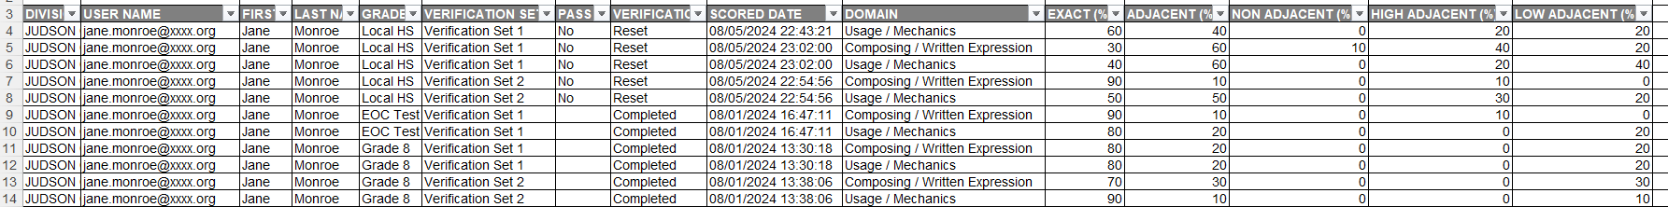
Sample Understand Scoring User Report

Slide 63
Data Fields in the User Report (1 of 2)
Division
User Name (Email)
First Name
Last Name
Grade (5, 8, EOC, EOC Test, Local HS)
Verification Set (Set 1 or Set 2)
Pass? (populated only for Local HS)
Verification Set Status (Completed or Reset)
Scored Date (date and time)

Slide 64
Data Fields in the User Report (2 of 2)
Domain (Composing/Written Expression or Usage and Mechanics)
Exact (%)
Adjacent (%)
Non Adjacent (%)
High Adjacent (%)
Low Adjacent (%)

Slide 65
How Will Divisions Receive These Reports?
School divisions are unable to download User Reports from Understand Scoring.
VDOE staff will provide the Understand Scoring User Report to the Division Director of Testing (DDOT) and DDOT2, if the DDOT2 has an account, through the Single Sign-On Web Systems (SSWS) Dropbox.
Understand Scoring User Reports will be provided monthly, beginning mid-September 2024 and continuing until mid-March 2025.
Any division needing an updated report outside this schedule should contact the Office of Assessment, and a report will be provided.

Slide 66
Stay Connected
Office of Assessment
  Student_Assessment@doe.virginia.gov
  (804) 225-2102
Office of Humanities
  Jill Nogueras, Associate Director of English Literacy PK-12, Jill.Nogueras@doe.virginia.gov
  Colleen Cassada, Secondary English Literacy Coordinator, Colleen.Cassada@doe.virginia.gov
  Ellen Frackelton, Elementary PK-5 Reading/Literacy Coordinator, Ellen.Frackelton@doe.virginia.gov

