Slide 1
Focus on Mathematics
Developing a Culture of Mathematics

Slide 2
Agenda
Developing a Positive Mathematics Identity
Building a Mathematics Community
Communicating Mathematically
Virginia Department of Education, 2025

Slide 3
Learning Goals
Develop positive mathematics identity in students
Explore classroom routines and structures to develop a mathematics community
Understand strategies to foster communicating mathematically
Virginia Department of Education, 2025

Slide 4
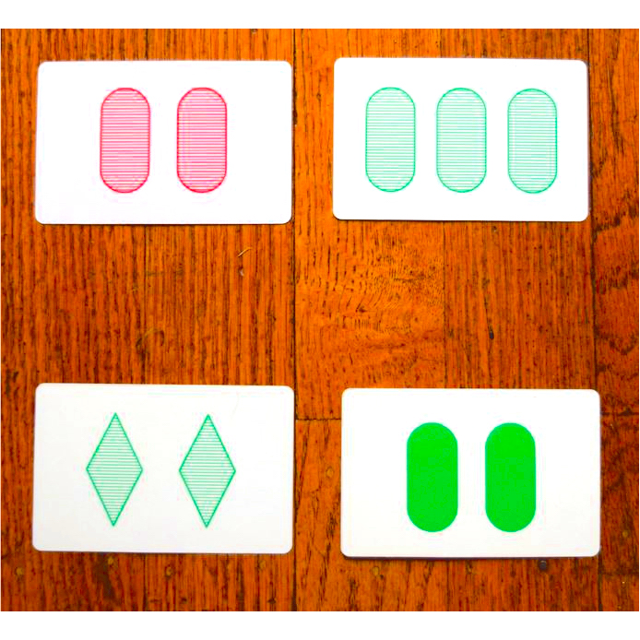
Reasoning Routine – Which One Doesn't Belong?
Virginia Department of Education, 2025
Notes:
Set the tone for the session with a reasoning routine. Display the images on the slide and ask participants to silently think about which of the cards does not belong. After allowing time for thinking, ask participants to share. Participants may share reasoning that each of the images doesn’t belong. The upper left is the only image that is red. The lower right is the only image that is solid colored. The lower left is the only image that has rhombi, and the upper right is the only image with three figures.
Share that this routine was selected to elicit discourse that focused on reasoning and justification. While the images don’t have a strong focus on mathematics content, they provide opportunities for justification as part of classroom discourse.

Slide 5
Positive Mathematics Identity

Slide 6

Who in the room is a "math person"?
Notes:
Ask the group to raise their hand if they identify as a “math person.” Ideally every hand is raised, because everyone is a math person. As educators, we play a major role in helping students to develop a positive mathematics identity.

Slide 7
What comes naturally to children in mathematics?
“They have a natural sense that allows them to understand and manipulate very small quantities with precision, and much larger quantities in approximation.”
“Those abilities are a far cry from the abilities teachers hope to develop in their students, but they are the base upon which teachers can build.”
“For educators, that means we should not expect students will learn mathematics with ease. Rather, we should expect that mathematical proficiency will require careful cultivation and will develop slowly. At the same time, we should keep in mind that students are born with the ability to learn math, and we should not let students give up by concluding that they’re just no good at math.”
Willingham, 2010
Notes:
Research has shown that we are born with the innate ability to understand mathematics. The quotes on slide 7 come from Daniel Willingham’s article and highlight this research. Allow participants to read the quotes and discuss points that resonate with them.
Ask the Cognitive Scientist: Is It True That Some People Just Can't Do Math? by Daniel T. Willingham, American Educator Winter 2009-10, American Federation of Teachers (aft.org)

Slide 8
Math Identity
Your math autobiography is your life story of who you are as a mathematics educator and a student of math. In it, you relate the events and experiences that have shaped your mathematics development.
Who were you as a student of mathematics?
What personal successes and/or struggles did you have in math classes?
What do you value in math and in your experiences?
Who was the first educator or math teacher that made an impact on you?
What were pivotal experiences and/or decisions that led to where you are today in your math educator journey?
“Reflection: Looking back so that the view forward is even clearer.” (unknown)
Notes:
Allow time for participants to individually think about their own math identity as the think about their math autobiography. Participants should make notes to answer a few of the questions on slide 8.

Slide 9
Discussion
Each person shares highlights of their math autobiography.
Reflect: What was similar in your experiences? Different?
Notes:
Provide time for participants to share their math autobiography with a partner or small group. What was similar in participant experiences?
The way we view the teaching and learning of mathematics is shape by our own experiences and it is critical that we understand how our feelings trickle down to the students we work with.

Slide 10
Reflection
What is the leverage point for a mathematical experience to be positive or negative?
Thinking about your classroom, what beliefs do you hold that promote positive mathematical experiences for students?
Notes:
Spend time reflecting on what ultimately made a math experience positive or negative and how your beliefs promote positive math experiences for students.

Slide 11
Why are students’ math identities important?
Julia Aguirre and her colleagues define mathematics identity as:
The dispositions and deeply held beliefs that students develop about their ability to participate and perform effectively in mathematical contexts and to use mathematics in powerful ways across the contexts of their lives.
“Depending on the context, a mathematics identity may reflect a sense of oneself as a competent performer who is able to do mathematics or as the kind of person who is unable to do mathematics.”
Aguirre et al., 2013
Notes:
Teachers, peers and parents can all influence how the mathematics identity of students develop and thus, as we turn our eyes to considering new instructional materials it is important to consider how the materials will help us support students in the five process goals of becoming mathematical problem solvers, communicating mathematically, reasoning mathematically, making mathematical connections, and using mathematical representations to model and interpret practical situations. In short, we are all "math people", and as educators we must lean into this identity.
The Impact of Identity in K-8 Mathematics – Julia Aguire

Slide 12
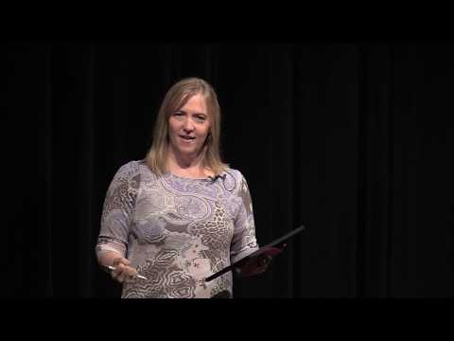
Mathematizing vs Answer-Getting
What is mathematizing?
Why is it important to focus on mathematizing and not answer-getting?
Think back to the activity from the start of our session. How is this an example of "mathematizing" and strong instruction?
Notes:
Share that you will watch a video that gives common language to discuss mathematics instruction. As you watch, consider the following three questions (included on the slide):
What is mathematizing?
Why is it important to focus on mathematizing and not answer-getting?
Think back to the activity from the start of our session. How is this an example of "mathematizing" and strong instruction?
At the heart of good instruction is the process of mathematizing versus answer-getting. in mathematizing, we use an instructional task to teach the mathematics and concepts so that students can answer questions like these. In answer getting, we use an instructional task to teach students the steps needed to get a right answer.
Pamela Weber Harris – Answer Getting Culture
https://www.youtube.com/watch?v=OZxtL9wVhX8&list=PPSV

Slide 13
"In the process of working out unclearness, that's where learning occurs."
Strong Instruction in Mathematics must focus on Mathematizing vs. Answer Getting for true learning to occur.

Slide 14
Building a Mathematics Community

Slide 15
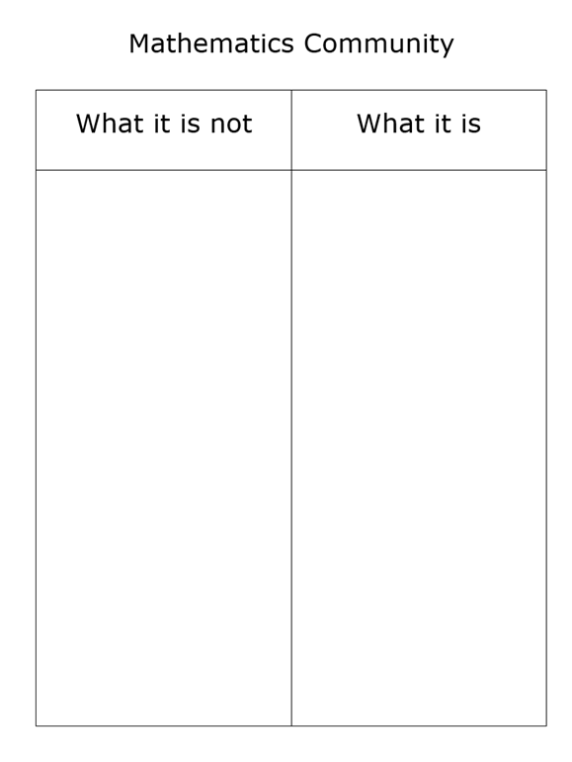
Mathematics Community
Virginia Department of Education, 2025
Notes:
Distribute the mathematics community sort to participants and ask groups to work together and sort the characteristics into examples and non-examples.
Alternately, you could ask participants to brainstorm characteristics of a mathematics community, providing both examples and non-examples.

Slide 16
Mathematics Community
What it is NOT: | What it is:
Teachers doing most of the math | Students doing most of the math
Assigned tasks | Student choice
Teachers showing the procedure and talking about the steps to follow | Students talking about their mathematical thinking and reasoning
Teachers as holders of knowledge | Teachers acting as facilitators – asking good questions
Students working in isolation; sharing answers or strategies is considered cheating | Students working collaboratively and learning from each other
Teachers rescuing students who are stuck or struggling | Students engaging in productive struggle with challenging mathematics and learning from errors
Teachers presenting to the whole class | Teacher working with small groups
Focused on procedural skill | Focused on conceptual understanding
Virginia Department of Education, 2025
Notes:
After the sort or brainstorming is completed, display slide 16 and discuss any characteristics that stand out to participants. Note that there will be times within a mathematics community where a teacher is explicitly teaching a skill or presenting to the whole class for a brief period; however, generally, those are not characteristics of a mathematics community.

Slide 17
Routines and Structures to Build Community
Reasoning Routines
Rich Tasks
Quality Questions
Virginia Department of Education, 2025
Notes:
There are a variety of routines and structures that support building a community of mathematics. This session will address three, reasoning routines, rich tasks, and quality questions.

Slide 18
Reasoning Routines
Brief (5-10 minutes)
Focused on mathematical understanding
Incorporate reasoning and justification
Class discussion without students writing (typically)
Virginia Department of Education, 2025
Notes:
Reasoning routines are brief routines that are designed to get students thinking and talking about mathematics. When you begin using reasoning routines, you may wish to start with something that does not have a strong mathematics focus so that students become familiar with sharing their ideas and recognizing that there is not always one correct answer.
Reasoning routines are typically short and only take 5-10 minutes. Many teachers prefer to start class with a routine to focus thinking and begin a dialogue.
Explore the routines on slides 19-24. As a facilitator, you may select the routines that are most appropriate for the grades that you are working with. Determine if you would like the participants to engage with the routines the way that students would with you facilitating the conversation or if you would prefer to have more general conversations about the selected routines.

Slide 19
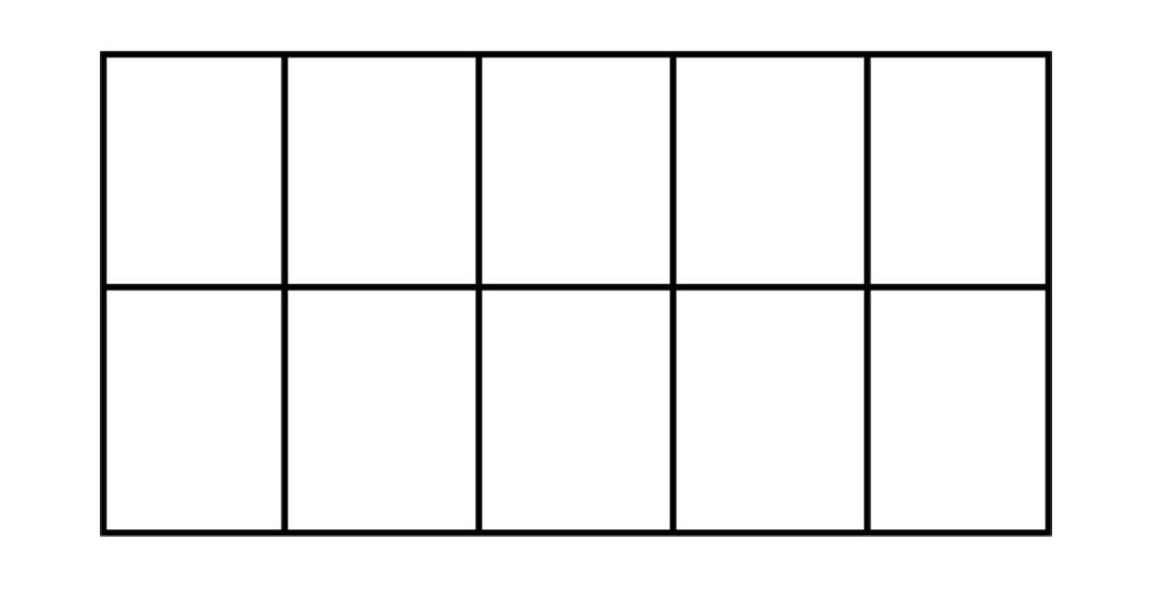
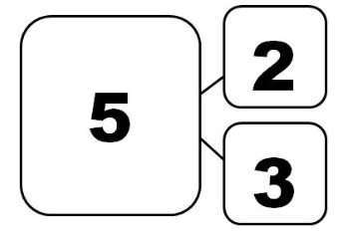
Which One Doesn't Belong
Virginia Department of Education, 2025
Notes:
When using a “Which one doesn’t belong?” routine, there is typically one or more justification that each of the elements could be the one that does not belong. Teachers should allow students to share a variety of justifications.

Slide 20
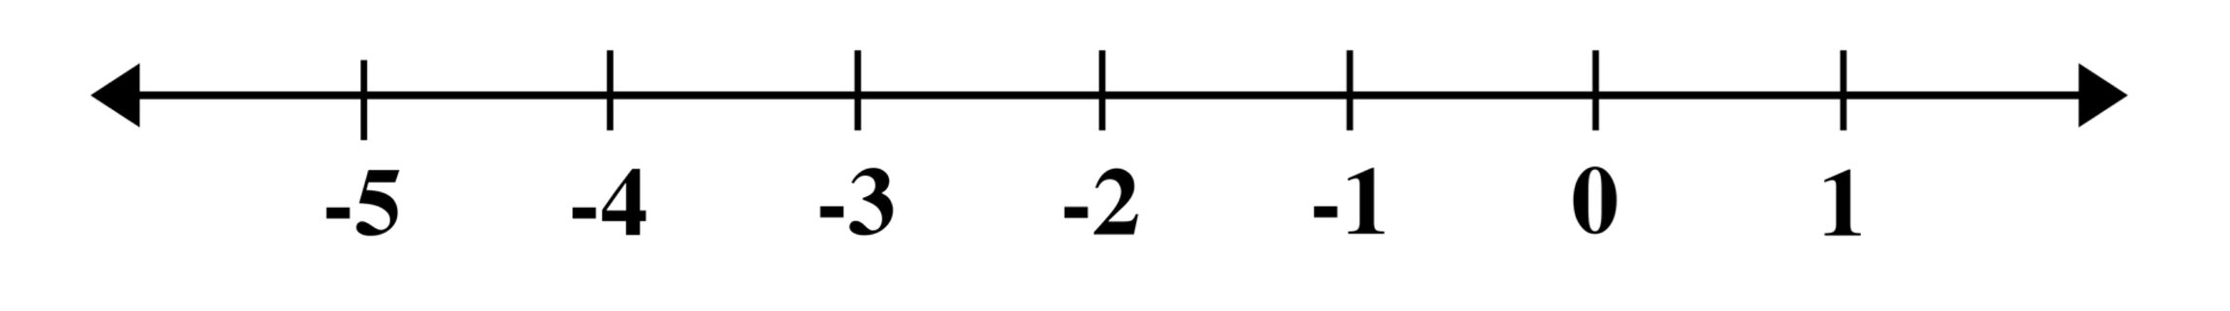
Which One Doesn't Belong
Virginia Department of Education, 2025
Notes:
When using a “Which one doesn’t belong?” routine, there is typically one or more justification that each of the elements could be the one that does not belong. Teachers should allow students to share a variety of justifications.

Slide 21
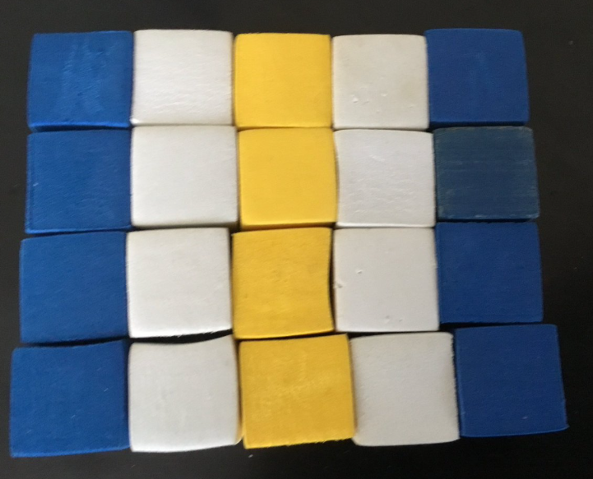
Notice and Wonder
Virginia Department of Education, 2025
Notes:
When using a “Notice and Wonder” routine, allow time initially for independent thinking. Then allow students time to turn and talk with a partner about what they notice and questions or wonders they may have. Students may notice and wonder about things that are not mathematical ideas, and the teacher should encourage students to think mathematically as they notice and wonder.

Slide 22
Notice and Wonder
Virginia Department of Education, 2025
Notes:
When using a “Notice and Wonder” routine, allow time initially for independent thinking. Then allow students time to turn and talk with a partner about what they notice and questions or wonders they may have. Students may notice and wonder about things that are not mathematical ideas, and the teacher should encourage students to think mathematically as they notice and wonder.

Slide 23
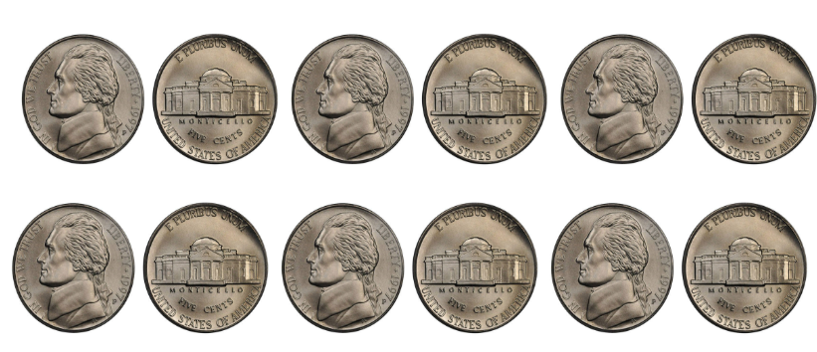
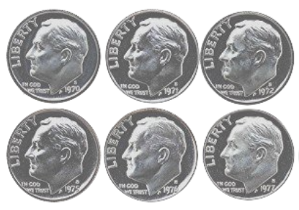
Alike and Different
Virginia Department of Education, 2025
Notes:
“Alike and Different” routines typically display two different representations that have some characteristics in common. Teachers should allow time for students to turn and talk with a partner about how the two representations are similar, then select a few students to share out with the entire class before focusing the conversation on how the representations are different.

Slide 24
Alike and Different
3m + 8
3(m + 8)
m
8
m
m
m
8
m
8
m
8
Virginia Department of Education, 2025
Notes:
“Alike and Different” routines typically display two different representations that have some characteristics in common. Teachers should allow time for students to turn and talk with a partner about how the two representations are similar, then select a few students to share out with the entire class before focusing the conversation on how the representations are different.

Slide 25
Rich Tasks
Rich tasks engage students in sense-making through deeper learning that require high levels of thinking, reasoning and problem solving.
Virginia Department of Education, 2025
Notes:
Share the definition of rich tasks, then ask participants to brainstorm a list of characteristics of rich tasks. What things should they have in common?

Slide 26
Rich Tasks
Promote high levels of cognitive demand
Allow multiple entry points to students with a wide range of skills and abilities
Allow for multiple solution pathways
Promote reasoning and sense making
Encourage the use of varied representations
Require justification or explanation
Encourage connections among ideas
Are authentic, relevant, or problem-based
Virginia Department of Education, 2025
Notes:
Allow time for participants to read the characteristics of rich tasks. Are there any that stand out?

Slide 27
Goldilocks Challenge
“… the task is challenging enough to provide a productive struggle for every student in the class. Learners who are still mastering the content may not complete the entire task, but their reasoning and problem-solving skills are challenged by the parts of the task they complete. Learners who are more advanced will progress further into the task and identify some of the more complex missing value calculations.”
-Teaching in the Visible Learning
Classroom: Grades 6-8, pg. 85
Virginia Department of Education, 2025
Notes:
Tasks should be accessible yet challenging for all students. Selecting a task is like the Goldilocks story – we want to find something that is not too easy and not too difficult. Using a “just right” task allows students to fully engage in mathematizing.

Slide 28
Selecting and Evaluating a Task
Use the characteristics of rich tasks and the Goldilocks challenge to evaluate a task for your grade level.
Virginia Department of Education, 2025
Notes:
Facilitators should determine in advance if they will provide one or more tasks for participants to evaluate or if participants should bring a rich task to the session to share.

Slide 29
Quality Questions
Carefully planning questions before teaching the lesson is essential.
Questions should elicit student understanding.
Questions should foster discussion.
Questions are intended to focus and clarify student thinking.
Virginia Department of Education, 2025
Notes:
Posing purposeful questions requires advance planning so that questions can foster discussion and focus on student understanding and thinking.

Slide 30
Five Types of Questions
Question Type | Purpose
Gathering Information | Ask students to recall facts, definitions, or procedures. Can you show me how you counted the animals?
Probing thinking | Ask students to explain, elaborate, or clarify their thinking, including articulating the steps in solution methods or completion of a task. Tell me about your model. How did it help you to determine the solution?
Making the mathematics visible | Ask students to discuss mathematical structures and make connections among mathematical ideas and relationships. How are these two equations related?
Encouraging reflection and justification | Reveal deeper insight into student reasoning and actions, including asking students to argue for the validity of their work. How do you know that those two angles are congruent?
Engaging with the reasoning of others | Help students to develop an understanding of each other’s solution paths and thinking, and lead to the co-construction of mathematical ideas. Who can explain Dana's strategy in their own words?
Virginia Department of Education, 2025
Notes:
The National Council for Teachers of Mathematics (NCTM) defines five types of questions in Taking Action. Allow time for participants to review and discuss the five types of questions. Which kind of questions are most easy to come up with quickly? Which kind of questions require more thought and planning? Which ones should be asked more frequently in the classroom?

Slide 31
Assessing Questions and Advancing Questions
Assessing Questions
Advancing Questions
Based closely on the work that the student has produced.
Clarify what the student has done and understands about what s/he has done.
Gives the teacher information about what the student understands.
Teacher stays to hear the answer to the question.
Use what students have produced as a basis for making progress toward the target goal of the lesson.
Move students beyond their current thinking by pressing students to extend what they know to a new situation.
Press students to think about something they are not currently thinking about.
Teacher walks away, leaving students to figure out how to proceed.
Virginia Department of Education, 2025
Notes:
NCTM further classifies questions as being assessing questions or advancing questions. Assessing questions give the teacher insight to student thinking, whereas advancing questions serve the purpose of moving students forward in their thinking. Note how teachers stay to hear the response to assessing questions but walk away from students after asking an advancing question to allow them to ponder the idea.

Slide 32
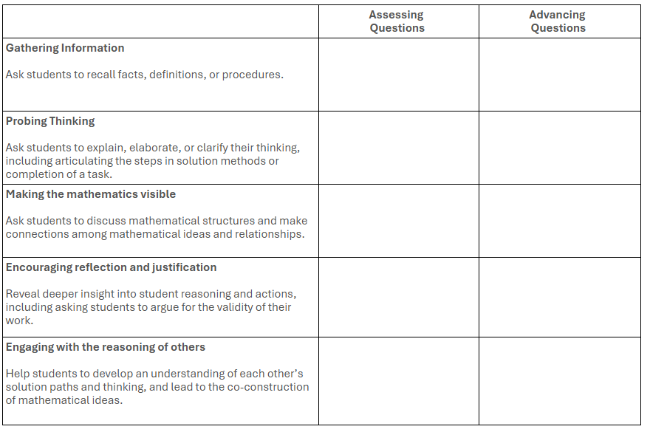
Planning for Questions
Virginia Department of Education, 2025
Notes:
The Planning for Questions handout can be a useful tool when preparing to implement a rich mathematical task in the classroom. The facilitator should determine how to use the handout in this session. If all participants evaluated the same task in the previous section, facilitators may wish to have participants brainstorm possible questions to ask when implementing that task in their classroom. If participants each brough their own task to evaluate, they may brainstorm questions for their individual tasks.

Slide 33
Communicating Mathematically

Slide 34
Communicating Mathematically
Pose purposeful questions
Use and connect mathematical representations.
Explain and justify reasoning
Virginia Department of Education, 2025
Notes:
The structures and routines explored in the previous section set the stage for meaningful mathematical discourse. We want students to be talking, but more importantly, we want students to be talking about math. Reasoning routines incorporate a variety of representations and allow students to connect to the reasoning of others in a non-threatening way. Rich mathematical tasks allow students to do the work and mathematize, and with teachers posing purposeful questions rich discussions can occur.

Slide 35
Sentence Frames to Support Discourse
I agree with ____________ because…
I respectfully disagree with that because…
I still have questions about…
I’m confused by…
I have a different perspective because…
I connected with what ____ said because…
I chose this method because…
I would like to defend the answer ____ because…
Could you say more?
I was wondering…?
I have a question about ____________?
I like how you explained this because…
I would like to revise my thinking.
I would like to defend my thinking.
Virginia Department of Education, 2025
Notes:
As educators, we don't only need to give students something to talk about, we need to assist them in the communication process. Sentence frames are one way to support discourse in the context of content.

Slide 36
Reflection
What elements must be in place to support meaningful mathematical discourse?
How does promoting meaningful mathematical discourse foster a community of mathematics?
What can you do to incorporate more discourse in your mathematics classroom?
Virginia Department of Education, 2025

