Slide 1
Focus on Mathematics Professional Learning Series
Concepts and Connections Vertical Articulation

Slide 2
Learning Goals
Describe why an understanding of vertical articulation is important
Use the Concepts and Connections Articulation Guide to support mathematics teaching and learning
Identify key understandings, vocabulary, and representations within a Strand Concept for the 2023 Mathematics Standards of Learning
Virginia Department of Education, 2025

Slide 3
Agenda
Benefits of Vertical Articulation
Concepts and Connections Articulation Guide
Exploring One Strand Concept
Ins and Outs
Content Progression
Vocabulary Progression
Representation Progression
Virginia Department of Education, 2025

Slide 4
Benefits of Vertical Articulation
Seamless progression of learning
Consistency in instruction
Preparedness for future learning
Data-informed decision making
Improved transition form course to course
Supports remediation and acceleration
Virginia Department of Education, 2025

Slide 5
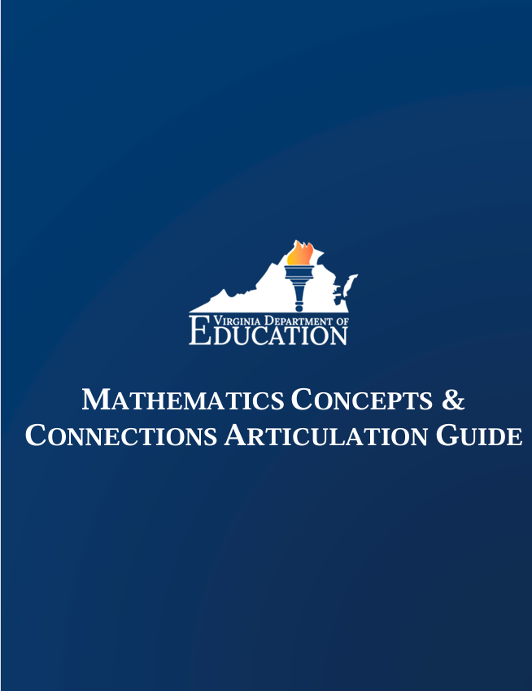
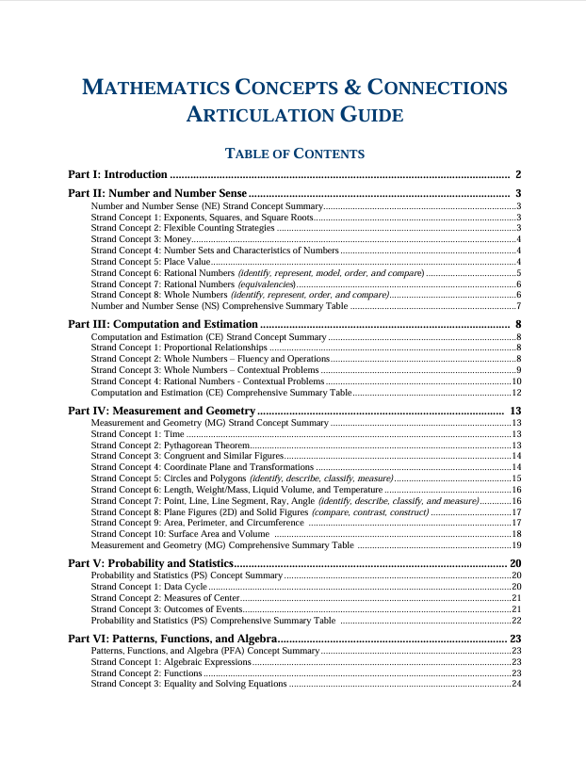
Concepts and Connections
Virginia Department of Education, 2025

Slide 6
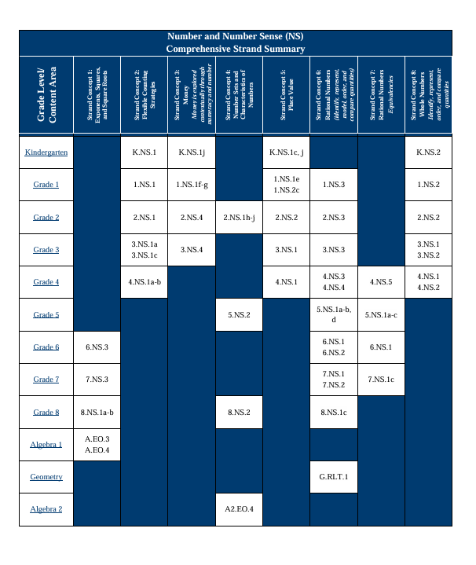
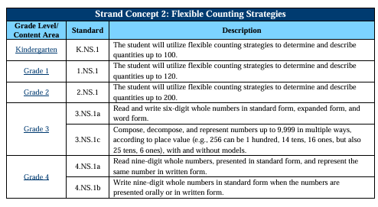
Concepts and Connections
Virginia Department of Education, 2025

Slide 7
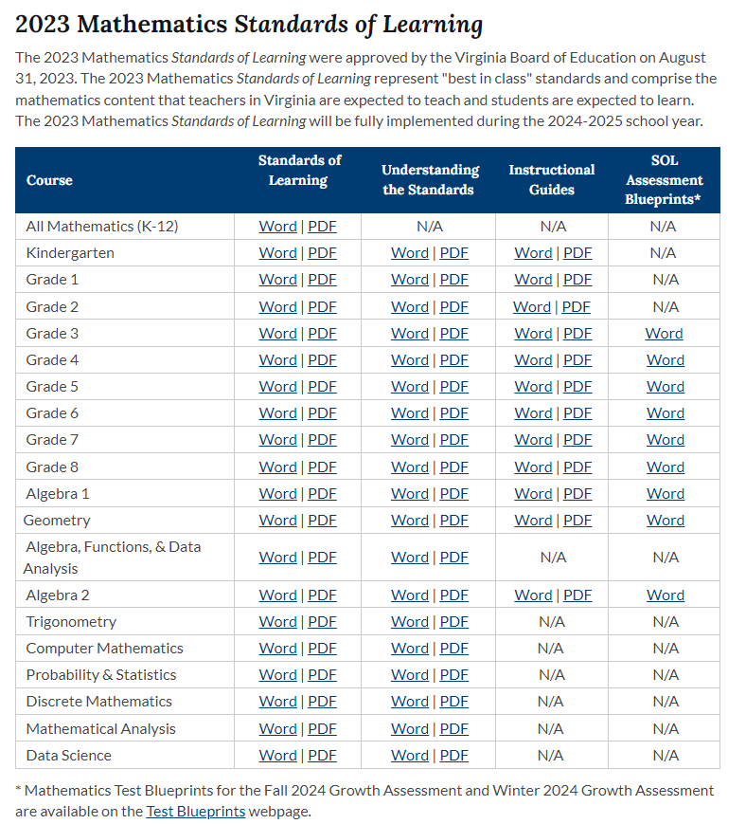
Strand Concept Flexible Counting Strategies
Virginia Department of Education, 2025

Slide 8
Ins and Outs of a Strand Concept
Ins | Outs
Identify three skills or understandings that students should bring into your grade level related to the given strand concept. * * * | Identify three skills or understandings that students should leave your grade level with related to the given strand concept. * * *
Virginia Department of Education, 2025

Slide 9
Content Progression
What do the students need to know in each grade?
How do the standards connect and build upon each other to develop understanding?
How are the process goals of problem solving, connections, communication, representations and reasoning addressed throughout the progression?
Virginia Department of Education, 2025

Slide 10
Vocabulary Progression
Review standards throughout the entire Strand Concept progression. Note when essential vocabulary is introduced.
It may be necessary to review the Mathematics Instructional Guides related to the Strand Concept to identify all essential vocabulary.
Virginia Department of Education, 2025

Slide 11
Representation Progression
Review standards throughout the entire Strand Concept progression. Note when various forms of representation are introduced.
It may be necessary to review the Mathematics Instructional Guides related to the Strand Concept to identify all forms of representation.
Virginia Department of Education, 2025

Slide 12
Next Steps
How can others support understanding of this concept?
How will the conversation about this strand concept impact your instructional practices?
Which additional strand concepts would you like to explore?
Virginia Department of Education, 2025

