Slide 1
Vendor Test Data Collection
April 2025

Slide 2
Agenda
Purpose of Collection and File Overview
Submitting a Data File
Reports and Data Verification
FAQs and Scenarios
Timeline
Questions

Slide 3
Purpose of the Collection
Collect scores for students where a substitute test has been taken in place of a HS Mathematics SOL
A substitute test may be submitted for any student who took all EOC Math tests in middle school (Test Subject Code 565)
Collect ASVAB test scores for ALL cohort students who took the test
Collect AP test scores for cohort students who took the test out of state ONLY
Collects IB and CLEP tests for cohort students who took the tests in previous school years in Virginia ONLY (school years 2021-2022 and 2022-2023); cohort students who took the tests out of state will need to be reported for all four cohort years

Slide 4
Purpose of the Collection
What is no longer reported in the collection:
Any substitute test reported for verified credit (this can be tracked locally)
Any substitute test reported for Accreditation purposes

Slide 5
Vendor Test Application
Tab delimited text file with a specified layout
Multiple record types (A and C records)
Submitted through the Vendor Test application in SSWS
Available June 16th through August 15th
Uploaded file will go through a process of edit checks
List of errors will be available for unsuccessful files
Superintendent must electronically sign the verification report

Slide 6
Record Types
Record Type | Record Name | Number of Data Elements
A | Header | 4
C | Student and Test Result Data | 25

Slide 7
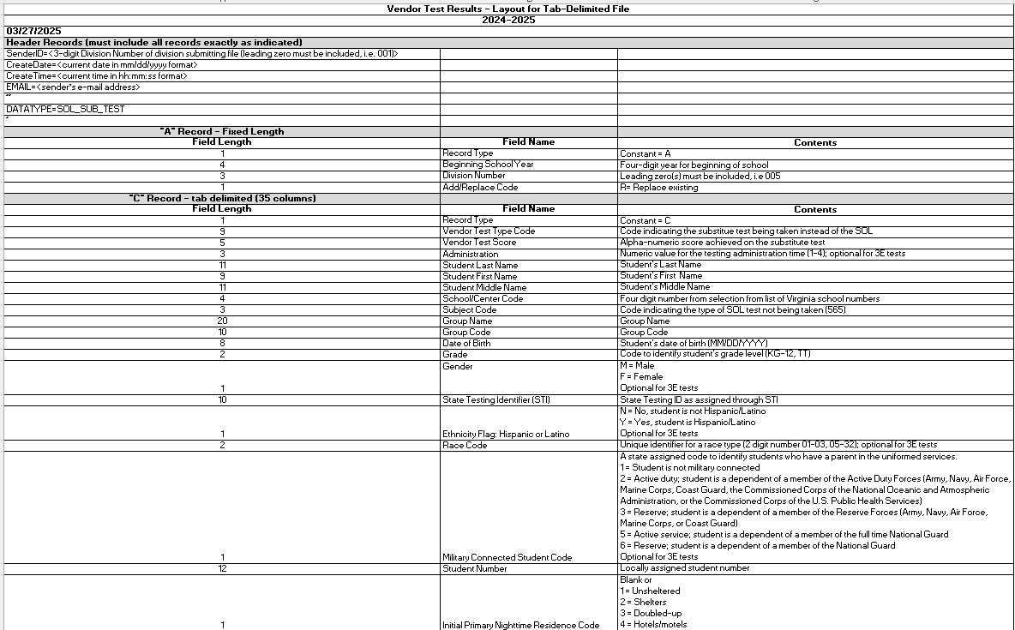
File Layout

Slide 8
A Record (Header Record)
Record Type (A)
Beginning School Year'
2024
Division Number
Three-digit division number with leading 0 (001, 002, 010, etc.)
Add/Replace Code
Always use “R”
The option to use the “Add” function was retired when the B records were retired
Since each file replaces the next, cumulative files must be submitted
EXAMPLE: A2024099R

Slide 9
C Record (Student and Test Data)
Record Type (C)
Vendor Test Type Code*
Vendor Test Score*
Administration
Student Last Name
Student First Name
Student Middle Name
School/Center Code
Test Subject Code
Group Name
Group Code
Date of Birth
Grade
Gender
State Testing Identifier (STI)
Ethnicity
Race
Military Connected Student Code
Student Number
Initial Primary Nighttime Residence Code
Foster Care
Economically Disadvantaged Flag
Receiving EL Services Code
Disability Status
Formerly EL
Retired (x3)
Test Date
Retired (x1)
Filler (x5)

Slide 10
C Record: Vendor Test Type Code
Vendor Test Type Code
Code indicating the vendor test
The list of codes is posted in the application in SSWS and on the VDOE website: https://www.doe.virginia.gov/data-policy-funding/data-reports/data-collection/testing-data
Edits
Invalid Vendor Test Type Code - Must be a valid Vendor Test Code from the list
(For SOL Substitute Tests only) Invalid Vendor Test Type Code/Subject Code Combination - The Substitute Test Code must be a valid combination with the SOL Subject Code (565)

Slide 11
C Record: Vendor Test Score
Vendor Test Score
Alpha-numeric score achieved on the vendor test
Minimum and maximum score ranges are based on the “Vendor Test Type Codes” document: https://www.doe.virginia.gov/home/showpublisheddocument/60862/638787538900994455
Edit
Must be a valid number or letter
Note: If the test score is not a valid value associated with that test, the proficiency level cannot be set

Slide 12
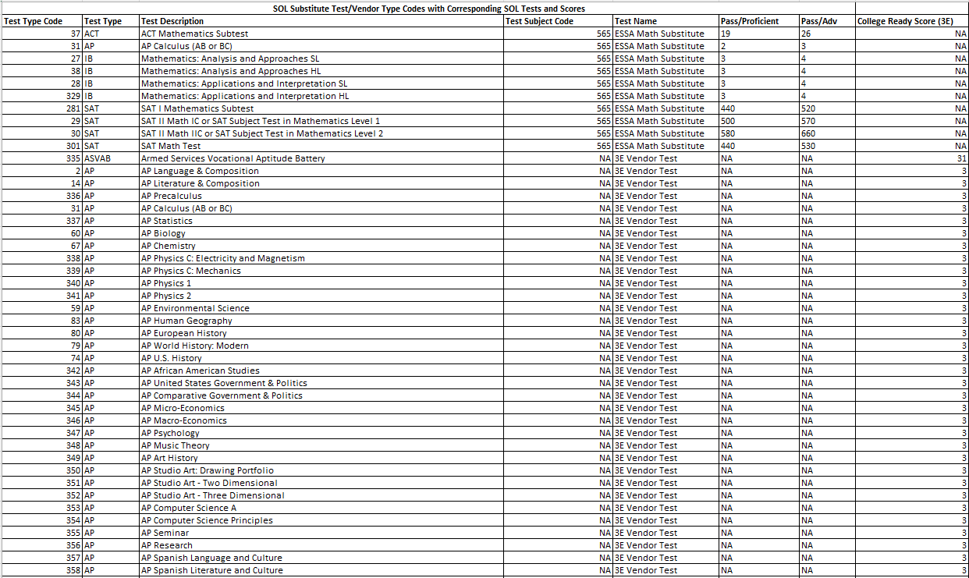
Vendor Test Type Code/Subject Code/Vendor Test Score

Slide 13
What Scores Should be Submitted?
Submit scores for all tests for students that are included in the cohort for this year.
While these tests can be submitted at any time over the four years of the student’s cohort, it is best to stay on a schedule in reporting as not to miss students

Slide 14
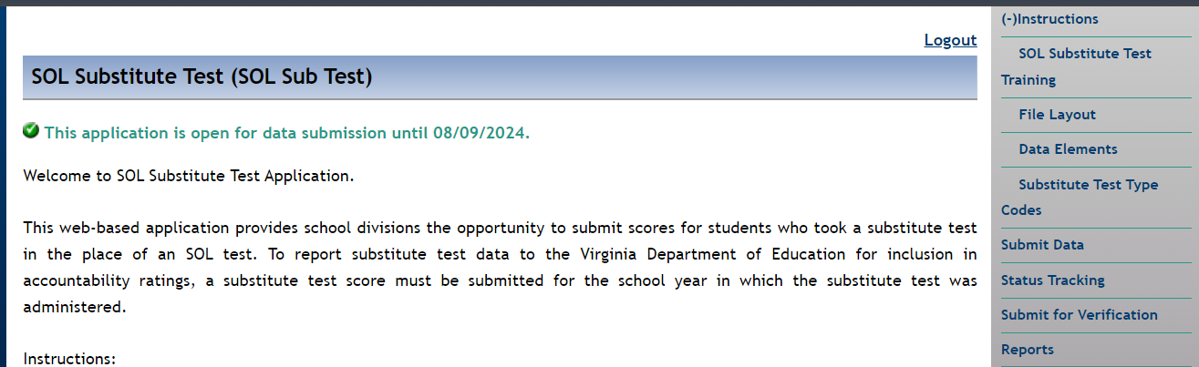
Submitting the Data File
The name of the application will be changing after the redesign!

Slide 15
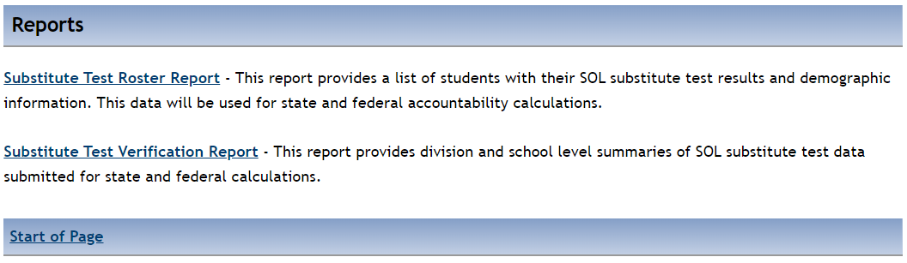
Reports
Both reports update overnight when VDOE runs the process to set the SOL proficiency levels based on the vendor test scores.

Slide 16
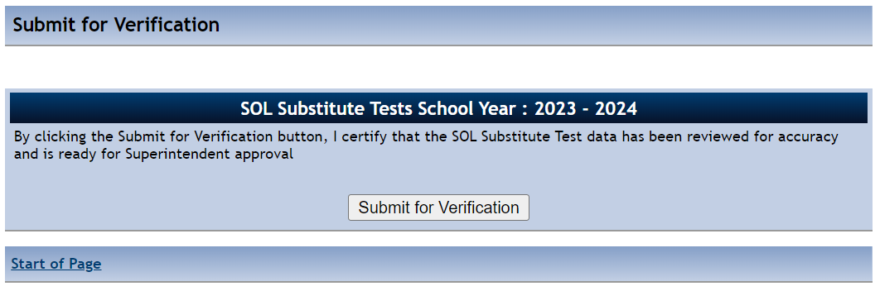
Verification
Once the Vendor Test Verification Report has been reviewed for accuracy by the collection manager, it should be submitted for verification, which sends an email to the Division Superintendent for final electronic signature.
Reminder: Always check the report before submitting for verification. If the nightly process has not run to set the proficiency levels, this report will be blank when it is submitted to the Division Superintendent.

Slide 17
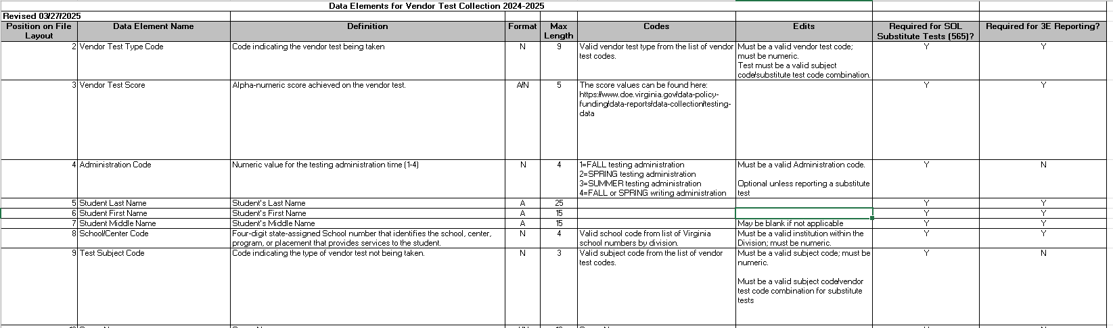
FAQs
Question: Do we need to report all fields for non-substitute vendor tests?
Answer: No, refer to the data elements document to check the elements that are required for these tests. Remember that the field does need to be in the record even if it is null

Slide 18
FAQs
Question: Are we still able to use substitute tests for verified credit?
Answer: Yes, but you will no longer need to report this information on the Vendor Test Collection. Substitute Tests for verified credit can be documented at the local level. Please use the current substitute test information from Assessment for locally awarded verified credits.
The document can be found on Assessment’s website here: https://www.doe.virginia.gov/home/showpublisheddocument/20660/638731535301330000

Slide 19
FAQs
Question: School divisions do not receive ASVAB scores in a division-level electronic file, which will make reporting to VDOE difficult. Is there a way to get this information electronically from the Armed Forces?
Answer: VDOE has tried to get ASVAB test reports from the Dept of Defense, but we have been told that we have to rely on divisions reporting it like any other data we do not get. It is unfortunate DOD sends paper reports, but VDOE is unable to do anything about that.

Slide 20
FAQs
Question: ASVAB scores are currently reported on the CTE Credentialing Collection (CTECC). Will we report ASVAB on both CTECC and on this new vendor test collection?
Answer: As of the 2024-25 CTECC, ASVAB scores will no longer be reported on the CTECC as it will no longer be used as a CTE credentialing test. As a result, please report all ASVAB information on the Vendor Test Collection moving forward.

Slide 21
FAQs
Question: Students are able to take the ASVAB test multiple times. Should we report all the scores or just the highest score?
Answer: Just the highest scores is required for reporting since that is what will be used in the 3E calculation.

Slide 22
FAQs
Question: If we are reporting an AP test for a student who took all EOC Math tests in middle and we would like that AP test to count in 3E as well, should we report one or two records on the Vendor Test Collection?
Answer: Please report two records for this test: one record with a test subject code of 565 for the substitute test and then one record for 3E.

Slide 23
FAQs
Question: Will the vendor test information appear on the Longitudinal Data Reports (LDR) since we will need the information to report for 3E?
Answer: This is an enhancement that we will work on during the 2025-2026 school year.

Slide 24
Scenarios
Reporting 565 substitute test records for Accountability
Student A fulfilled all Math requirements (passed the Algebra II SOL in 8th grade) before reaching high school. This student is currently in 12th grade in the 2025 cohort. The school has documentation that the student took and passed the SAT II Math IC as a 10th grader in the 2022-2023 school year.
Report this student with a “C” record on the 2024-2025 substitute test file with an Administration Code of 2 (Spring), an SOL Testing Code 565, and a Test Type Code = 29.
Since the ESSA calculation is cohort based, and the student was not expected to take Math SOL in high school in a given year, these tests can be reported at any time prior to the student’s graduation and do not have to be directly tied to a testing year or testing administration.

Slide 25
Scenarios
Reporting ASVAB Test Results
Student B took the ASVAB test during their 11th grade school year (2023-2024). This student is currently in 12th grade in the 2025 cohort. The school has documentation that the student took and received a readiness score on the ASVAB.
Report this student with a “C” record on the 2024-2025 vendor test file with a Test Type Code of 335
Report ALL ASVAB tests that were taken by cohort students during their four years in the cohort

Slide 26
Scenarios
Reporting Out of State AP Test Results
Student C came from Tennessee their junior year and had taken two AP tests during their sophomore year. This student is currently in 12th grade in the 2025 cohort. The school has documentation that the student took and passed the AP Psychology and AP European History tests during the 2022-2023 school year.
Report this student with two “C” records on the 2024-2025 vendor test file, one for AP Psychology (Test Type Code 347) and one for AP European History (Test Type Code 80)
Only out of state AP test results are required for current cohort students

Slide 27
Scenarios
Reporting IB or CLEP Test Results
Student D took IB Language A: Literature (SL) in the 2022-2023 school year. This student is currently in 12th grade in the 2025 cohort. The school has documentation that the student took passed the test (Test Type Code 303).
Report this student with one “C” record on the 2024-2025 vendor test file for IB Language A: Literature (SL) (Test Type Code 303)
For students who took the tests in-state, only IB and CLEP tests from school years 2021-2022 and 2022-23 are needed as VDOE will have results from 2023-24 and later for in-state students
For students who took the tests in another state, please report all school years included the cohort

Slide 28
Data Reporting Timeline
Division-level data gathering is ongoing July - August
June 16, 2025: Data collection window opens
In the future, data can be submitted throughout the year
Subsequent files replace previous ones, so the file must be cumulative
August 15, 2025: Superintendent electronic signatures due for verification report

Slide 29
Contact Information
Vendor Test web site https://www.doe.virginia.gov/info_management/data_collection/testing/index.shtml
Allison May, Accountability Data and Research Specialist, Office of Data Standards and Governance
Email: allison.may@doe.virginia.gov or resultshelp@doe.virginia.gov
Office of Accountability
Email: accountability@doe.virginia.gov
Office of Student Assessment
Email: student_assessment@doe.virginia.gov

Slide 30
Questions?

