Slide 1
Focus on Mathematics
Implementing the Data Cycle

Slide 2
Learning Goals
Describe the components of the data cycle
Plan for authentic opportunities for students to engage with the data cycle
Notes:
Set the stage for learning by reviewing the learning goals and agenda for the session.

Slide 3
Agenda
Importance of the Data Cycle
Data Talks
Components of the Data Cycle
  Formulate Questions
  Collect or Acquire Data
  Organize and Represent Data
  Analyze Data and Communicate Results

Slide 4
The Data Cycle
Analyzing data requires the ability to read, write, and communicate about data in context.
A process for data analysis is included in the standards as a Data Cycle. The cycle includes asking meaningful questions, collecting or acquiring appropriate data, and analyzing, interpreting and communicating about the data.
Notes:
The world can be investigated through posing questions and collecting, representing, analyzing and interpreting data to describe and predict events and real-world phenomena. K-12 students will engage with the data cycle.
The skills needed to analyze data are integrated in the mathematics standards and derived from and build upon a strong mathematical foundation.
The standards include direct reference to mathematical skills needed to analyze and interpret data. Data and data analysis are necessary for many jobs such as those in science, technology, business, and engineering, but also to ensure students can develop problem solving skills and navigate as a citizen in a world in which data plays a vital role.

Slide 5
Data Talks
Notes:
Data talks are a way to engage students in analyzing data represented in a variety of ways. Data talks can be used to review previously taught concepts or introduce new types of graphs in a less formal way. Data talks could incorporate grade level specific graphs, but this is not necessary. Data talks could also look at data that is presented in non-routine graphs.
Facilitators may choose to have participants engage with each of the data talk routines or may select one routine to use and highlight the structures of the other routines.

Slide 6
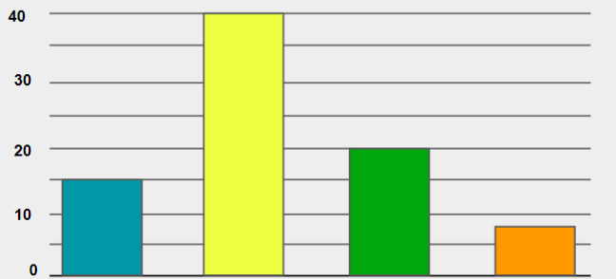
Notice and Wonder
Notes:
Notice and Wonder
When presenting data or a graph in a notice and wonder routine, you may wish to present a complete graph with all necessary labels and a complete scale. You might choose to present a graph that is missing one or more essential components. Ask participants to look at the bar graph displayed on the slide and discuss with a partner the things that they notice. Allow a few individuals to share with the group. Participants should notice that there is a scale that is counting in labeled increments of ten and that there are four bars displayed on the graph. Participants might notice the value displayed by each bar on the graph. Next ask participants to turn and talk with a partner to discuss things they wonder about the graph, then allow a few individuals to share with the group. Participants may be wondering about what the data represents. Encourage participants to discuss what could be represented in this graph. How could the categories and each axis be labeled? What would be a good title for the graph?

Slide 7
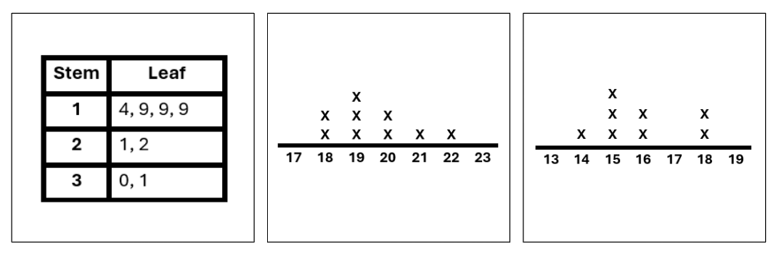
Which One is Different and Why?
Stem | Leaf
1 | 8, 8, 9, 9, 9
2 | 0, 0, 1, 2
Key: 2 | 1 represents 21
Notes:
Which One is Different and Why?
The Which One is Different and Why? Routine can be used to introduce a type of graph before students have received formal instruction on that topic. Students can discuss key components of a graph and begin to understand the structures of that display through informal conversation.
Ask participants to look at the three graphs displayed on the screen and share which graph is different and their reasoning for selecting that graph. Participants may select the stem-and-leaf plot in the center because it looks different than the other two graphs. Participants may select the line plot on the right because the other two graphs display the same data. After discussing which graph is different, encourage participants to think about what data might be displayed in these three graphs.

Slide 8
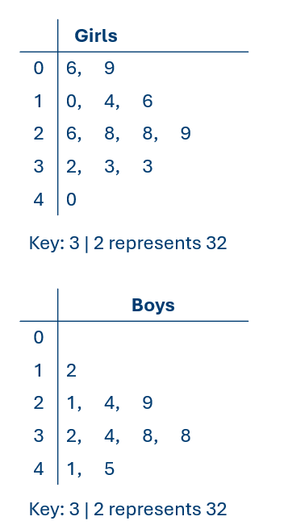
Alike and Different
Boys |  |  |  |  | Girls
 |  |  |  | 0 | 6, | 9
 |  |  | 2 | 1 | 0, | 4, | 6
 | 9, | 4, | 1 | 2 | 6, | 8, | 8, | 9
8, | 8, | 4, | 2 | 3 | 2, | 3, | 3
 |  | 5, | 1 | 4 | 0
Boys Key: 2 | 3 represents 32
Girls Key: 3 | 2 represents 32
Notes:
Alike and Different
Alike and Different is a routine that can be used to push students towards comparing data displayed in two different types of graphs. This routine could incorporate a bar graph and a pictograph that display the same data, or a bar graph and a circle graph that display the same data. In this example displayed on the slide, the same data is presented a double stem-and-leaf plot and two separate stem and leaf plots. Ask participants to turn and talk to a partner about how the two displays are similar. Allow a few individuals to share with the group. Next ask participants to turn and talk to a partner about how the two displays are different.
Note that while stem-and-leaf plots are introduced in Grade 5, the double stem-and-leaf plot on the left would not be introduced until high school.

Slide 9
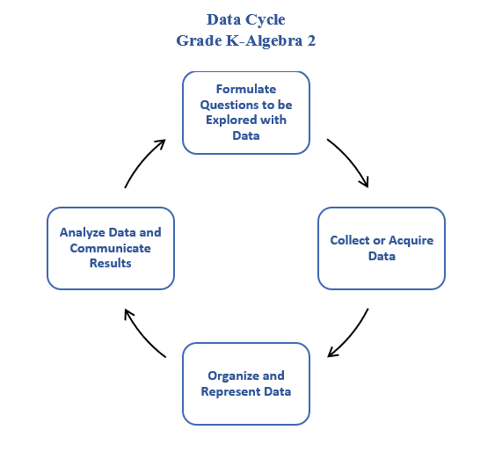
The Data Cycle
The data cycle includes formulating questions to be explored with data; collecting or acquiring data; organizing and representing data; and analyzing data and communicating results.
Notes:
Have participants review the progression of Data Cycle standards. You may wish to provide links to the Concepts and Connections Articulation guide that highlights the progression of standards on page 20-21, the Data Cycle Progression of Types of Graphs document which highlights examples of graphs at each grade level, and/or the Data Cycle Standards document. The Data Cycle Standards document provides the most comprehensive look at the standards but participants may find the document to be overwhelming.
Ask participants to reflect on what is similar in all of the data cycle standards and what changes throughout the progression. Participants should notice that each standard has students applying the data cycle; posing questions, collecting or acquiring data, organizing and representing data, and analyzing data and communicating results. These four components of the data cycle remain consistent throughout all grade levels. The types of data and manner in which data is collected varies throughout the grades. Similarly, the types of graphs and degree of analysis will vary as well.
Facilitators may wish to provide access to the grade level data cycle resources at this time. These resources may be a beneficial reference throughout the remainder of the session because they offer suggestions for questions and cross-curricular connections.

Slide 10
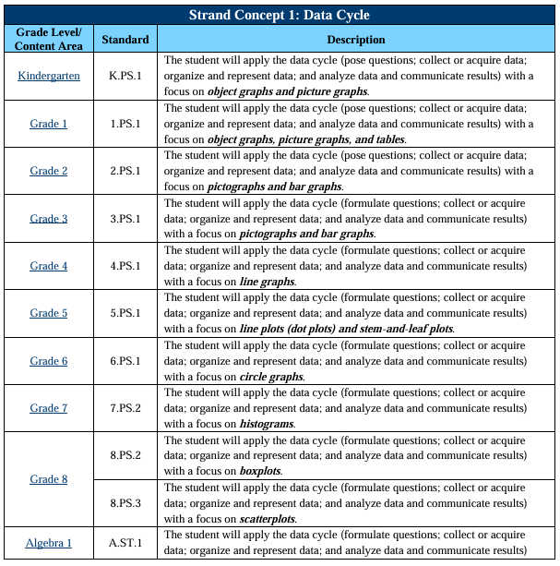
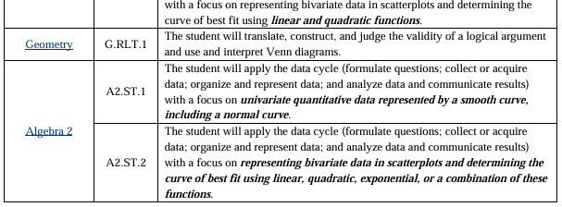
The Data Cycle

Slide 11
Formulate Questions
What contexts would provide meaningful opportunities for students to ask questions that would require the collection of data?
What questions could they ask? What data would those questions generate?
Notes:
Formulate Questions
Students should be engaging with data in authentic, meaningful ways.
As students ask questions that require the collection of data to address problems, they may develop questions that do not align with the data cycle standards for their grade level. Part of the learning process is determining the type of data that could be generated by asking different questions. At times you may wish to limit student questions and resulting collection of data to graphs identified in specific grade levels. You may also wish to allow students to ask their questions and gather data, then come to their own conclusions about the type of graph that can be used to represent the data.
Ask participants to brainstorm a list of situations or contexts that would provide meaningful opportunities for students to ask questions that would require the collection of data. What things are students interested in? What problems exist that students could use data authentically in order to solve?
Next ask participants to brainstorm a list of questions that students could ask and the type of data that could be generated from those questions.
Allow participants to share their contexts and questions with the group.
Ideally students will be developing their own questions to ask as part of the data cycle and all of the questions used to gather data will not be presented by the teacher. However, there will be times during classroom instruction that it is necessary for the teacher to structure the questions or guide students towards a specific data set.

Slide 12
Collect or Acquire Data
How could students collect or acquire data?
What methods are efficient and provide a representative sample?
What existing data sets do students have access to?
Are there cross-curricular connections that provide additional opportunities to collect or acquire data?
Notes:
Collect or Acquire Data
In the primary grades data can be collected by sorting and classifying objects or conducting surveys. In the upper elementary and middle grades, this can transition to conducting an experiment or scientific investigation in addition to conducting surveys. Data may also be acquired from existing sources. There are numerous opportunities for cross-curricular connections to be explored while collecting data.
Ask participants to consider how students could collect or acquire data. Discuss the methods that students might use and the effectiveness of those methods. Ask participants to consider cross-curricular connections and access that students have to existing data sets. Recognize that while discussing this component of the data cycle participants may discuss additional contexts and questions that students may explore. Encourage participants to add to their initial lists throughout this discussion.

Slide 13
Organize and Represent Data
How will students organize and represent the data they have collected?
What scaffolds or supports can be provided to students as they organize and represent the data?
How can technology be leveraged when organizing and collecting data?
Notes:
Organize and Represent Data
Ask participants to consider how students organize and represent data at their grade level. Facilitate a conversation about what is important in this part of the standard. Consider the following questions as part of the discussion:
How will students organize and represent the data they have collected?
What scaffolds or supports can be provided to students as they organize and represent data?
How can technology be leveraged when organizing and collecting data?
When creating pictographs, recognizing that a symbol can represent more than one object is more important than the act of actually drawing the symbols. Consider using printed paper shapes that can easily be cut into parts.
When creating bar graphs, line graphs, and histograms it is more important for students to identify appropriate increments for a scale than it is for them to use a ruler to space the increments and draw the hash marks on the scale by hand. Consider providing grid paper or graphing templates that already have increments spaced that only need to be labeled or leverage the use of technology to create graphs.
Creating a circle graph by hand is a tedious process that requires significant understanding of fractions, percent, and angles. Leveraging technology to create circle graphs allows for a more productive use of time and results in a more accurate representation.
The Desmos graphing calculator can be leveraged to represent data as part of all high school mathematics courses.

Slide 14
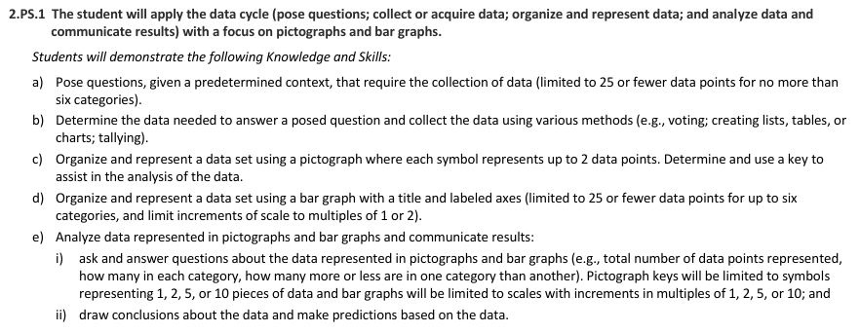
Parameters
Notes:
It is important to note that the parameters for organizing data might be different than for analyzing data at a specific grade level. If a parameter is noted in the parent standard, it applies to the entire standard. If a parameter is noted in one of the bullets, it only applies to the bullet in which it is mentioned. For example, in 2.PS.1c where students are organizing and representing data, it is noted that each symbol in the pictograph will represent up to 2 data points. However, in 2.PS.1e where students are analyzing data represented in pictographs the keys will be limited to symbols representing 1, 2, 5 or 10 pieces of data. Similar instances occur at many grade levels, so carefully review the parameters for the standards you are responsible for teaching.
Encourage participants to carefully review the probability and statistics standards for their grade level and note where parameters vary for different parts of the standard.

Slide 15
Analyze Data and Communicate Results
How will students communicate about the data?
What questions can be asked about the data? How can students be guided to develop these questions?
Notes:
Analyze Data and Communicate Results
Many standards require students to draw conclusions and make predictions in addition to answering questions about data represented in graphs.
Ask participants to consider how students will analyze the data and communicate about the graphs they have created. Analysis and communication may be dependent on the actual data collected and displayed in a graph. While students may be expected to make predictions, some data may not provide information necessary to make those predictions.

Slide 16
Next Steps
What ideas from this session will you incorporate into classroom instruction?
How can you set the stage for authentic student experiences with the data cycle?
Notes:
Next Steps
Ask participants to process the discussions they have had about the components of the data cycle. How can they use ideas from this session to set the stage for authentic student experiences with the data cycle? What next steps will participants take in the classroom?

