Slide 1
Focus on Mathematics
Developing Formulas to Strengthen Student Understanding

Slide 2
Learning Goals
Describe the importance of students investigating and developing formulas
Identify representations and questions that support developing understanding while developing formulas
Notes:
Set the stage for learning by reviewing the learning goals and agenda for the session.

Slide 3
Agenda
Investigating and Developing Formulas
Exploring Classroom Routines and Resources
  Grade 4 Area and Perimeter
  Grade 5 Area of a Right Triangle
  Grade 5 Volume of a Rectangular Prism
  Grade 6 Approximation for Pi
  Grade 6 Circumference
  Grade 7 Surface Area of Rectangular Prism and Cylinder
Representations and Questions to Support Understanding

Slide 4
When students develop formulas, they gain conceptual understanding of the ideas and relationships involved and they engage in "doing mathematics."
Teaching Student-Centered Mathematics
Van de Walle et al., 2014
Notes:
When students engage in developing formulas, they are building conceptual understanding of the ideas and relationships that are connected to the formulas. It is less likely that students will confuse formulas when they have developed an understanding of the relationships involved.

Slide 5
Investigate and Develop Formulas
Review the instances in the 2023 Math Standards of Learning where students are asked to investigate and develop formulas.
What do you notice about these standards? How are they similar? How are they different?
Notes:
Review the Investigate and Develop Formulas handout. Have participants share what they notice about the highlighted standards. Ask participants to share how the standards are similar and how the standards are different.

Slide 6
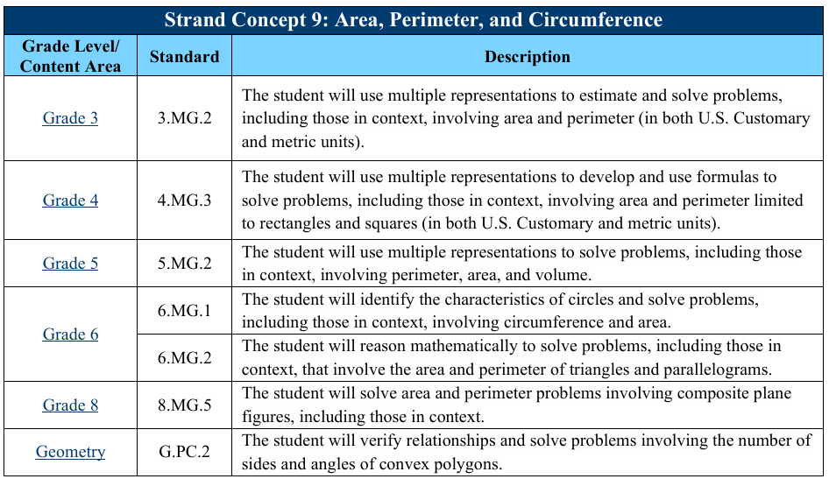
Concepts and Connections Articulation Guide
Notes:
The Concepts and Connections Articulation Guide can also be used to highlight the progression of developing formulas as it fits into the larger strand concepts of Area, Perimeter, and Circumference and Surface Area and Volume.

Slide 7
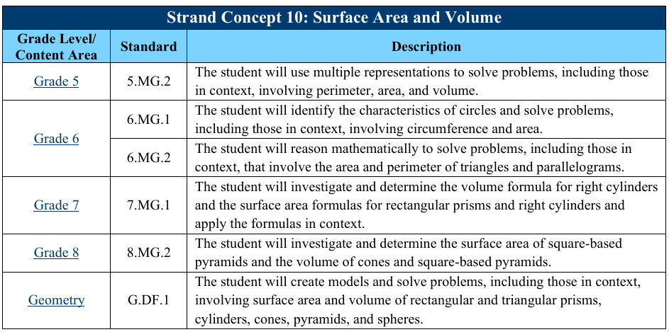
Concepts and Connections Articulation Guide

Slide 8
Instruction
What does classroom instruction need to look like to address these standards?
Notes:
Ask participants to share what classroom instruction needs to look like to address these standards. Discussion should include the following ideas:
Use of hands-on materials and pictorial representations
Students having conversations about the relationships that are key to the formula
Making connections to previous learning
Not providing the formula to the students

Slide 9
Assessment
How do you assess student mastery of these standards?
Notes:
Ask participants to share what assessment should look like to address these standards. Discussion should include the following ideas:
Performance assessment that demonstrates how the formula is derived
Open ended questions that ask students to explain how they could determine a formula
Questions that ask students to select the correct formula or calculation

Slide 10
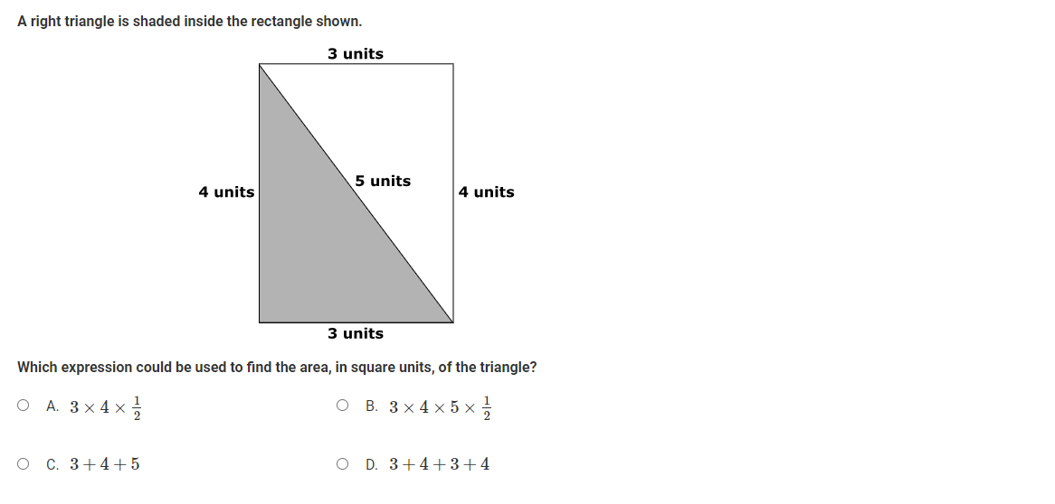
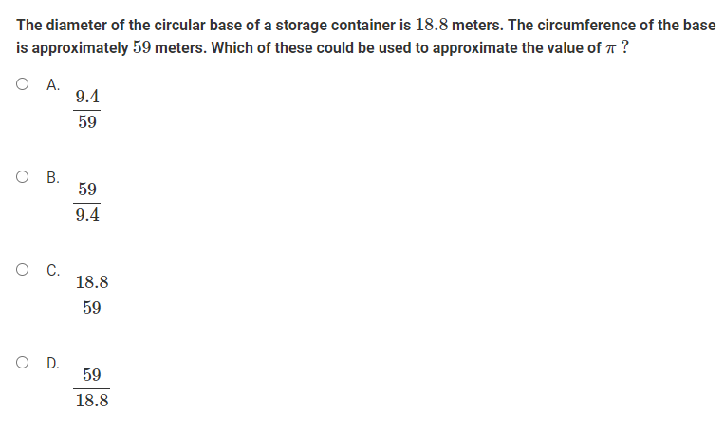
Examples from TestNav8 Practice Items
Notes:
There are several items in the TestNav8 Mathematics practice items that address these standards. Note that some of these questions include model or pictorial representation and others include a context. While these items may not necessarily address content at the specific grade level that participants teach, ask them to consider how content at their grade level could be addressed in a similar fashion.

Slide 11
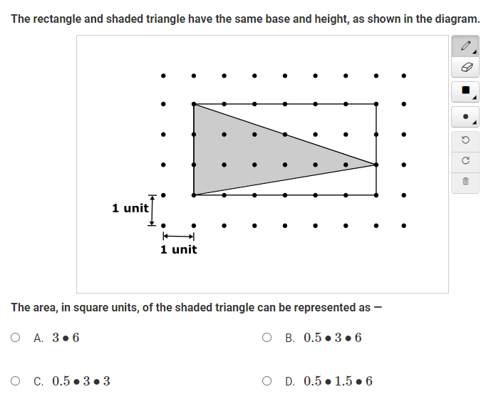
Examples from TestNav8 Practice Items

Slide 12
Which One Doesn’t Belong?
Notes:
Classroom Instruction
Now look a little closer at instructional materials that address these standards. The following activities are broken into grade level sections.
Facilitators should determine how deeply to explore the activities at each grade level depending on participants. Each grade level includes a reasoning routine with multiple representations related to the standard as well as a classroom activity.
Facilitators may choose to have participants:
Explore activities for each grade level
Engage in reasoning routines for all grade levels and explore some activities
Engage in one or more specific reasoning routine and coordinating classroom activity
Engage in one or more specific reasoning routine and explore all classroom activities through a station model
Grade 4 - Perimeter and Area of Rectangles and Squares
Which One Doesn’t Belong?
Display the slide and ask participants to look at the four images and determine which image doesn’t belong. Allow for multiple participants to share their reasoning. Possible answers include:
The yellow rectangle in the upper right does not belong because it only has one row of squares.
The green rectangle in the lower left does not belong because it is a square.
The blue rectangle in the lower right doesn’t belong because it is the only figure with a vertical orientation.

Slide 13
4.MG.3a - Area and Perimeter of Rectangles and Squares
What materials can be used for investigation?
What connections do you want students to make?
What questions can you ask to support understanding?
Notes:
After participants have shared their reasoning, ask them to describe how all four figures are similar. The figures are all made up of smaller squares, they are all rectangles, they all have the same area. Ask participants to determine the perimeter and area of each figure. As participants share, encourage them to explain the strategies that they used to determine the perimeter and the area.
It is a huge leap for students to move from counting squares inside a rectangle to the conceptual development of a formula. As students work to develop formulas for determining area of rectangles and squares, help them build connections to the area model for multiplication.
As participants engage with the classroom activities for Grade 4, encourage them to brainstorm additional hands-on materials and representations that could be used for investigation. Suggested materials may include grid paper, color tiles, geoboards, sticky notes or cut paper squares, and other array representations.
Also encourage participants to consider the connections they want students to make and the questions they can ask to support students making those connections and developing an understanding of area and perimeter formulas. Students should make connections between array models for multiplication and area. They should also recognize that there is not a need to measure each side of a square or rectangle to determine perimeter. These connections can be supported through questions such as:
Can you find the area without counting each square?
Is there a more efficient way to find the total number of squares that make the area?
What dimensions of a square do you need to know to determine the perimeter?
What dimensions of a rectangle do you need to know to determine the perimeter? How would you use those dimensions?
Does that strategy or formula always work? How do you know?

Slide 14
4.MG.3d - Relationship Between Area and Perimeter
What materials can be used for investigation?
What connections do you want students to make?
What questions can you ask to support understanding?

Slide 15
Alike and Different
Notes:
Grade 5 – Area of a Right Triangle
Alike and Different
Display the slide and ask participants to share ways that the two images are alike. Ask participants to turn and talk with a partner before allowing a few individuals to share with the group. Participants may share that both images have shaded figures on a grid and the shaded amounts cover the same area. Participants may share that the image on the right also has a triangle shaded in dark blue.
After participants have shared their ideas, ask how area is represented in the two figures.

Slide 16
5.MG.2a - Area of a Right Triangle
What materials can be used for investigation?
What connections do you want students to make?
What questions can you ask to support understanding?
Notes:
Students form general relationships when they see how all area formulas are related to the big idea of base times height. Students who understand where formulas come from tend to remember them and be able to derive them when they are needed.
As participants engage with the classroom activities for Grade 5, encourage them to brainstorm additional hands-on materials and representations that could be used for investigation. Suggested materials may include grid paper, color tiles, paper rectangles that can be cut into congruent right triangles, and other array representations.
Use the area of right triangles lesson to have participants explore the connection between the area of rectangles (and squares) and right triangles with the same dimensions. It is important to have conversations around how the dimensions of a rectangle are typically referred to as length and width, but they can also be discussed as base and height. It does not matter which dimension is noted as length as long as an adjacent side is noted as the width. Similarly, it does not matter which dimension is labeled as the base of a rectangle, as long as an adjacent side is labeled as the height. It is important to help students make the connection that length and width (or base and height) of a rectangle can be found by measuring the length of adjacent sides that form a right angle where they meet. This is helpful when students are identifying the base and height of right triangles, as the sides of the triangle that represent the base and height are adjacent sides that form a right angle where they meet.
Another connection that students should make is the connection between dividing by two and multiplying by one-half. The formula for finding the area of a right triangle is typically represented as A=12bhA=12bh. However, students in Grade 5 are often more comfortable dividing by two than multiplying by one-half.
Understanding of these connections can be supported by asking questions such as:
What do the rectangle and triangle in this example have in common?
How are the area of a rectangle and a triangle that have the same base and height related?
What does it mean to multiply by one-half?

Slide 17
Build It – Quick Images
Notes:
Grade 5 – Volume of a Rectangular Prism
Build It – Quick Images
You may choose to have a collection of cubes available for participants so that they can build the images on the screen, or you can simply ask participants how many cubes would be needed to build each image. The slide contains three figures that are animated to individually appear and then disappear when the mouse is clicked. Click to display the first image, and after the image has disappeared ask participants to build the figure with blocks and/or share how many blocks were needed to create the figure. Repeat with the second image.
If participants are not able to determine the total number of blocks in the short amount of time, ask them to share what they are certain that they know about the image. Maybe they know for sure that it was two blocks tall, or that there was a square of four blocks in the front. Maybe someone else saw that there were three layers going front to back. These are critical characteristics that students need to recognize as they develop an understanding of volume of rectangular prisms

Slide 18
5.MG.2d - Volume of a Rectangular Prism
What materials can be used for investigation?
What connections do you want students to make?
What questions can you ask to support understanding?
Notes:
Grade 5 – Volume of a Rectangular Prism
Build It – Quick Images
You may choose to have a collection of cubes available for participants so that they can build the images on the screen, or you can simply ask participants how many cubes would be needed to build each image. The slide contains three figures that are animated to individually appear and then disappear when the mouse is clicked. Click to display the first image, and after the image has disappeared ask participants to build the figure with blocks and/or share how many blocks were needed to create the figure. Repeat with the second image.
If participants are not able to determine the total number of blocks in the short amount of time, ask them to share what they are certain that they know about the image. Maybe they know for sure that it was two blocks tall, or that there was a square of four blocks in the front. Maybe someone else saw that there were three layers going front to back. These are critical characteristics that students need to recognize as they develop an understanding of volume of rectangular prisms.
As participants engage with the Volume of a Rectangular Prism MIP, encourage them to consider other materials and representations that could be used during investigation. Using hands-on materials, like cubes, when exploring volume helps to give meaning to the unit as well as building an understanding of how a formula is developed.
Also encourage participants to consider the connections they want students to make and the questions they can ask to support students making those connections and developing an understanding of volume of a rectangular prism. Students should make connections between the dimensions of a rectangular prism and the number of layers of cubes it would take to fill the prism. These connections can be supported through questions such as:
How can we find the total number of cubes without counting all the cubes?
If you know there are six cubes on the front layer of the prism, what do you know about the other layers? How could you use that information to find the total number of cubes?
What dimensions of a rectangular prism do you need to know to determine the volume?
Does that strategy or formula always work? How do you know?

Slide 19
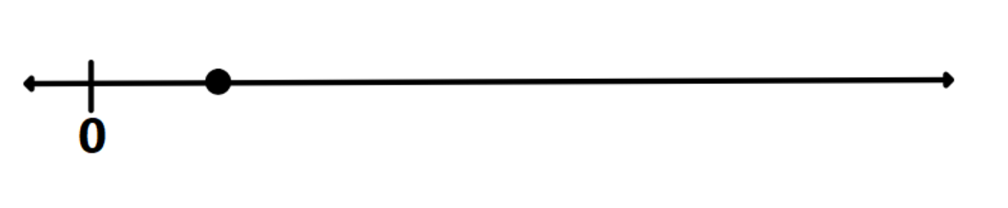
Number Line
The diameter of a circle is marked on the number line. Where would the radius and circumference of the same circle be located?
Notes:
Grade 6 – Circumference and Approximating Pi
Number Line
Display the number line and ask participants to turn and talk to a partner to discuss where the location of the radius would be if the point represents the diameter. Participants should describe that the radius would be located midway between the point and zero because the radius of a circle is half the length of the diameter. Next ask participants to turn and talk to a partner about where the circumference would be located on the number line.
Participants should describe that the circumference would be located further to the right on the number line, approximately three times the distance away from zero than the distance of the original point from zero. Note that this routine may be difficult for Grade 6 students to discuss prior to in class activities that address the relationship between parts of a circle.

Slide 20
6.MG.1c – Approximation for Pi
What materials can be used for investigation?
What connections do you want students to make?
What questions can you ask to support understanding?
Notes:
As participants work through the activities, have them consider additional materials that could be used during the investigation. While the activities suggest using string or rope and a ruler to find the circumference of various circles, a flexible measuring tape may also be used.
Use the Human Circles Lesson and Going the Distance MIP to have participants explore the relationship between radius, diameter, and circumference of a circle and develop an approximation for pi. Students should make connections that the diameter is twice the length of the radius and that the circumference is approximately three times the length of the diameter. Connections can be supported through questions such as:
What patterns do you notice when you look at the lengths of the radius, diameter, and circumference of the circles?
How are the measurements related?
Can you estimate the circumference of a circle if you know the length of the diameter or radius? How?

Slide 21

6.MG.1d - Circumference
What materials can be used for investigation?
What connections do you want students to make?
What questions can you ask to support understanding?

Slide 22
Which One Doesn’t Belong?
Notes:
Grade 6 – Area and Perimeter of Triangles and Parallelograms
Which One Doesn’t Belong?
Display the slide and ask participants to look at the four images and determine which image doesn’t belong. Allow for multiple participants to share their reasoning. Possible answers include:
The triangle doesn’t belong because it is the only figure that is not a quadrilateral.
The figure on the far right doesn’t belong because it is the only figure that is combined by joining the short sides of the triangles.
The triangle doesn’t belong because it is the only figure that is not a parallelogram.
The rectangle doesn’t belong because it is the only figure with right angles.

Slide 23
6.MG.2a – Area and Perimeter of Triangles and Parallelograms
What materials can be used for investigation?
What connections do you want students to make?
What questions can you ask to support understanding?
Notes:
Students form general relationships when they see how all area formulas are related to the big idea of base times height. Students who understand where formulas come from tend to remember them and are able to derive them when they are needed.
As participants explore the Contextual Problems Involving Area and Perimeter activities, encourage them to think about additional materials that could be used for investigation. Participants may suggest using geoboards for something more concrete than the dot paper included in the lesson. Physically cutting paper parallelograms and rearranging the pieces may be helpful for students that struggle to visualize moving the pieces. Tangrams can also be a useful tool for this exploration as the two smallest triangles can be used to make a parallelogram, a square and a medium triangle.
Also ask participants to consider the connections they would like students to make and questions that could be asked to support student understanding. Students should make connections between the base and height of a parallelogram and the length and width of a rectangle. Connections can be supported through questions such as:
How are base and height and length and width of a rectangle related?
How are the base and height measured in a parallelogram?
Is there a difference between
A= lw and A = bh?
How are areas of a triangle and a rectangle related?
How are areas of parallelograms and rectangles related?

Slide 24
Which One Doesn’t Belong?
20cm
30cm
30cm
10cm
10cm
10cm
30cm
30cm
Notes:
Grade 7 – Volume of Right Cylinders and Surface Area of Right Cylinders and Square-Based Pyramids
Which One Doesn’t Belong?
Display the slide and ask participants to look at the four images and determine which image doesn’t belong. Allow for multiple participants to share their reasoning. Possible answers include:
The upper left net doesn’t belong because the diameter of the base is 10 cm.
The upper right cylinder doesn’t belong because it has a measurement of 20 cm.
The lower left doesn’t belong because the cylinder is laying on its side.
The lower right net doesn’t belong because the height of the cylinder is unknown.

Slide 25
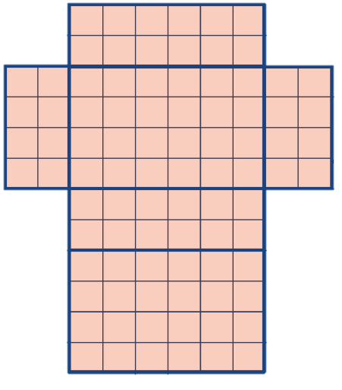
7.MG.1ab – Surface Area and Volume of Rectangular Prisms and Right Cylinders
What materials can be used for investigation?
What connections do you want students to make?
What questions can you ask to support understanding?
Notes:
Students form general relationships when they see how all area formulas are related to the big idea of base times height. Students who understand where formulas come from tend to remember them and be able to derive them when they are needed.
As participants explore the Volume and Surface Area of Rectangular Prisms and Cylinders lesson, encourage them to think about additional materials that could be used for exploration. Using nets that can be folded and unfolded helps students visualize all faces.
Ask participants to consider the connections they would like students to make and questions that could be asked to support student understanding. Students should make connections between subdividing shapes to determine area to subdividing nets of shapes to determine surface area. Students should also connect the idea that base x height can be used to find the volume of rectangular prisms and cylinders. Connections can be supported through questions such as:
How are the formulas V = lwh and V = Bh similar?
How are the formulas V = πr2 and V = Bh similar?
How are the formulas for finding the volume of a rectangular prism and cylinder similar?
How can the net of a solid figure help you to determine the surface area?
What dimensions of a rectangular prism do you need to know to determine surface area?
What dimensions of a cylinder do you need to know to determine surface area?

Slide 26
Closure
Manipulatives and Representations
Questions to Support Connections
Benefits of Developing Formulas
Notes:
Conclusion
Facilitate a discussion about the manipulatives and representations used throughout the reasoning routines and classroom activities in this session. Focus on the characteristics of the manipulatives that allowed students to develop the formula. Representations allow students to see components of the formula. Some manipulatives allow students to break apart or rearrange a figure to prove how and why a formula works.
Review the questions that participants noted that would help students develop understanding and make connections. Questions that can be applied throughout the grade levels include:
What can you determine if you know those measurements?
How can you use that information to determine ________?
Is there another way to use that information?
Does that strategy/formula always work? How do you know?
How does your strategy or formula relate to this formula?
Wrap up the session by revisiting the benefits of students developing formulas:
Students build conceptual understanding
Students make connections between attributes and formulas
Students are less likely to confuse formulas
Students have understanding to rely on if a formula is forgotten

